Slide 1
Smart Waste Tracking Challenge event
29 June 2018
@defradigital

Slide 2
Harriet Green
Chief Technology Officer
Defra
@defradigital

Slide 3
@defradigital

Slide 4
Defra Design Principles
Act together – collective ownership of a shared agenda
Make it simpler – be easier to do business with
avoid duplication – adding value in the right place
Maximise impact – do what makes the biggest difference in the face of complexity
Embrace digital and data – making data-driven decisions, automating processes and deploying remote technology

Slide 5
Darragh Kelly
Engagement Lead: Emerging Technology
GDS Innovation
@defradigital

Slide 7
Call for public
sector challenges
Challenges are turned
into competitions
Responses are
evaluated
Feasibility outputs
are evaluated
Entire public sector
can now buy solutions
Submitted challenges
are reviewed
Companies, not for profits and social enterprises respond
Up to 5 companies
are funded to
show feasibility
Up to 2 companies
are funded for development

Slide 8
The UK’s
Innovation Agency
Innovate UK

Slide 10
What is the
Small Business Research Initiative (SBRI)?

Slide 11
SBRI Overview
The Small Business Research Initiative (SBRI) is a structured process enabling the public sector to engage with innovate suppliers:
Helping fulfil objectives
Accelerating commercialisation of ideas
Supporting the development of innovative companies

Slide 12
SBRI key features
Development Contracts:
100% funded R&D (procurement contract)
UK implementation of EU
pre-commercial procurement
Deliverable based for R&D services

Slide 13
SBRI key features cont.
Contract with prime supplier
Who may choose to sub contract, but remain accountable
IP rests with supplier
Certain usage rights with public sector – companies encouraged to exploit IP & will be assessed on this basis

Slide 14
Eligibility
Open to all organisations - no limit on size or type of company
Open to companies not currently engaged in the sector
Research organisations can also apply, but must demonstrate a route to market

Slide 15
Application process

Slide 16
Competition overview
 | Phase 1 (Feasibility) | Phase 2 (Prototype Development & Testing)
Type of Competition | SBRI
Project composition | Prime Supplier
Project Size (inc VAT) | Up to £50K (inc VAT) | Up to £500K (inc VAT) (anticipated)
Anticipated Project length | Up to 3 months | Up to 12 months
Submit your application
Assessment and moderation panel

Slide 17
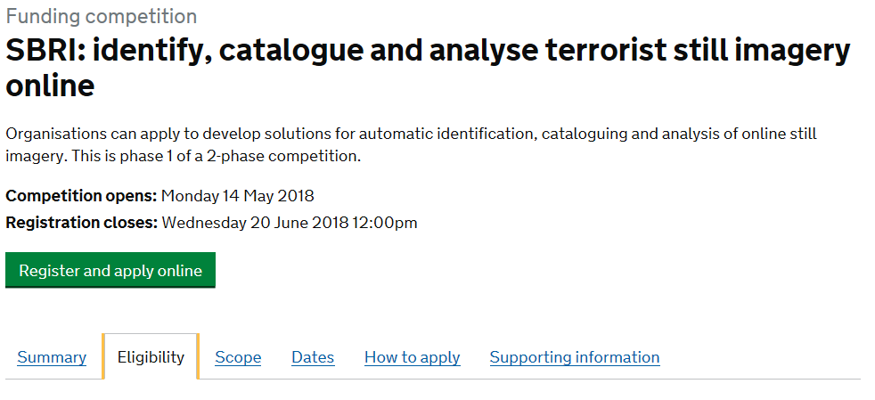
Competition page

Slide 18
Application submission process
1
REGISTER
Via competition website
2
DOWNLOAD documents
- Brief, ITT, Guidance..etc
3
COMPLETE documents
Take your time, use all space provided
4
UPLOAD documents
Don’t leave it to the last minute. Do it early!
5
NOTIFICATION received
On date provided
6
FEEDBACK received
Within 4 weeks of receiving your notification

Slide 19
First REGISTER for the competition (Registration ends 1 week prior to the competition close)
You will receive an email with your username & password, a link to the secure upload area, your application form & unique application number
For multiple projects (differentiated proposals) contact the support team (support@innovateuk.gov.uk)

Slide 20
Notification of award will be received on
30 September 2018
For successful projects:
Financial project cost review and viability checks undertaken
Contracts issued 2 weeks after notification
Project can not start until received and returned signed acceptance of contract

Slide 21
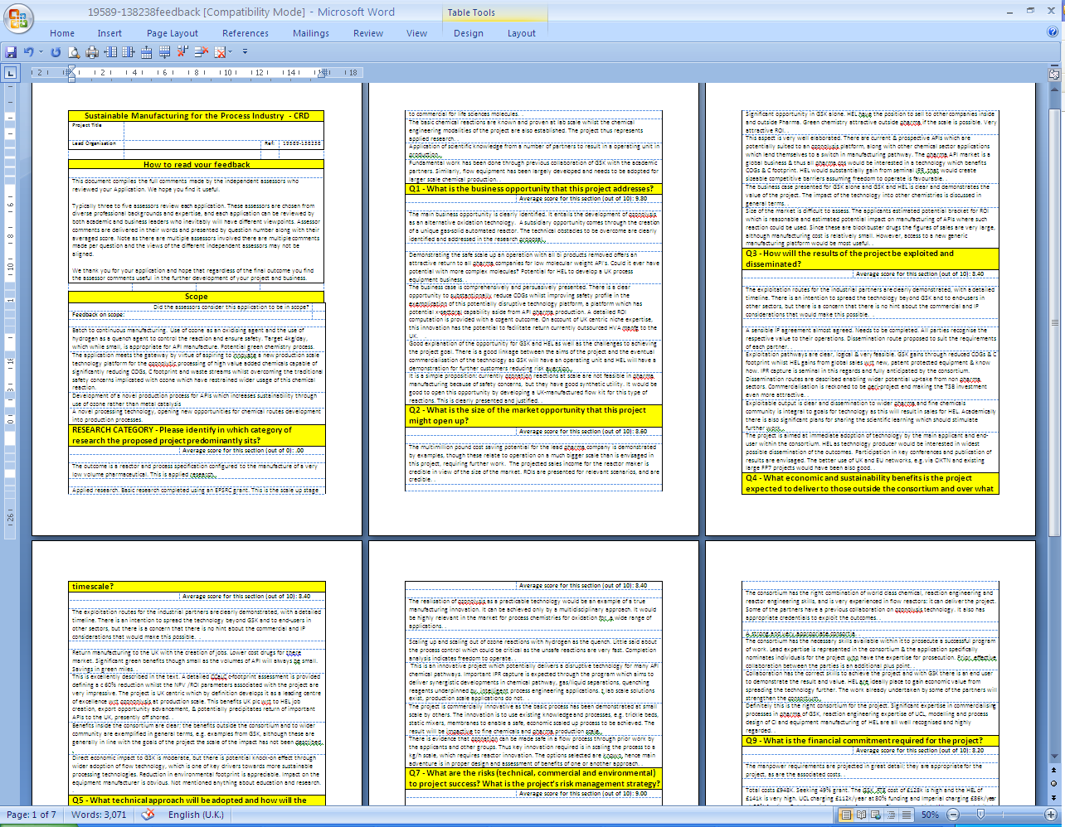
Issued within approximately 4 weeks of receiving your notification

Slide 22
Important hints & tips

Slide 23
Things to note
Applications must be fully complete
Any size/ type of organisation is eligible
Ensure route to market is demonstrated
Contract values quoted should include VAT
Fair market value
The contract Ts&Cs are not negotiable
Appropriate level of due diligence

Slide 24
Application assessment
All applications are assessed by selected reviewers
What do they look for?
Clear and concise answers
Right amount of information
Quantification and justification
The right people with the right bright idea and the means to exploit its potential

Slide 25
Key dates
Phase 1: Feasibility Studies
Open date | 11 June 2018
Applicant briefing | 29 June 2018
Registration closes | Noon 18 July 2018
Competition closes | Noon 25 July 2018
Applicants notified of decision | 30 September 2018
Phase 1 contracts awarded | 31 October 2018
Feedback provided | 31 October 2018

Slide 26
Allison Townley
Head of Control & Data Management, Regulation Unit Northern Ireland Environment Agency

Slide 27
THE FOUR UK ENVIRONMENT AGENCIES
Scottish Environment Protection Agency
Northern Ireland Environment Agency
Environment Agency
Natural
Resources
Wales
Notes:
Who we are and what we do

Slide 28
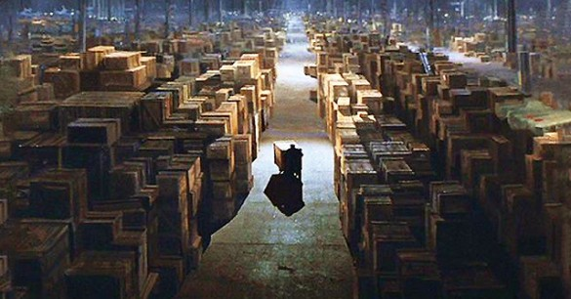
Administrative burden
Notes:
Estimated 23 million waste transactions per year -mainly using paper
Our challenge: complex paper trail/numerous systems and numerous players!

Slide 29
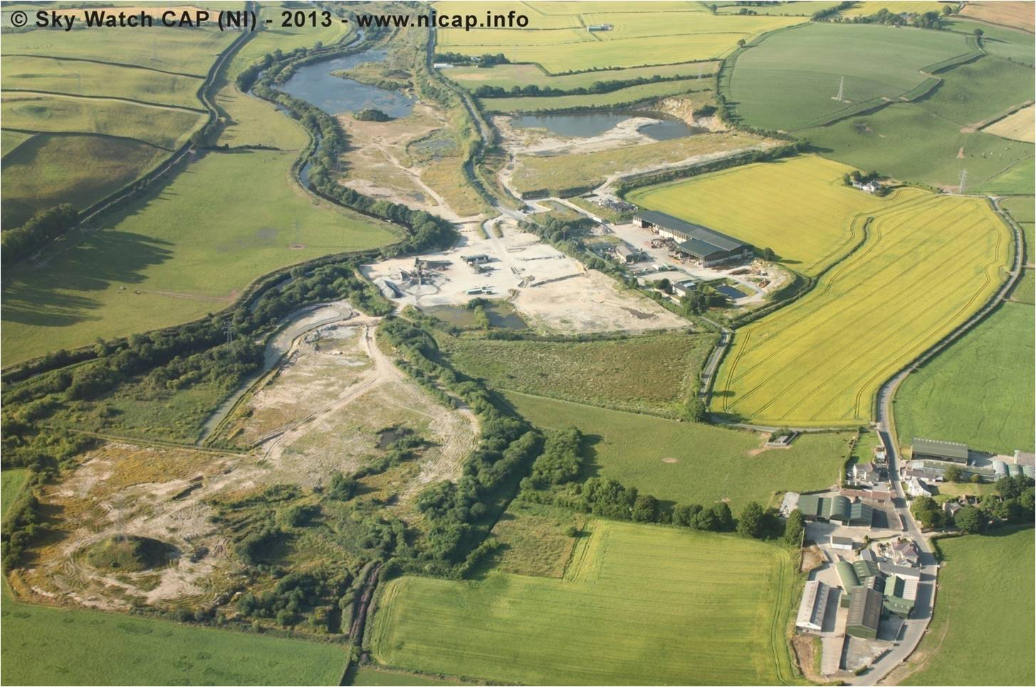
Illegal Waste Site - Mobouy
Waste crime is not just damaging the environment; it is damaging our economy.
Notes:
Our biggest challenge

Slide 30
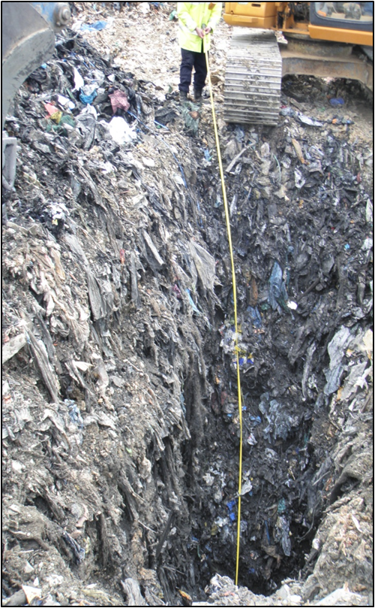
Notes:
Not just area but depth

Slide 31
Waste crime volumes?
A snapshot of cases being dealt with by NIEA:
73 live cases and 22 Financial Investigations
Estimated 561,644 tonnes of waste illegally dumped in the above cases
Average waste per site is 6,300 tonnes
Average criminal benefit could reach £ ¾m per case
The Driver? Financial – pure & simple
Notes:
Modus operandi

Slide 32
Why we need a new approach?
We don’t have an accurate picture of what waste is actually out there
Our current datasets are too numerous and sit in isolation
Too much administrative burden on regulators & stakeholders
New and more efficient ways of delivering, managing our business in a resource constrained environment.
Overly reliant on waste industry generated data
Combat illegal activity in the whole of the industry

Slide 33
Our approach
A single system that will allow the live tracking of waste throughout the UK by all parties involved, including regulators
A simple to use interface to allow our stakeholders to record their waste movements
An end to producing, carrying, submitting & storing all that paper
An end to stakeholders having to submit waste summary returns each quarter or complete waste data flow system
Notes:
If amazon can do it!

Slide 34
Our approach cont...
Accurate reporting for all stakeholders, increased quality and integrity of data, traceability
Reporting capability
Mandatory system
Based on the movement of waste as well as the transfer of waste

Slide 36
Need to meet future business and technology requirements and reflect the technological advances and opportunities becoming available now and in the future. The new system will be flexible, agile and ‘future-proofed’ to ensure we continue to comply with relevant legislation in the future and support new and more efficient ways of delivering, managing our business in a resource constrained environment.

Slide 37
Alistair Paul
Joint Head -
Waste Regulation and Crime
Defra
@defradigital

Slide 38
What I will cover
Why waste?
What's so challenging about it?
Some things that might help you
Notes:
[not sure if this is needed

Slide 39
Why waste tracking?
Notes:
So why waste tracking?
It doesn’t sound very glamorous does it?
Have you thought about how it sounds to your friends?
I’m working on a project to track stuff that we throw away because we don’t have a use for it
To which the response is surely: why are you tracking stuff we don’t have a use for?
It sounds pointless, but it is actually quite the opposite

Slide 40
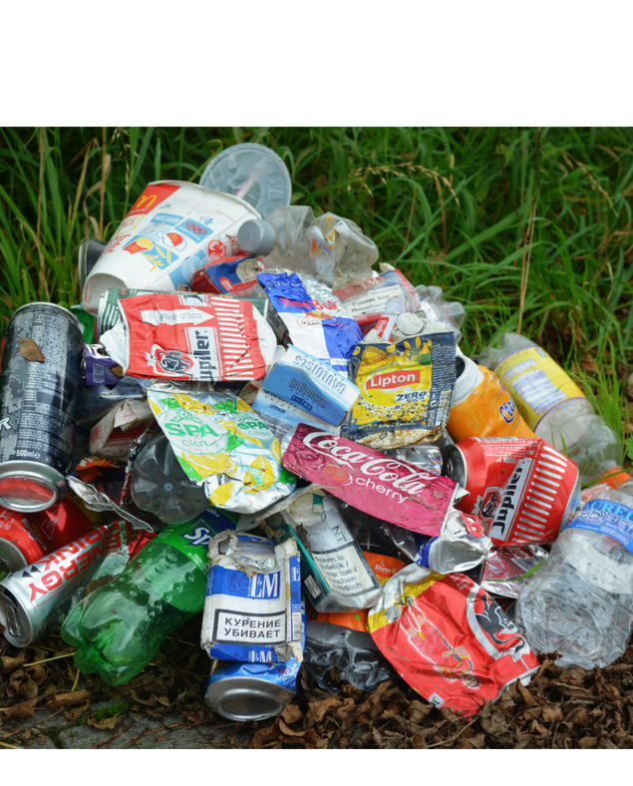
What happens to waste when we throw it away?
Notes:
Because answering this question……..
Is both difficult and important.
It is difficult because there are lots of types of waste, we deal with waste in lots of different ways, but we don’t record this accurately or consistently
And it is important because how we manage our waste effects our environment, our economy and society

Slide 41
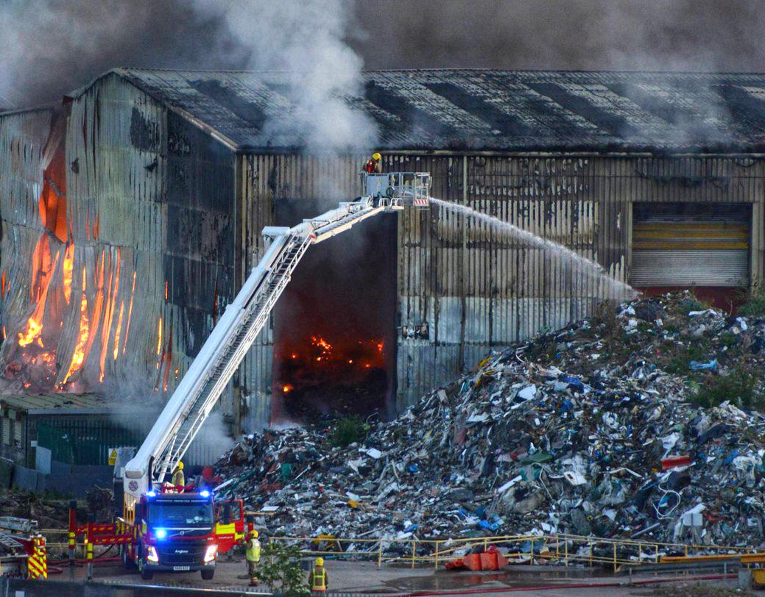
Waste can cause harm…
Notes:
If we manage waste in the wrong way it can cause harm in many forms:
In this country poorly or illegally managed waste creates fly infestations, dust, odour, air and water pollution.
It severely effects local housing, business and infrastructure.
It can be a cause of large scale fires or pollution incidents.
Give example, eg waste fire, – with reference to picture
Estimates suggest the cost to the economy of illegal waste activities run to several hundreds of millions of pounds
And of course outside of this country there are often less strict controls and this harm can be magnified – as the imagery of plastic waste in our oceans shows.

Slide 42
…but we can also create value from waste
Notes:
But it is also important to understand what happens to our waste when it is thrown away because we can create value from it as a resource
We all know this really:
Paper and glass can be recycled
Food waste can be turned into compost
Waste electronics contain many valuable components
Even waste that can’t be turned into secondary materials can be burned to generate energy
[summary sentence w/r to strategy or chief scientists report]

Slide 43
“We need to put in place the fundamental building blocks of data gathering and analysis to ensure we know the types, amounts and quality of waste, and where it is generated and ends up”
From waste to resource productivity
Notes:
There are lots of different policy approaches governments can take to minimise the harm and maximise the value of waste
But key to any of them is having the right data
Or as recent report from the Gov Chief Scientific adviser puts it…

Slide 44
The building blocks of waste data
What is it?
Where does it comes from?
How much is there?
Where does it go?
What happens to it?
Notes:
Specifically, the building blocks of data we need are:
We have this information for some wastes for some points in the waste chain
But what if we had it for all wastes – each point in the chain
If we could join up– or track – waste like this, it could help government, regulators and businesses

Slide 45
The data can help inform policy
Are we meeting recycling targets?
Do we have enough waste processing infrastructure capacity?
What markets are emerging for waste materials?
Are we collecting the right amount of landfill tax?
Notes:
This is because the same core data set can help us to answer a lot of policy questions.
If we know where waste comes from, where it goes to and what is done to it we can answer questions like
Are we meeting our legal recycling targets?
Do we have enough waste processing infrastructure capacity?
What markets are emerging for waste materials?
Are we collecting the right amount of landfill tax?

Slide 46
It can help us tackle waste crime
Waste disappears from the chain
Waste descriptions change when they shouldn’t
Timings and patterns of transfers that don’t make sense
The wrong waste ends up in the wrong place
Notes:
Similarly this information would be a vital enforcement tool for regulators
It can help us tackle waste crime by identifying where
Waste disappears or doesn’t reach next stage (illegal dumping)
Waste description changes (landfill tax avoidance)
Strange patterns of transfers (fraud schemes)

Slide 47
And it can support business
Visibility of waste destination
Scope for efficiencies
New markets (open data?)
Less paperwork

Slide 48
To use innovative technology to record and track individual movements of waste through the economy
Notes:
So this is our challenge…
Just to unpack this statement slightly.
The Solution needs to enable businesses to record or collect the most useful data on movements of the waste they handle
I distinguish between record and collect because some businesses will have their own systems that do this. We don’t want to replace those systems but they need to share some of the data they collect with us [reword]
This data needs to be available in a usable form for the business, the regulatory and government, and we will want to consider opportunities for open data
Because we think this is crucial to effective waste regulation and policy, and to helping drive improved business productivity and investment

Slide 49
“We will work with industry to explore options to introduce electronic tracking of waste”
Notes:
And the importance of this is reflected in key UK government strategies
For the UK government this Govtech challenge delivers commitments in 25yr Env Plan and Industrial strategy to…”work with…
It also supports commitments we are looking at developing in the forthcoming UK Government resources and waste strategy planned for later this year
So waste tracking joins up priorities across government in relation to xyz

Slide 50
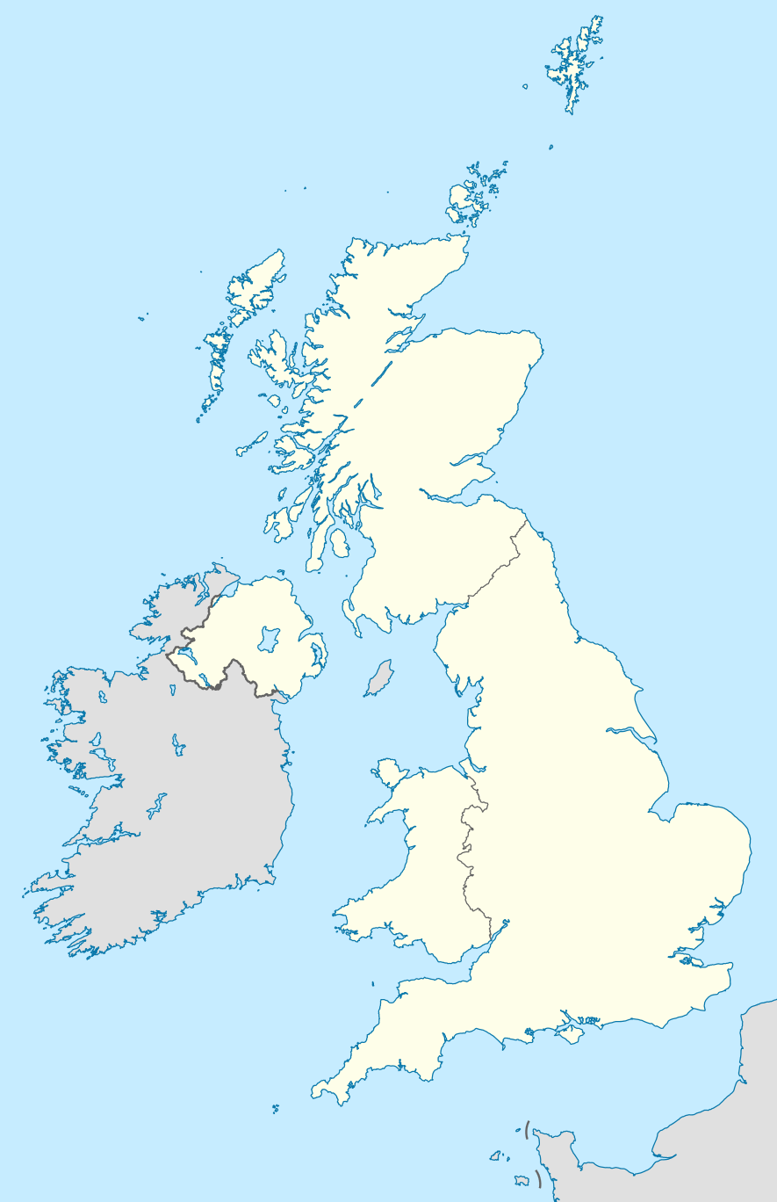
We want this to work at a UK level
We want this to work at a UK level
Notes:
The challenge also builds on discovery work conducted by the four nations
At different times over the last couple of years different governments and agencies across NI, Wales, England and Scotland have taken a lead in looking at this challenge
We have done some initial work looking at user needs, data requirements, legacy systems and so on
We are very aware that many companies work at a UK level, and we think the greatest benefits stem from developing a solution that could work for all four nations so we would like to work in partnership on this

Slide 51
What is so challenging about waste tracking?

Slide 52
We produce a lot of waste
We produce a lot of waste
We produce a lot of waste
Notes:
We produce 200m tonnes of waste a year in the UK
That means a solution is going to need to record and store a large number of waste transactions
Previous estimates have suggested that under the current system of regulations businesses generate over 25m notes to record the transfer of both hazardous and non-hazardous waste each year

Slide 53
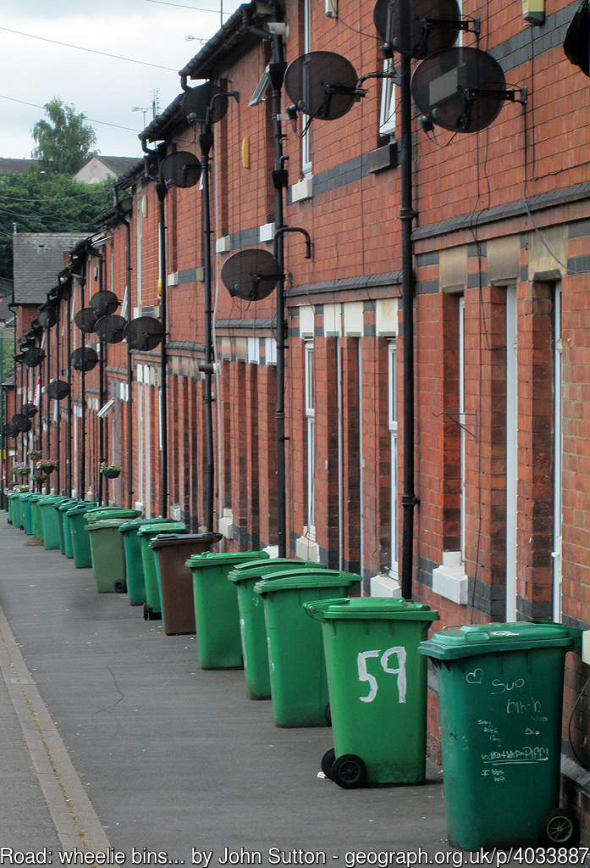
Waste comes from many different sources
Waste comes from many different sources
Moving forward – shaping ourselves and our environment to enhance our success going forward
Notes:
this waste comes from many different sources
So this is factory waste
But waste also comes from:
Kerbside collections
Collection points
Council recycling centres (tips)
Offices and shops
And it is collected in different ways, directly by councils, by companies operating on their behalf or purely through commercial arrangements between businesses and waste companies
We are interested in covering all waste streams, so we can household waste and commercial waste

Slide 54
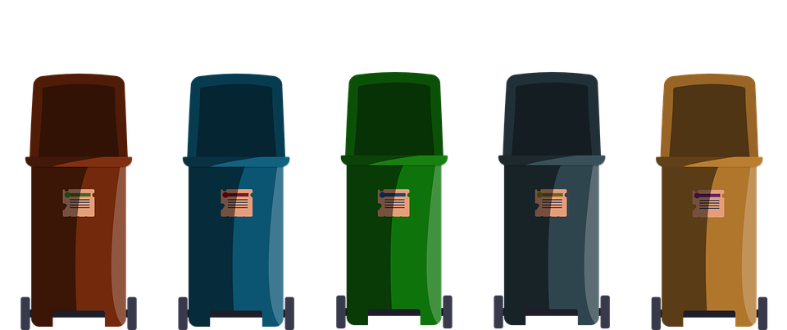
Over to you –
Thoughts, perceptions, feelings?
The choices are yours.
There are lots of types of waste
Notes:
There are lots of types of waste
And they can be described by:
- their origin
- material
- physical and chemical properties
In the UK there are xx codes for describing waste according to EU rules
But that makes describe waste difficult and technical. People often get waste descriptions wrong
We can have the best waste tracking system in the world but it will be useless if the information users record is inaccurate or of poor quality
So the solution needs to design in ways of supporting good quality and accurate record keeping
It also needs to provide assurance mechanism and analytics that help users identify when this is not happening or things are going wrong

Slide 55
Waste chains are complex
Waste chains are complex
Moving forward – shaping ourselves and our environment to enhance our success going forward
Notes:
And because there are lots of types of waste there are lots of ways of dealing with it
Whereas once waste ended up in the local landfill, waste chains now are complex and have international dimensions
Give example

Slide 56
Waste is difficult to trace
Waste is difficult to trace
Notes:
But even relatively simple waste chains are difficult to fully trace
This is a mechanical treatment facility it takes in truckloads of mixed waste from households and businesses
It then essentially sorts that waste.
Some goes to an incinerator to be burned
Some goes to landfill
Some is recovered for recycling
This waste is out of its container, it is mixed around. Waste from the same source may end up in three different destinations
So a solution to the challenge needs to accommodate that. Identify the best way of giving certainty of initial destination and a good idea of final destination within the realms of possibility

Slide 57
Some things that might help you

Slide 58
Fully compatible with own business needs and data collection methods
This is what businesses have told us
This is what businesses have told us
Protect commercially sensitive data
Allow data imports into own systems
capable of operating offline and in remote or sensitive locations
Notes:
To draft – key themes from user research

Slide 59
Improve data quality with automatic validation
This is what regulatory officers have told us
This is what regulatory officers have told us
Provide for data in real time
Moving forward – shaping ourselves and our environment to enhance our success going forward
Provide ability to identify trends
Be simple, quick and easy to use
Notes:
To draft – key themes from user research

Slide 60
The proposal can be for all or part of the solution
The proposal can be for part or all of the solution
Notes:
Check with innovate uk - Proposal for all or part of the service?
Collection, submission, analytics, access

Slide 61
The proposal can leverage ideas
The proposal can leverage existing ideas
Notes:
Explain point on R&D spend – how it can fit with bidders existing IT – need to check this with Innovate UK

Slide 62
Regulations
can help
Moving forward – shaping ourselves and our environment to enhance our success going forward
Notes:
Explain waste transfer notes and haz waste consignment notes

Slide 63
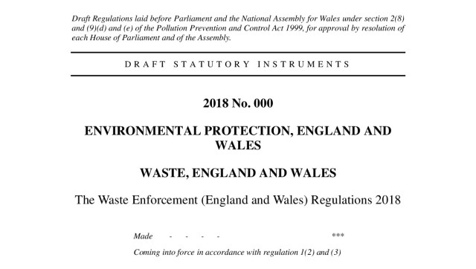
Regulations
can change
Regulations can change
Notes:
Explain in particular the EU circular economy package
Good test of future proofing

Slide 64
Think about where the record starts…and ends
Think about where the record starts…and ends
Moving forward – shaping ourselves and our environment to enhance our success going forward
http://www.yunphoto.net/en/
Notes:
The challenge is purposely called waste tracking, not resource and waste tracking.
Tracking waste in itself is a big enough challenge without expanding that to all material resources
And we are interested in waste, in its own right, for sound regulatory and policy purposes – such as tackling waste crime
BUT some companies have come to use and said. I want complete traceability of my product from the point it comes on the market. That’s because I think I’m going to have pay for that products disposal as part of a producer responsibility scheme.
And at the other end of the waste chain the trail for us often goes cold when waste ceases to be a waste and becomes a secondary material
If you see opportunities to make these links through your solution that would be very interesting.

Slide 65
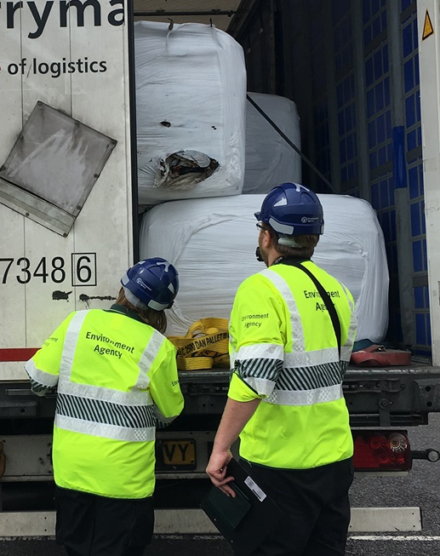
Over to you –
Thoughts, perceptions, feelings?
The choices are yours.
Think about domestic and international movements
Notes:
Explain that waste doesn’t stop at our borders
Capacity to track beyond borders also would be beneficial

Slide 66
Think about how you would work with us
Moving forward – shaping ourselves and our environment to enhance our success going forward
Notes:
Previous research available etc
All very exciting etc

Slide 67
Questions?
@defradigital

Slide 68
Smart Waste Digital Tracking Challenge
Closing date for registration:
18 July 2018 @ 12.00pm
Competition closes:
25 July 2018 @ 12:00pm
WasteTracking@defra.gsi.gov.uk

