Slide 1
Skills and Employability The Regulator’s view
Phil Beach CBE
Ofqual

Slide 2
Agenda
The Qualification Landscape
Current picture
The skills plan
Future
Reform
Functional Skills
Apprenticeships
T Levels
Engaging with employers
Questions

Slide 3
The current qualifications landscape
Qualifications taken primarily in schools/ colleges
A & AS level
Other GQ
Applied General
GCSE
A*-G
Tech Level
Tech Award
Functional Skills
Tech Cert
SELT/ ESOL
503 quals
1.9m certs
Other quals eg licence to practice, personal dev’t
250 quals
620k certs
190 quals
240k certs
342 quals
4.9m certs
425 quals
150k certs
Qualifications primarily taken in other settings (eg work-based learning centres, adult/community learning centres)
110 quals
370k certs
190 quals
785k certs
205 quals
130k certs
140 quals
220k certs
14000 quals
3.9m certs
VTQ ‘uses’ (cutting across qualification categories)
This snapshot shows: - VTQs – qualifications available for certification as of start June ‘17
VTQs – number of certifications for 12 months to end March ‘17
GQs – qualifications available for certification summer 2016
GQs – qualifications certificated in summer series 2016
Other GQs – such as Pre-U quals, international GCSEs, International Baccalaureate middle years programme (again summer ‘16)
VTQs used in
Framework apprenticeships
VTQs featuring in Performance tables
1750 quals
1.5m certs⁺
1020 quals
840k certs
(⁺ cert number includes those VTQs achieved as part of an apprenticeship but is not an exclusive number)

Slide 4
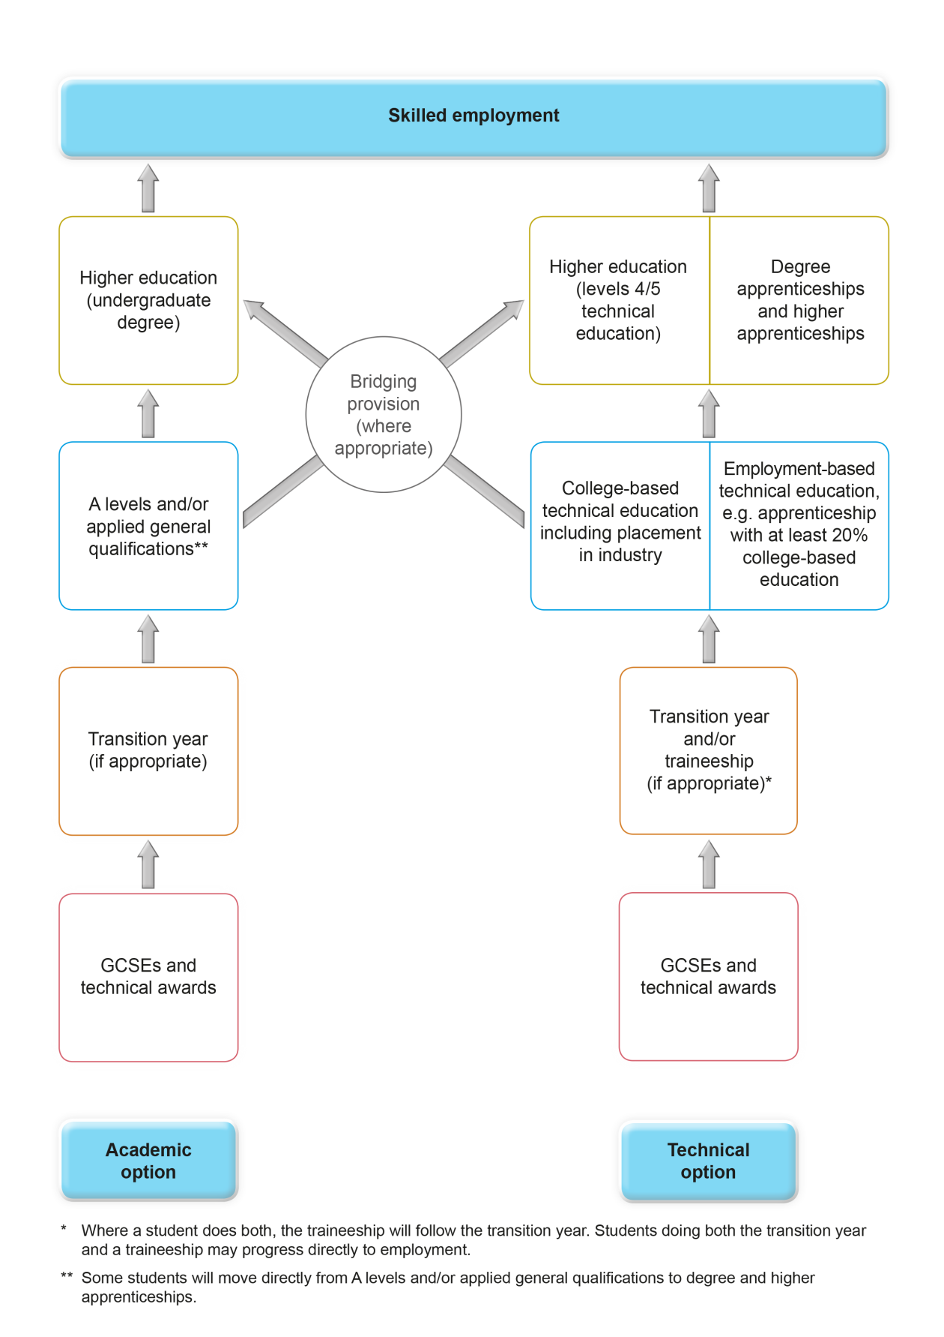
Reform
Academic Route
Technical Route

Slide 5
What reform might mean
Qualifications taken primarily in schools/ colleges
Other GQ
A & AS level
Applied General
Technical Qual’n
Tech Award
GCSE
9-1
“T level”
Functional Skills
SELT/ ESOL
Other quals eg licence to practice, personal dev’t
Qualifications primarily taken in other settings (eg work-based learning centres, adult/community learning centres)
EPA
What is the ‘future’?
Current policy position states that by 2022:
All T levels will be in place (replacing Tech Levels and Technical Certificates)
All apprenticeships will be on standards, and assessed through end-point assessments (EPA)
GCSEs will all be awarded with grades 9-1

Slide 6
Functional skills reform
Overall qualification policy and purpose
Formal consultation on subject content
(DfE)
Subject content
Consultation live
Approach to regulating assessment & standards
Formal consultation on assessment policy
Detailed rules and guidance
Formal consultation
(Ofqual)
Assessment policy
(Ofqual) Conditions & guidance
Consultation launch 27 Sep
Qualifications that reflect published rules
Assurance through bespoke process
(AOs/Ofqual)
Development and upfront evaluation

Slide 7
Apprenticeships – responsibilities
The Quality Alliance

Slide 8
Apprenticeship End Point Assessment
Apprenticeship standard
Assessment plan
Employer
Group
Approve standard
Approve assessment plan
Institute
External
Quality
Assurance
ESFA Funding
Design and deliver End Point
Assessment
Apprenticeship Assessment Organisation

Slide 9
What we do
We regulate EPAs so that they meet the needs of employers
We look at assessment plans at an early stage
This ensures that they support a reliable and consistent EPA that means employers get a reliable measure of apprentice performance

Slide 10
What we do
We regulate EPAs so that they meet the needs of employers
We look at assessment plans at an early stage
This ensures that they support a reliable and consistent EPA that meets the needs of employers
Once approved, Awarding Organisations (AO) develop EPAs:
We will look at a sample of EPAs to check their quality
AOs must (continue) to meet our rules
They are responsible for the appropriate delivery of EPAs
We have a range of regulatory tools to:
Maintain standards in EPAs
Protect the interests of apprentices (in relation to EPAs)
Maintain public confidence in the EPAs we are responsible for
Assure employers that EPAs continue to meet their needs

Slide 11
T Levels
Academic Route
Technical Route

Slide 12
Connecting with employers and other qualification users

Slide 13
Skills and Employability The Regulator’s view
Phil Beach CBE
Ofqual

