Slide 2
Quality of marking – confidence and consistency
Michelle Meadows

Slide 3
What work have we been doing on quality of marking?
Analysed data from Reviews of Marking and appeals
Conducted audits of exam board processes e.g. for monitoring the quality of marking
Continued to calculate metrics of marking consistency
Researched features of levels based mark schemes that aid marking consistency
Surveyed 14,000 examiners as to their experience of on-line standardisation
Conducted a number of research studies into marking quality
Monitored confidence in marking through the annual perceptions study

Slide 4
Consistency of marking metrics
To calculate any quality of marking metric you need some form of double marking (2 or more views of the mark worthiness of a student’s response)
Exam boards’ live online marking quality assurance processes give us double marking data
Seeding
Double marking
Caveats:
Metrics tell us about consistency of marking rather than marking errors
Seeds that function well as QA might not function well to give us metrics

Slide 5
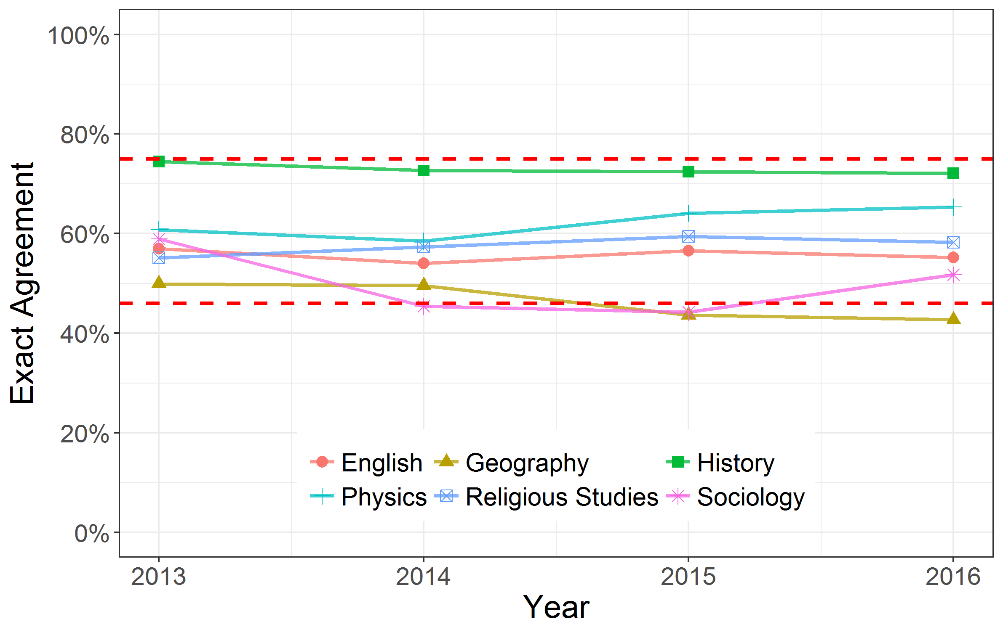
6 mark items in different subjects – exact agreement
- - - - - - - International bounds

Slide 6
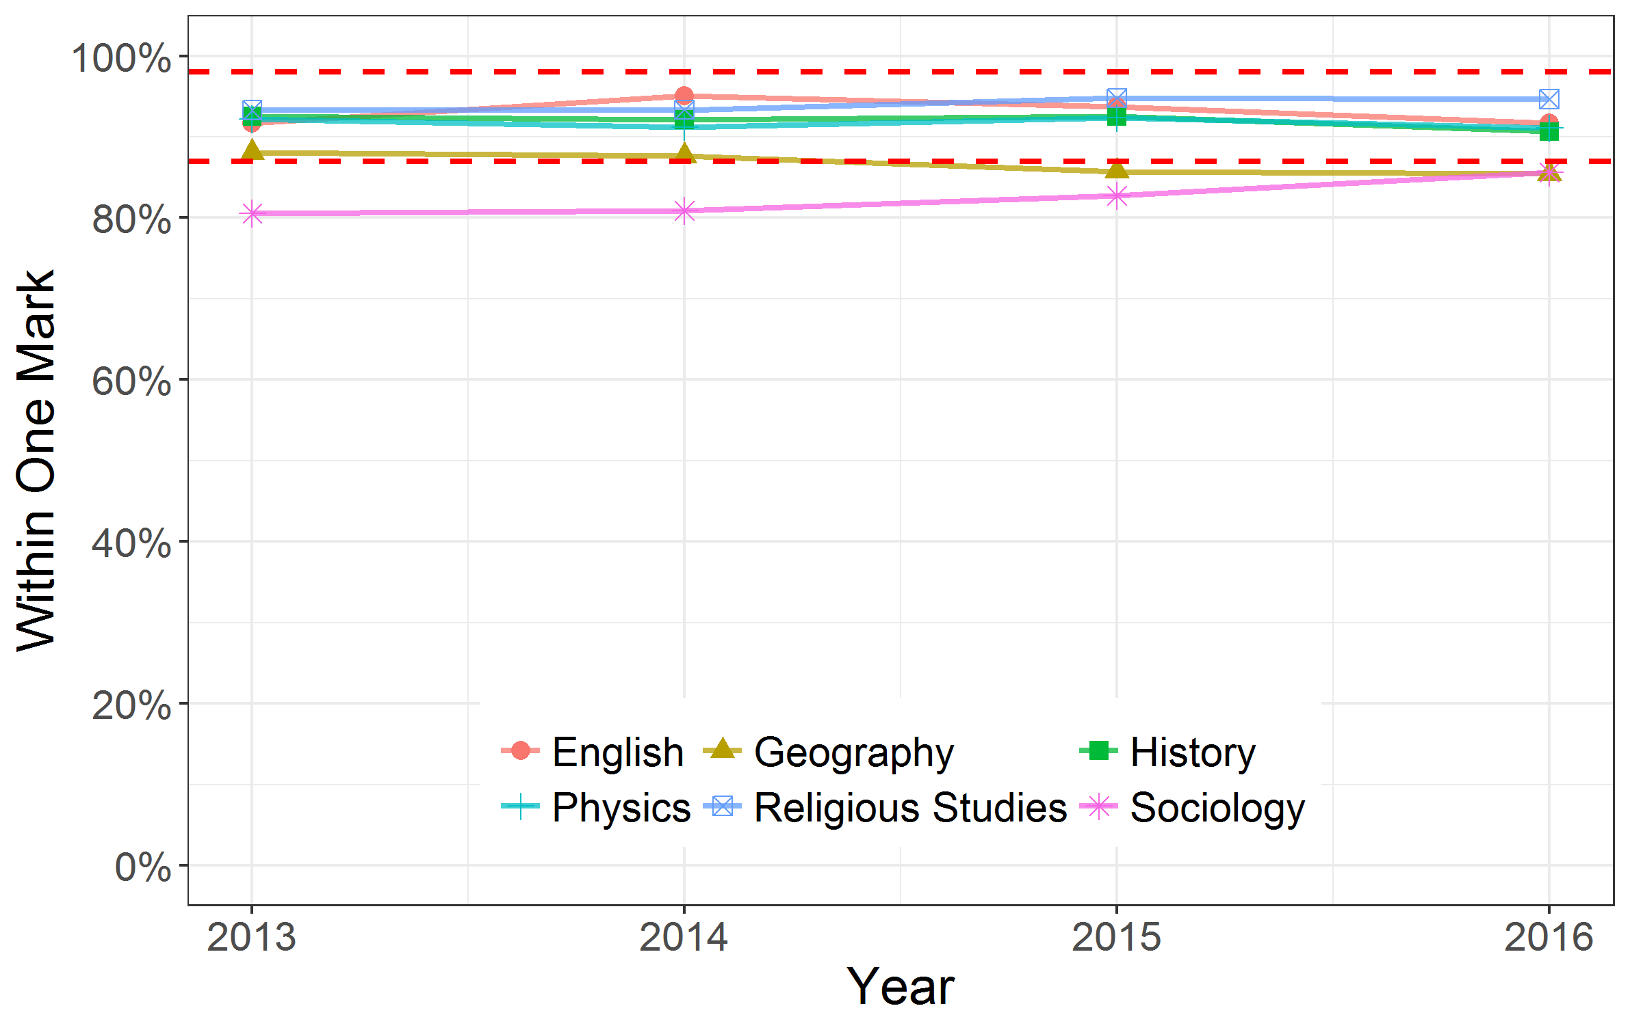
6 mark items in different subjects – within +/- 1 mark
- - - - - - - International bounds

Slide 7
A level and GCSE papers over time

Slide 8
More on marking metrics…
https://www.gov.uk/government/publications/marking-consistency-metrics
https://www.gov.uk/government/news/ofquals-symposium-presentations

Slide 9
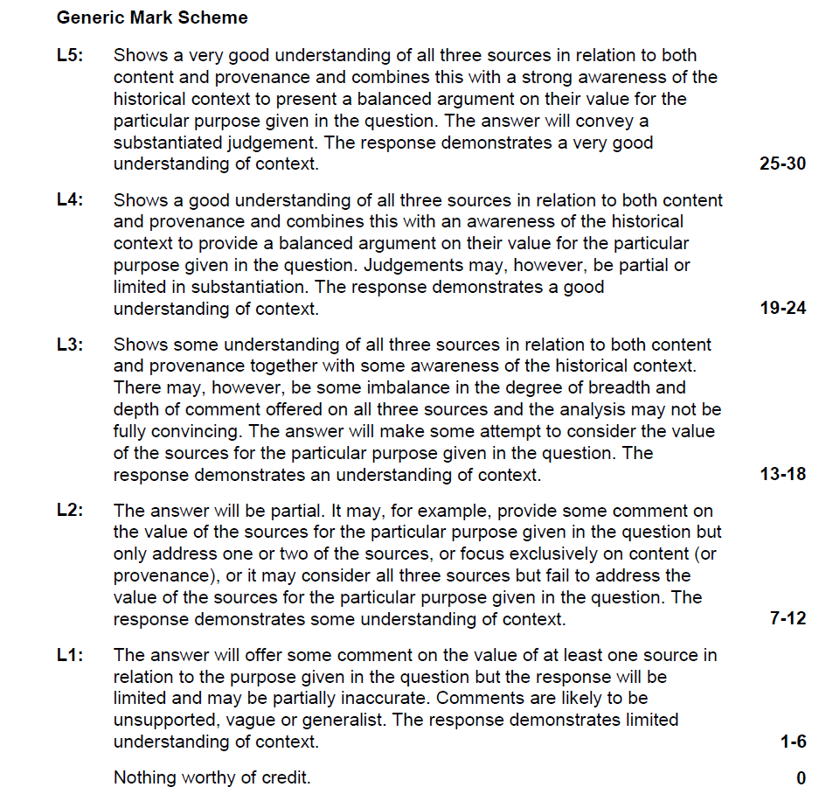
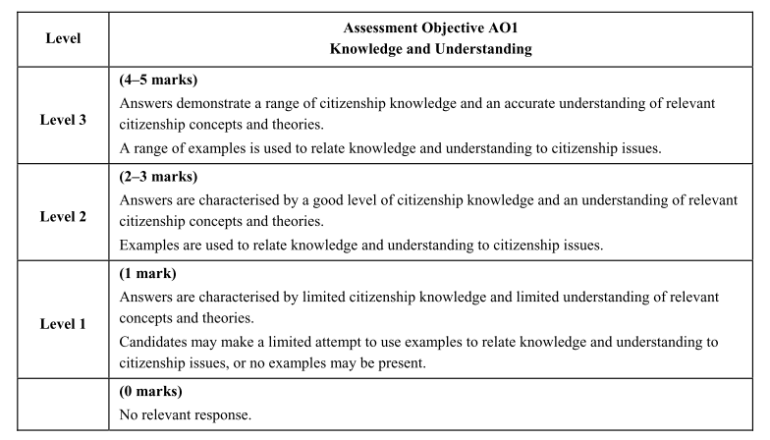
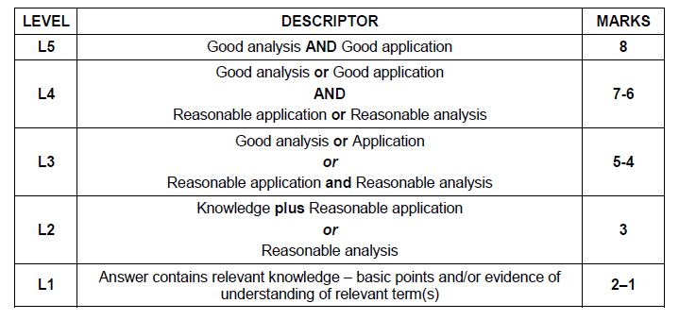
Levels of response mark schemes

Slide 10
Data obtained from exam boards
2014 marker monitoring data for items from 10 subjects (GCSE, AS & A level)
217 units, 2,040 extended response items
Business Studies
English
English Literature
French
Geography
History
Physical Education
Psychology
Religious Studies
Sociology

Slide 11
Features associated with more consistent marking
Even distribution of marks per level
Hurdles
Similar to other items in the paper
Maximum mark is even (not odd)
Use of bold/italics
Level descriptors in prose
Information about judging the level
Best level at the bottom
Separate Assessment Objectives
Identifiable Assessment Objectives

Slide 12
Reliability of marking study 1
Clean scripts from summer 2016 marked by a team of examiners
The aim was to look at agreement between examiners
4 AS English Literature units, 4 GCSE English units, 3 AS History units & 3 GCSE Biology units
For each unit, a team of 8 examiners marked the same 100 scripts
Principal Examiner
2 Team Leaders
5 Assistant Examiners
Leading experts in mark scheme construction reviewed the quality of the mark schemes

Slide 13
Reliability of Marking study 2
Aimed to tease out errors from legitimate differences of opinion and to understand why some scripts are more difficult to mark consistently than others
Focused on 4 units in GCSE English & 3 units in GCSE Biology
Sample of 100 scripts that had gone through the Review of Marking process in 2016
For each unit, we worked with a team of 8 examiners - a Principal Examiner and 7 examiners who had conducted Reviews of Marking in 2016
Derived a definitive mark for each script by having 4 of the examiners mark clean scripts; and also had 4 examiners mark annotated scripts (counter-balanced design)
The examiners met to discuss scripts where there was low levels of agreement

Slide 14
The percentage of teachers who agree/disagree that the marking of GCSEs is accurate

Slide 15
The percentage of teachers who agree/disagree that the marking of A levels is accurate

Slide 16
Thank you.

