Slide 1
Documenting HS2’s historic environment programme Myrddin Edwards, Senior Project Communications Manager
Notes:
Thank you for inviting me to give an overview of the communications work we are doing around HS2’s historic environment programme. I work in the Project Communications team in the Corporate Affairs Department at HS2.
The Project Communications team was set up to identify, co-ordinate and deliver high-profile, public-facing, integrated communication campaigns for HS2. So when we discovered more about the fascinating work Helen, Mike and the team are doing- well, we were like archaeologists who had just discovered a major find. We were very excited.
In this presentation, I’m going to give you a quick overview of the work we are doing at the moment with Helen and Mike to communicate, in local communities up and down the line of route and on a national level, the exciting work that will begin next year.

Slide 2
GWSI: HERDS
Knowledge creation
Engagement with people
Creation of a lasting archival and skills legacy.
Notes:
The communications strategy we are currently working to promote the historic environment programme will support the Generic Written Scheme of Investigation: Historic Environment Research and Delivery Strategy (GWSI:HERDS). That is a mouthful.
The GWSI: HERDS presents a clear statement of objectives for us at HS2, broadly they are:
Knowledge creation
Engagement with people
Creation of a lasting archival and skills legacy.
From a communications point of view, engagement with people is going to be the key objective for us.

Slide 3
The communications opportunity
Large projects have the inherent potential for significant finds of local, regional and national interest.
Theses discoveries are likely to be of interest to the public and provide excellent opportunities to engage effectively with local communities through outreach and education programmes.
When combined with a media programme, the resulting focus of attention can bring indisputable benefits to the finding business”
J.J.Carver, Crossrail Lead Archaeologist
Notes:
JJ Carver, the lead archaeologist at Crossrail, put it nicely by saying:
Large projects have the inherent potential for significant finds of local, regional and national interest. Theses discoveries are likely to be of interest to the public and provide excellent opportunities to engage effectively with local communities through outreach and education programmes. When combined with a media programme, the resulting focus of attention can bring indisputable benefits to the finding business.
Obviously, this is something HS2 is very keen to capitalise on.

Slide 4
HS2 Communications objectives
Build awareness of the HS2 project on a positive and engaging subject
Enhance the reputation of HS2 as an organisation committed to being a good neighbour and delivering benefits.
Notes:
As the HS2 Bill has passed through Parliament, there has been little change to the levels of awareness and support/opposition to the project from the general public. Tracking from Ipsos Mori shows that the general public (apart from those directly impacted) have a low understanding of the impact of the project and the positive role it will play as a catalyst for growth across Britain.
We know that there is a huge appetite among the public and the media for stories about archaeological projects, discovering more about our common heritage and challenging our understanding of history. This has been evidenced by the success and level of interest that Crossrail achieved in its communications and documentaries promoting its archaeology activities
You also only need to think about the popularity of programme programmes like Who Do You Think You Are, Time Team, The Fifteen Billion Pound Project and so on. We also know that media stories about archaeological finds are very popular.
So they key communications objectives of HS2 on this project are to:
Build awareness of the HS2 project on a positive and engaging subject
Enhance the reputation of HS2 as an organisation committed to being a good neighbour and delivering benefits

Slide 5
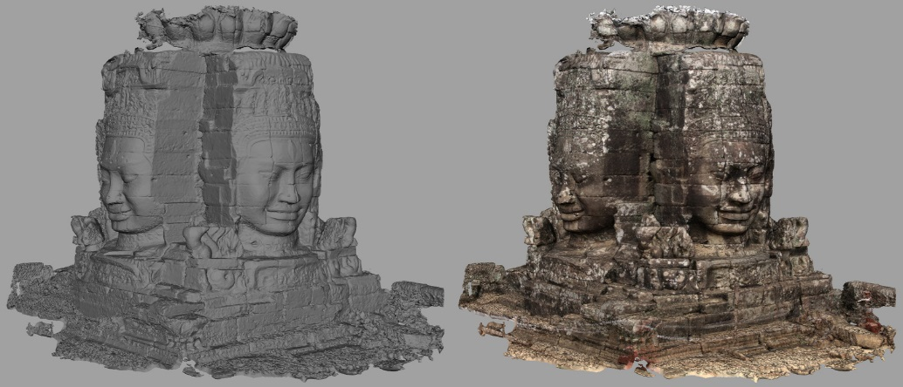
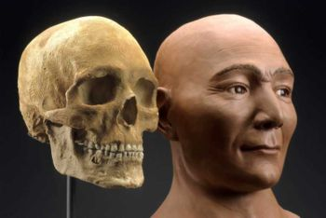
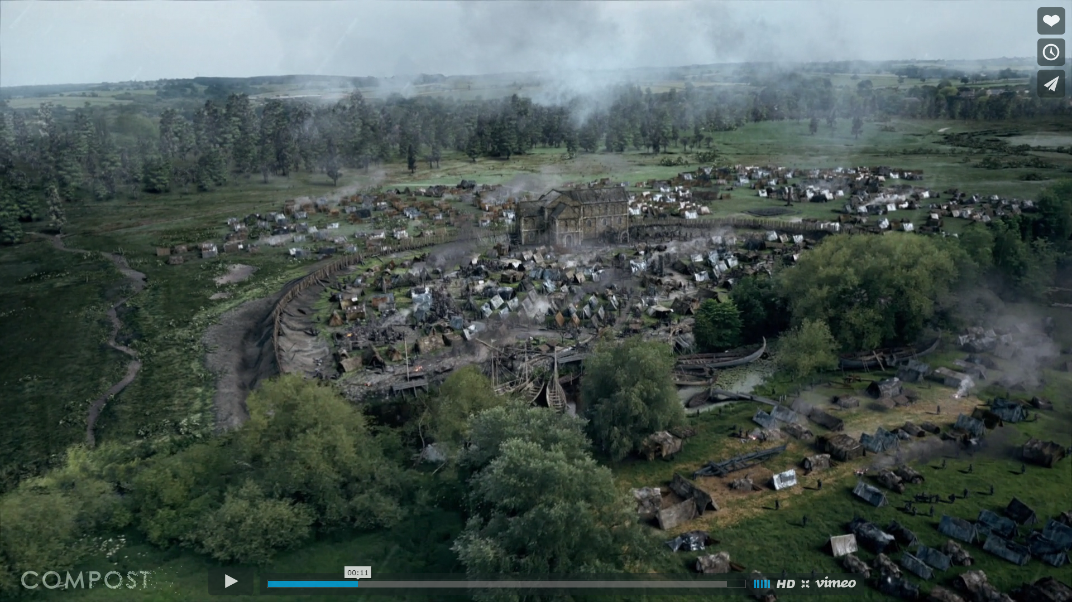
Visual storytelling
Photogrammetry
Facial reconstructions
3D models of key sites
Augmented 3D models/reconstructions
Integrating CGI and presenters
Photo-real composting onto areal footage
3D Cartography
Notes:
We’ve asked the production company to be engaging, using the latest technology to bring history alive.
The visual language of the series will be as ambitious as the archaeological project itself.
Whilst much of the time they’ll be on the ground with our presenters and the experts at work at the dig sites and in the labs, they’ll break away from reality at key points to bring the research to life in breath-taking and informative CGI and data-visualisation.
Some of the techniques the will work on you can see on the slide.
This is abut making this documentary as engaging as possible for as many viewers, age groups and demographics in different parts of the country,

Slide 6
Community engagement
Content
generation
Web and Social media
Local and national press
Internal Comms
Notes:
Moving on beyond television and documentary…….
In the interest of time I am going to skim over this section but I will take you through the first two areas (CE and content) in a bit more detail so you get a feel for the direction of travel.

Slide 7
Community Engagement
Notes:
There is a huge opportunity for community engagement activity along the line of route and we are currently working with our Community Engagement teams in HS2.
HS2 is divided into three areas. Area North, Area Central and Area South.
Area North is Birmingham and its environs
Area Central is the largest from the outskirts of Birmingham to just outside London, taking in a big part of the country.
Area South is essentially greater London.
Each Area has a committed team of community engagement specialists who know their community very well.
I’ve already presented to the CE teams and they are looking into opportunities for engagement with local school, colleges and universities, local history societies and so on. They are working with Sara-Jane Farr to develop a series of community engagement opportunites in the New Year to start to build up interest.
To give you a flavour:

Slide 8
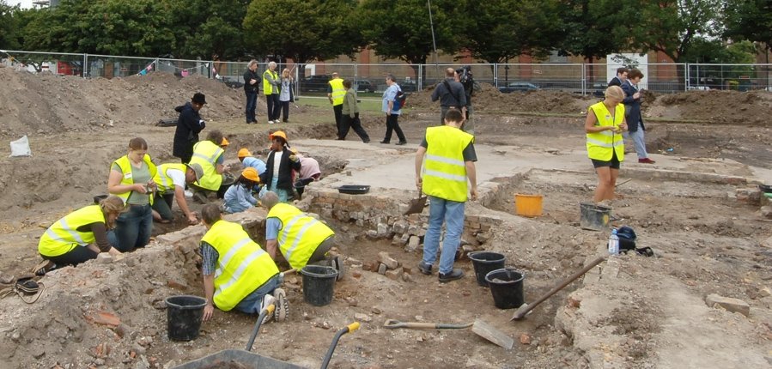
Open days
Notes:
We hope to hold open days at certain sites involving dig boxes for children, public viewing, voluntary archaeological work.
MOLA case study
http://www.mola.org.uk/blog/headstone-manor-training-dig-and-open-day
This photo is from MOLA, showing a training excavation.
Crossrail case study
Stepney City Farm dig 2013
Crossrail in conjunction with MOLA ran a community dig at Stepney City Farm during the Festival of Archaeology in 2013.
90 volunteers became amateur archaeologists. There were also open days and expert talks throughout the week.
Charterhouse dig 2014
Crossrail in conjunction with MOLA ran a community dig at the Charterhouse during the Festival of Archaeology in 2014 (18th-25th July 2014). This involved open days (dig boxes, public viewing) and a Big Day for Families which included a 45 minute digging session with MOLA archaeologists.
The Stage case study
http://www.thestageshoreditch.com/archaeology/community/events
- Public tours of the Curtain Theatre with MOLA archaeologists

Slide 9
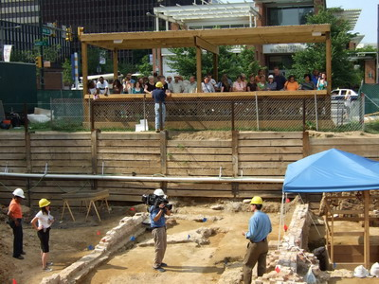
Viewing platforms
Notes:
At certain archaeological sites we hope to have viewing platforms for members of the public to view artefacts and the archaeologists in action. These viewing platforms will be accompanied by contextual information panels and age restrictions depending on the excavated material at these sites.
Crossrail case study
http://www.crossrail.co.uk/sustainability/archaeology/liverpool-street/
- Crossrail had a viewing platform at Liverpool St Station which attracted 3,000 people (including school trips, local stakeholders, members of the public) while it was open

Slide 10
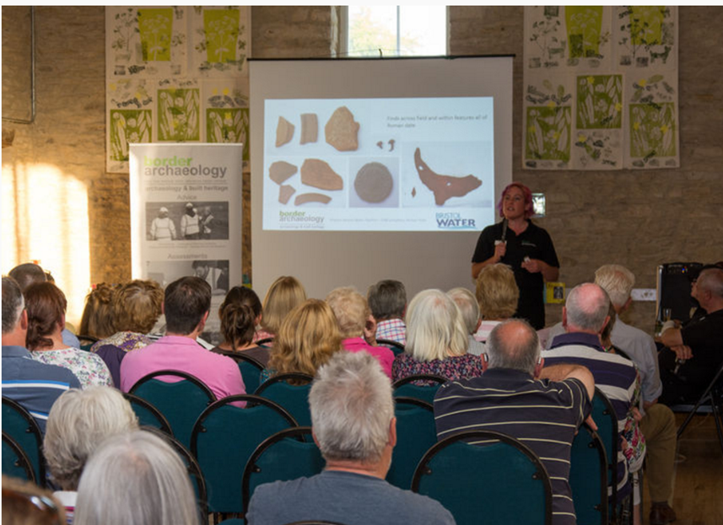
Community lectures
Notes:
We will engage local, affected communities through community lectures and community newsletters highlighting discoveries and the progress of the archaeological work.
Border Archaeology case study
http://www.borderarchaeology.com/bristol-water-sherston-village-hall
This photo shows an archaeology evening in Wiltshire, put on by Border Archaeology for their client Bristol Water.
Crossrail case study
http://www.crossrail.co.uk/news/articles/volunteers-to-unearth-londons-history
Crossrail held public lectures during the annual Festival of Archaeology
Wednesday evening seminars were held at the two small exhibitions in the Tottenham Court Road visitor centre

Slide 11
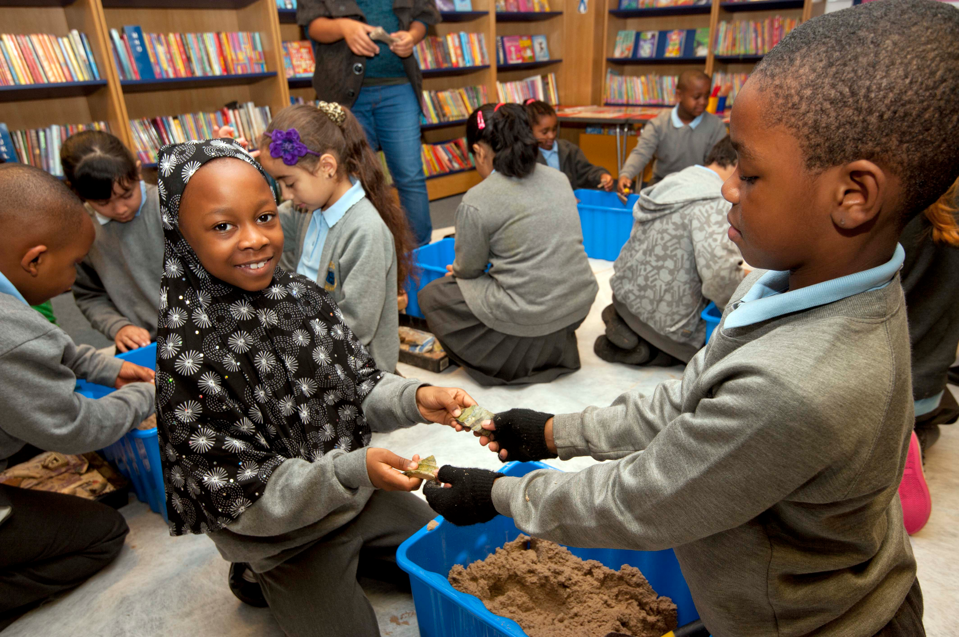
School sessions
Notes:
We will engaged with children of all ages through dig boxes, talks from archaeologists and classroom materials.
We will also collaborate with the production company and broadcaster to deliver educative materials, such as adapted films, lesson plans related to the documentary content and online materials.
MOLA case study
http://www.mola.org.uk/projects/research-and-community/community-archaeology-reach-out-project
MOLA case study
http://www.mola.org.uk/projects/commercial/gunnersbury-park-community-archaeology-project
A group of school children engaged with 3 stages of archaeological investigation: site walkover, excavation and finds sorting
MOLA’s archaeologists produced a ‘Gunnersbury Park Discovery Trail’

Slide 12
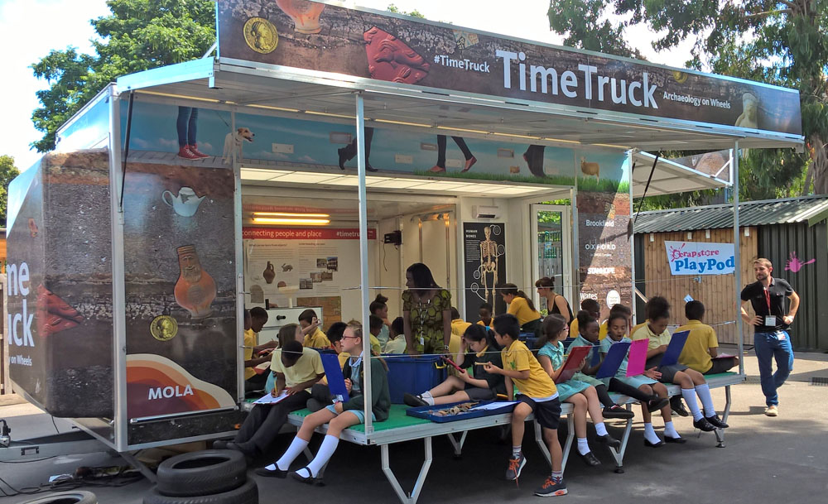
Mobile museum and educational resources
Notes:
Archaeological finds and information can be transported to reach local communities.
MOLA case study
http://www.mola.org.uk/time-truck
MOLA’s Time Truck can be used as a classroom, lab, theatre or exhibition venue.
It brings archaeological material and research to the heart of a community.

Slide 13
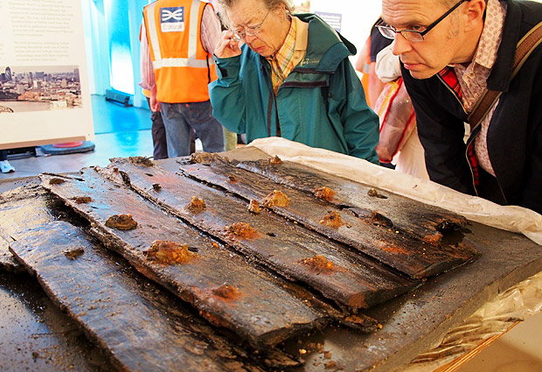
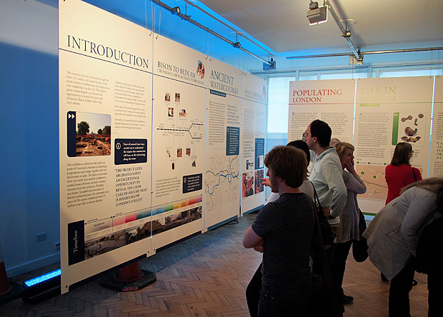
Pop up museums and large exhibitions
Notes:
HS2’s community visitor centres will host exhibitions and information resources showing the archaeological work.
Crossrail case study
Crossrail held two pop-up exhibitions of archaeological finds at their visitor centre on Tottenham Court Road. These exhibitions were small (displaying 50-100 artefacts) and accessible. The pop-up museums hosted weekly evening talks and prize draws.
Bison to Bedlam – Crossrail’s Archaeology Story So Far
http://www.crossrail.co.uk/sustainability/archaeology/archaeology-exhibition-bison-to-bedlam/ - July to November 2012
Crossrail – Portals to the Past http://www.crossrail.co.uk/sustainability/archaeology/archaeology-exhibition-portals-to-the-past-february-2014/
February to March 2014
We hope to partner with institutions which have national scope and are situated close to our excavation work, such institutions may include: Museum of London, British Museum, Wellcome Collection, British Library, Natural History Museum, Bucks County Museum, Birmingham Museum and Art Gallery
Crossrail case study:
https://www.museumoflondon.org.uk/museum-london-docklands/whats-on/exhibitions/tunnel-archaeology-Crossrail
The Museum of London Docklands will host a major exhibition ‘Tunnel: The Archaeology of Crossrail’ between 10th February and 3rd September 2017
The exhibition was announced in September 2016 and attracted attention in the press (see: http://www.huffingtonpost.co.uk/entry/tunnel-the-archaeology-of-crossrail_uk_57ef7bdae4b00e5804f13aa7 and http://www.standard.co.uk/goingout/arts/roman-horseshoes-among-crossrail-finds-for-display-a3343591.html)

Slide 14
Archaeological traineeships and NVQs
Archaeological traineeships and NVQs
Notes:
One of HS2’s objectives is ‘HS2 will create opportunities for skills and employment’ and A&U 119 is ‘HS2 will offer appropriate training to local, disadvantaged and under-represented groups in order to promote fair and equal access to the employment opportunities generated by HS2.’
Creating skills and employment applies to the archaeological works just as much as the construction aspects of the project. We hope to offer traineeships leading to NVQs, apprenticeships, training digs and sponsored PhDs as part of this programme.
MOLA case study: http://www.mola.org.uk/blog/wanted-ten-londoners-archaeology-traineeship
In 2015 MOLA partnered with Tower Hamlets to offer 10 Londoners to undertake a 6-month paid traineeship, which included completing an NVQ and construction site safety qualifications through the Construction Skills Certification Scheme

Slide 15
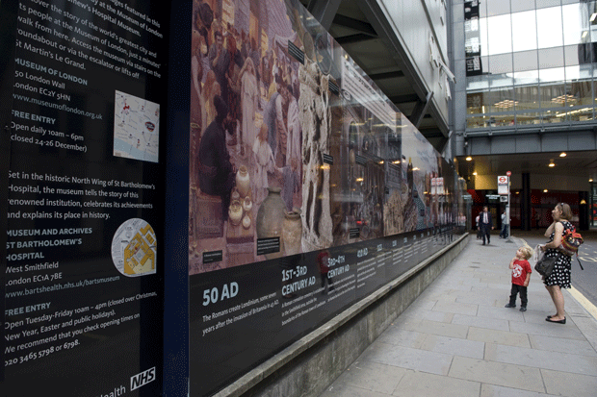
Hoardings
Notes:
We will use hoardings around archaeological and construction work to inform the public on the archaeological activity occurring behind the hoardings and to inform the public of interesting discoveries.
Crossrail case study - ‘Behind the Hoardings’ campaign
- To see the information panels displayed at the Liverpool St viewing platform, click here: http74f85f59f39b887b696f-ab656259048fb93837ecc0ecbcf0c557.r23.cf3.rackcdn.com/assets/library/document/r/original/route_to_the_past-archaeology_at_liverpool_street_station.pdf ://
MOLA case study
http://www.mola.org.uk/projects/commercial/walbrook-community-archaeology-programme. Development of Bloomberg London (2012-3) included pictorial hoardings, linked to a dedicated blog which could be accessed via QR codes
See MOLA’s page on their policy for interpretative hoardings http://www.mola.org.uk/blog/placemaking-community-engagement-2013

Slide 16
Creating content across all our platforms
Notes:
So as well as creating the documentary series, and community engagement activites, there are lots of other content we can create to share with different audience groups

Slide 17
Public facing website
Interactive maps showing finds
Online archives and database
360 degree interactive photography
In house videos hosted on Youtube
Notes:
There will be a dedicated archaeology section on HS2’s website.
Crossrail case study
http://www.crossrail.co.uk/sustainability/archaeology/

