Slide 1
EFA funding guidance for young people 2014 to 2015
‘Funding rates and formula’ v1, published July 2014
‘Funding regulations’ and ‘ILR funding returns’ are explained in separate presentations
EFA Young People’s Team

Slide 2
Funding guidance for young people
The format of the funding guidance is the same as last year. It consists of four separate books:
‘Funding regulations’ (published June 2014)
‘Funding rates and formula’ (published July 2014)
‘ILR funding returns’ (published August 2014) – this does not apply to schools or academies
‘Sub-contracting control regulations’ (published April 2014)
All these documents are available at www.gov.uk/16-to-19-education-funding-guidance.

Slide 3
Funding: the aims
The 2014/15 funding methodology has several aims.
Continuing to simplify the funding arrangements, to let post-16 institutions concentrate on delivering study programmes that will meet young people’s needs as they progress to employment or higher education.
Funding students so that study programmes can deliver a broader focus and so that more young people who are currently NEET can be recruited into further education and training.
To meet the raising the participation age (RPA) requirements for young people over the years ahead.

Slide 4
Who we fund
The EFA’s 16 to 19 model funds:
students aged 16 to 19,
students up to the age of 24, when they have a Learning Disability Assessment (LDA) or Education, Health and Care Plan (EHCP),
14 to 16 year olds who are directly recruited into eligible FE institutions, and
electively home educated (EHE) students of compulsory school age at any further education college.

Slide 5
Who we fund
The EFA’s 16 to 19 model funds provision students aged 16 to 19 in these kinds of institution:
colleges of further education,
higher education institutions,
special post-16 institutions,
commercial and charitable providers (CCPs), and
maintained school and academy sixth forms.
It does not include Apprenticeships.

Slide 6
The funding formula
The elements that make up the formula:
funding factors and how they are applied,
other amounts of funding.

Slide 7
The funding formula

Slide 8
Student numbers
The volume of delivery is measured through:
the number of students, and
the size of their programmes.
Allocations use a lagged approach - meaning that the data used is from a previous year.
Student numbers: the number of young people participating in the previous year.
Programme size from two years ago.
Lagged student numbers are calculated in different ways for different types of institutions (see guidance).

Slide 9
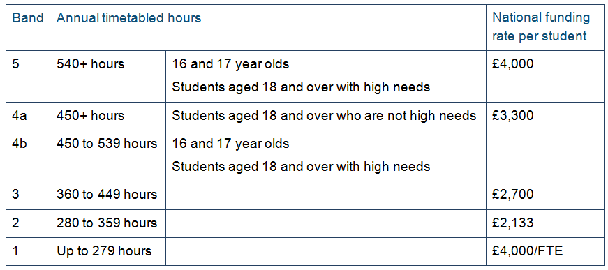
National funding rate
All full time students are funded at the same basic funding rate per student, per year.

Slide 10
Historic data
Some funding factors are worked out using historic data:
retention factor,
programme cost weighting, and
disadvantage funding.
The information is taken from the latest full year’s data – for 2014/15 allocations, 2012/13 data was used.
When historic data is not available (eg, when the institution is new), we use averages for the institution type.

Slide 11
Core aims
The core aim is the principal, most important or, ‘core’ activity in a student’s programme.
It will usually be the component with the largest amount of timetabled activity associated with it.
Programmes can only have one core aim at a time.
Vocational programmes will usually have a substantial core aim – equivalent in size to one A level or making up at least 50% of the programme.

Slide 12
Core aims
The core aim is used:
to calculate programme cost weighting,
to determine whether a student is retained on the programme or not, and
to determine whether the programme is academic or vocational.
The school census only needs the core aim for students studying vocational or mixed programmes.
It is not always a qualification (eg, it can be work experience).
Traineeships will always have work experience as the core aim.

Slide 13
Programme type
Academic programmes have one of the following as a core aim.
A levels/AS/A2 (apart from General Studies and Critical Thinking).
International Baccalaureate (IB).
Pre-U Diplomas.
Access to HE.
GCSEs.
Free-standing maths qualifications (FSMQs).
Students who are not on academic programmes are on vocational programmes.

Slide 14
Retention
‘Retention’ means whether a student completed their programme (were retained) or withdrew/dropped out.
The retention factor gives institutions less funding to compensate for students who had less delivery and therefore who incur less cost.
Retention criteria are different for the two types of programme.
Academic programmes: a student must stay on or complete at least one of the academic aims in their programme (not necessarily the core aim) in the funding year.
Vocational programmes: a student must stay on or complete their core aim in the funding year to count as retained.

Slide 15
Retention
The retention factor is calculated from the retention rate (how many students are retained).

Slide 16
Starts
Students have to stay on their programmes for a certain amount of time before they qualify for funding.
This is known as being counted as a ‘start’.
Students have to count as a start for every year that they study.
eg, if a student is doing a two-year A level course from September 2014 to June 2016, they have to complete the qualifying period in September 2014 and September 2015.

Slide 17
Transfers and withdrawals
A transfer is when a student stops studying one qualification and takes up another in its place, while staying at the same institution. It does not affect the retention rate/factor.
When a student withdraws from their whole programme, they count negatively in the retention rate/factor and therefore may get less funding in future.
There is no clawback or adjustment to the funding for that year.
When a student withdraws and goes to another institution, that institution will be funded.

Slide 18
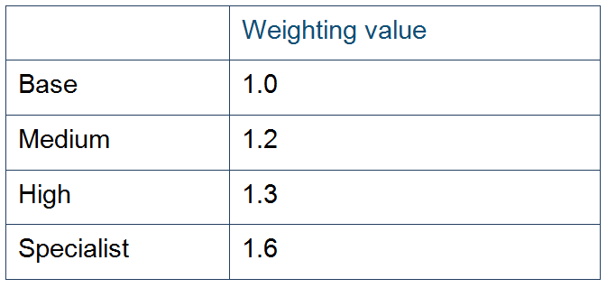
Programme cost weighting
Programme weightings are used to give more funding to vocational programmes that are more expensive to deliver.
All academic programmes are weighted at the base rate.
The programme’s weighting is determined by the core aim’s sector subject area (SSA) tier 2 classification.

Slide 19
Disadvantage funding
Disadvantage funding is made up of two blocks.
Block 1: to account for students’ economic deprivation.
Block 2: to account for low prior attainment in English and maths.
Disadvantage funding is not ring fenced. Institutions are free to choose the best ways for them to attract, retain and support disadvantaged students and those with learning difficulties and disabilities.

Slide 20
Disadvantage funding: block 1
Engaging, recruiting, and retaining young people from economically disadvantaged backgrounds means additional costs for institutions. Block 1 funding covers these costs.
Whether a student is eligible for block 1 funding is determined by their home postcode and the level of deprivation recorded for that area in the Index of Multiple Deprivation (IMD) 2010.
Block 1 also provides an additional amount of funding for students who are in care or who have recently left care (£480 per student).

Slide 21
Disadvantage funding: block 2
Block 2 funding covers the additional costs incurred for teaching students who have low prior attainment.
Low prior attainment = not achieving English and/or maths GCSEs at grade C or above by the end of year 11.
Block 2 funding is for supporting all students to achieve their learning goals.
This includes support for low cost, high incidence learning difficulties and disabilities.
Each instance of a student not having achieved a maths or English GCSE is counted. This means that a student who does not have either GCSE will be counted twice for the block 2 uplift.

Slide 22
Disadvantage top-up
Every institution will receive at least £6,000 of disadvantage funding.
If the disadvantage funding calculations for block 1 + block 2 are less than £6,000, the disadvantage funding allocated will be topped up to this value.

Slide 23
Area cost uplift
The costs of delivering education in London and the South East are higher than the rest of England.
Institutions in these parts of England receive additional funding through the area cost uplift.
The area cost uplift varies from 20% to 1%.
Outside of London and the South East, the area cost uplift is 0%.

Slide 24
Funding outside the formula
High need student funding
Care standards (residential) funding
Transitional protection, formula protection funding, and 18+ rate reduction mitigation
14 to 16s in FE and electively home educated students
Traineeships
Supported internships
Student financial support funding

Slide 25
High needs student (HNS) funding
High needs students (HNS):
have a Learning Difficulty Agreement (LDA) or Education Health and Care Plan (EHCP), and
receive element 2 and 3 funding.
HNS funding has three parts.
Element 1 – programme funding.
Element 2 – additional education support funding: £6,000 per high needs student.
Element 3 – top-up funding: additional funding provided on a per-student basis by their local authority.

Slide 26
Care standards (residential) funding
Institutions that offer residential accommodation for students under the age of 18 have additional costs because of their responsibilities under the Care Standards Act 2000.
Care Standards funding is available to specialist colleges and other individual institutions where students are in residence primarily because similar provision is not available locally.
To get care standards funding, institutions have to:
be registered with Ofsted or the Care Quality Commission (CQC) for inspection under the Care Standards regulations, and
have a minimum of 12 EFA-funded students aged under 18 in residential accommodation on campus.

Slide 27
Transitional protection
Transitional protection ensures that institutions do not lose more than a certain amount per student (in cash terms) compared with the 2010/11 baseline.
2014/15 is the last year for transitional protection.

Slide 28
Formula protection funding
Formula protection funding shields institutions from significant decreases in funding per student that result from the changes to the funding formula that were made in 2013/14.
Only institutions that received formula protection funding in 2013/14 are eligible to receive formula protection funding in 2014/15.
Formula protection funding will be paid for at least three academic years from the introduction of the formula changes (that is, up to and including the academic year 2015/16).

Slide 29
18+ rate reduction mitigation
To mitigate some of the effect of the funding rate change for students who are 18 and over, the EFA will allocate additional funding.
This will only be done for 2014/15.
No institution will lose more than 2% of their programme funding.

Slide 30
14 to 16s in FE
The EFA funds 14 to 16 year olds when they are enrolled in eligible sixth form or FE colleges that
meet certain criteria, and
have been approved by the EFA.
14 to 16 year olds who are in a school or academy continue to be funded through the usual school funding methodologies.
Full guidance on 14 to 16 funding is available online: www.gov.uk/government/publications/enrolment-of-14-to-16-year-olds-in-full-time-further-education.

Slide 31
Electively home educated students
The EFA funds electively home educated students (EHE) for part time courses in FE institutions.
If an institution recruits an EHE student for a full time course, then they are no longer home educated and the institution will need to meet the criteria for direct recruitment.
EHE students are returned in the ILR in exactly the same way as other 16+ students.
Institutions should use the learning delivery monitoring (LDM) code 321 to identify EHE students.
Guidance on EHE students is available in the 14-16 guidance, annex C: www.gov.uk/government/publications/enrolment-of-14-to-16-year-olds-in-full-time-further-education.

Slide 32
Traineeships
For funding purposes, a traineeship programme uses the same principles as any other study programme.
Traineeships last up to six months.
Traineeships can be part time or full time.
If they are full time, students will be completing a significant number of hours in a short period of time. The EFA is monitoring this kind of ‘compressed delivery’ for quality through:
qualification success rates, and
positive destinations.

Slide 33
Traineeships
When a student progresses from a traineeship to another 16 to 19 study programme:
the second programme must have a new core aim of its own, and
the planned hours must be updated to include the additional activity planned for the year.
The traineeships delivery framework is available online: www.gov.uk/government/publications/supporting-young-people-to-develop-the-skills-for-apprenticeships-and-sustainable-employment-framework-for-delivery

Slide 34
Supported internships
Supported internships are type of study programme.
They are:
for young people aged 16 to 24 who have learning difficulties and/or disabilities,
planned by a post-16 institution, and
delivered mainly on an employer's premises
They are funded in the same way as any other study programme.
More information is available online: www.gov.uk/government/publications/supported-internships-for-young-people-with-learning-difficulties

Slide 35
For more information and questions
Contact us
All academies: academy.questions@education.gsi.gov.uk
Other institutions should contact their geographical team:
ypnorthern.efa@education.gsi.gov.uk
ypcentralsw.efa@education.gsi.gov.uk
ypsouthern.efa@education.gsi.gov.uk
Visit the website
‘Funding rates and formula’: www.gov.uk/government/publications/funding-guidance-for-young-people-2013-to-2014-rates-and-formula
Other funding guidance: www.gov.uk/16-to-19-education-funding-guidance

