Slide 1
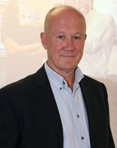
Marking: Celebrating and Enhancing a Vital Professional Skill
Professor Roger Murphy
Assocate Director, AlphaPlus Consultancy; Board Member, Pearson Education Ltd; Emeritus Professor of Education Nottingham University; Recent Member of Ofqual Standards Advisory Group

Slide 2
Marking: Three Key Features
A core skill within high quality education

Slide 3
Marking: Three Key Features
A core skill within high quality education
Gains credibility through effective standardisation

Slide 4
Marking: Three Key Features
A core skill within high quality education
Gains credibility through effective standardisation
Depends upon skilled human judgements

Slide 5
Marking: Three Key Features
A core skill within successful education
Gains credibility through effective standardisation
Depends upon skilled human judgements

