Slide 1
Using European Component Oriented Architecture (ECOA™) on a CDE phase-1 project
Dstl Platform Systems Division
9 September 2016
Dstl Document Reference: DSTL/PUB097811
UK OFFICIAL

Slide 2
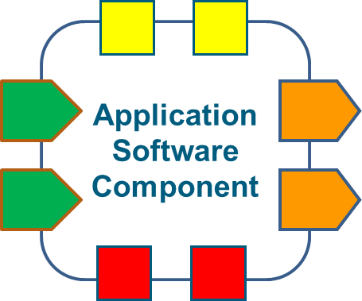
What’s ECOA?
ECOA specifies the design of software applications as components with defined interfaces
This makes it easier to integrate your software onto different computing infrastructures (portability)
It also lets you construct a system from a number of components, all using well defined ECOA interfaces (modularisation)
Container
Computing Infrastructure
UK OFFICIAL

Slide 3
Why ECOA for CDE?
ECOA is an important part of the MOD’s Strategy for Air Mission Systems
Future MOD Air Systems will be expected to use ECOA for their Application Software architecture
(unless a case is made to use an alternative)
This means that if MOD Mission System research software adopts ECOA, it will be much easier to pull-through into Operational Systems
UK OFFICIAL

Slide 4
What we’d like
We’re not expecting software from CDE phase-1 projects to comply fully with the ECOA architecture specification
that would require a lot more engineering effort than needed at this stage
We’d like to see software applications consider adoption of service orientation, as described in the following slides. However, this isn’t mandatory for proposals:
It’ll allow you to ‘wrap’ your software applications to look like ECOA, without having to re-engineer your underpinning software product
adopting service orientation should help you understand how this approach can be used to modularise your software in the future
This will make it easier:
to integrate your software with other systems and software products, and demonstrate the benefits of using it as part of a wider integrated system
to convert your software to comply more fully with ECOA as part of any follow-on activity, supporting integration onto more representative MOD Air Systems
UK OFFICIAL

Slide 5
What next?
Read the ECOA key concepts document for a more comprehensive overview of how ECOA works
Look at applying the following steps in the construction of your CDE phase-1 software product
This slide pack is to support the generation of CDE phase-1 proposals
an ECOA training workshop will be provided to help successful bidders funded at phase 1 to consider implementing ECOA during phase-1 projects
more extensive guidance will be provided during any phase-2 activities
UK OFFICIAL

Slide 6
HOW TO WRAP YOUR
SOFTWARE PRODUCT AS
ECOA FOR DEMONSTRATION
INTEGRATION
UK OFFICIAL

Slide 7
Wrapping a product as ECOA for demonstration (1 of 7)
Identify operation exchanges related to the provision of the functional inputs and outputs of your software product
Output operations and incoming calls for data
My software product
UK OFFICIAL

Slide 8
Wrapping a product as ECOA for demonstration (2 of 7)
Group cohesive operations (for example, those that provide related outputs). These are your service operations and the grouping represents the service
My software product
UK OFFICIAL

Slide 9
Wrapping a product as ECOA for demonstration (3 of 7)
Now you have identified your services
Service A
My software product
Service B
UK OFFICIAL

Slide 10
Wrapping a product as ECOA for demonstration (4 of 7)
You need to map your operations as Events, Synchronous (blocking) Request-Response (RR), or Asynchronous (non-blocking) Request-Response.
These are described in the ECOA mechanisms document
Event In
Event Out
Event Out
Asynch RR
RR Callback
Event Out
Event Out
Event Out
Event Out
My software product
UK OFFICIAL

Slide 11
Wrapping a product as ECOA for demonstration (5 of 7)
The ECOA Logical Interface (ELI):
the ELI is specified in Part 6 of the ECOA Architecture Specification
the ELI is a structured format for data packets. The ELI is formatted in the application layer, before being passed to the underlying transport stack
the ELI provides a common interface, supporting interoperability between ECOA Components
UK OFFICIAL

Slide 12
Wrapping a product as ECOA for demonstration (6 of 7)
You’ll need to write some interface code to ensure that to the outside world your service operations appear to behave as per the ECOA ELI Specification
all outgoing operations will need to be composed as ELI messages.
all incoming operations will be formatted as ELI messages that will need to be parsed so that your software can understand them
If you submit a successful CDE phase 1 proposal, we will provide a workshop to support you in doing this
Interface code for behaviour management and composition/ decomposition of ELI messages
My software product
ELI MESSAGES
UK OFFICIAL

Slide 13
Wrapping a product as ECOA for demonstration (7 of 7)
You’ve now wrapped your product so it appears from the outside as an ECOA service provider. Note:
this is a process to achieve integration of your functional software into a demonstration environment. It assumes that your software is running on your own computing infrastructure
this does not make you product compatible with or appropriate for deployment into anything other than the demonstration architecture
your wrapped product is not an ECOA component - it just looks like one from the outside
For CDE phase-1 projects, we’d appreciate consideration of the ECOA approach, but it isn’t mandatory. As projects move forward and become more engaged with the MOD’s Air Mission Systems programmes, there will be opportunities to further align with ECOA and wider MOD Air Mission System architectures.
www.ECOA.technology
UK OFFICIAL

Slide 14
Further information
All information on ECOA is available at www.ECOA.technology
This includes the specification documents, end-to-end developers guide, tutorials, and detailed guidance
UK OFFICIAL

Slide 15
Notes:
This slide may be shown at the end of the presentation.

