Slide 1
GCA - Annual Survey Results
2016
Gavin Ellison
Research Director
Public Sector & NfP

Slide 2
Who took part

Slide 3
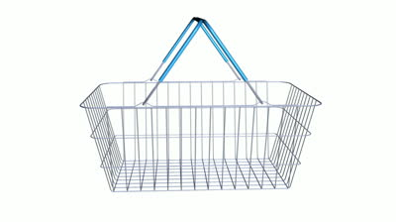
Survey details
921 Direct suppliers
105 Indirect
suppliers
44 Trade Associations
Live from 14th March to 6th May 2016

Slide 4
Who took part?
Supplier categories
2015
2014
Personally based…
2015
2016

Slide 5
Which retailers supplied?
Direct suppliers

Slide 6
Awareness of the Code and GCA

Slide 7
‘Good’ level of Code understanding rises by 7pp
Large direct suppliers are most likely to have a ‘good’ understanding of the Code (40%).
Only 54% of direct suppliers outside the UK are aware of the Code.

Slide 8
‘Good’ understanding of the GCA’s role and responsibilities rises by 7pp
Direct suppliers
Indirect suppliers
Trade associations
Only 54% of direct suppliers outside the UK are aware of the Code (94% UK).

Slide 9
No increase in whether direct suppliers would raise issues with the GCA
Direct suppliers
Indirect suppliers
Trade associations
Smaller suppliers are more likely to consider raising issues with the GCA than larger ones-
53% of micro & small suppliers say they would consider raising an issue, compared to 45% of large suppliers.

Slide 10
Why not raise an issue?
Among this 17%...
Among this 36%...

Slide 11
The GCA’s Critical Success Factors
An increase in the proportion of direct suppliers judging the GCA’s success based on ‘suppliers having greater influence over the terms of the supply’.

Slide 12
Training on the Code

Slide 13
A rise in the proportion of direct suppliers receiving training
Have you received any training on the Code?
And who provided this training?
2015
45% of Large suppliers say they have received training on the Code, compared to 29% of Micro & small suppliers and 28% of Medium sized suppliers.

Slide 14
Awareness of training is low
And why haven’t you received any training on the Code?
Have you received any training on the Code?
Net: 56%
2015

Slide 15
Many unsure whether their trade association offers training
Large suppliers were more likely to favour classroom based training (48%) than micro & small or medium suppliers (38% / 37%)

Slide 16
Supply agreements and the CCO

Slide 17
Have a written supply agreement with these retailers?
Average across the 10 retailers and 3 years:
2016: 52%
2015: 46%
2014: 40%

Slide 18
Knowing who is or where to find the CCO
Average across the 10 retailers and 3 years:
2016: 46%
2015: 37%
2014: 26%

Slide 19
Experience of issues

Slide 20
Proportion of suppliers with issues falls by 8pp Issues in the language of the Code
2
1
Issue position change compared to 2015
1
2
Moved up
1
No change
1
Moved down
3
1
4
2

Slide 21
Incorrect deductions and excessive artwork charges: Issues in the language of suppliers
2016
2015

Slide 22
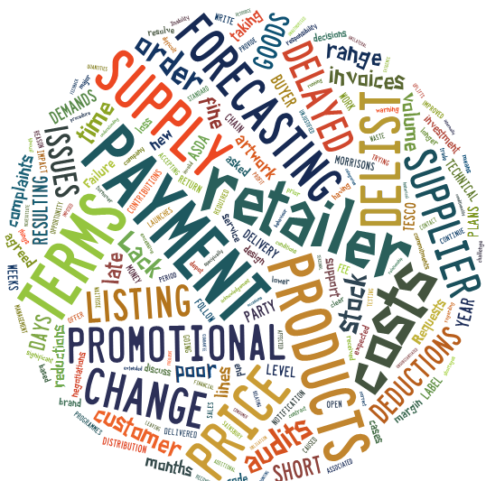
Aspects of retailer practice that have the most significant negative impact
‘Forecasting issues not being communicated effectively & resolved in a timely manner’
‘Delays in payments and attempts to change agreements already in place relating to payment terms’
.
‘Demands for payments for loss of profit which could result in delists. Requests to move marketing costs into cost of goods - failure to do could result in delists. Overrides demanded in order to engage on business growth initiatives such as NPD.’
‘The biggest issue with supplying is the expectation of increased rebates together with lower pricing. In some cases we trade for turnover only, and make no profit from trading. Also very late decisions on product/promotions makes operating without fines difficult.’
‘Technical charges for testing, audits, artwork costs and late payment’

Slide 23
4pp fall in suppliers having raised an issue with a retailer
14% of micro & small, 14% of medium, 11% of large direct suppliers
Raised an issue over the
last 12 months?
2015

Slide 24
Issues categorised by the Code: Which issues have direct suppliers experienced? – by retailer
 | Retailer 1 | Retailer 2 | Retailer 3 | Retailer 4 | Retailer 5 | Retailer 6 | Retailer 7 | Retailer 8 | Retailer 9 | Retailer 10
De-listing without giving reasonable notice | 7% | 4% | 6% | 2% | 9% | 3% | 2% | 2% | 3% | 3%
Incorrect deductions from invoices with or without notice | 14% | 8% | 13% | 2% | 9% | 5% | 3% | 5% | 6% | 5%
No compensation for/ incurring penalty charges as a result of inaccurate forecasting by the retailer | 11% | 3% | 10% | 3% | 8% | 6% | 4% | 3% | 3% | 5%
Excessive retailer charges for artwork/ design | 10% | 13% | 9% | 15% | 11% | 7% | 3% | 5% | 7% | 5%
Unjustified payments for consumer complaints | 10% | 10% | 8% | 0% | 5% | 9% | 3% | 0% | 5% | 6%
Drop and drive: delivery performance | 8% | 8% | 9% | 2% | 6% | 5% | 1% | 5% | 5% | 3%

Slide 25
Overall assessment

Slide 26
Change in retailer practice over the last year
Net improvement
score (2016)
(improved% minus worsened%)
Tesco
60
Aldi
18
Co-operative
16
Lidl
14
Iceland
14
Sainsbury's
13
Morrisons
0
Waitrose
0
Marks and Spencer
-1
Asda
-10
Retailers ranked by net improvement minus worsened score

Slide 27
Overall assessment of compliance with the Code
Consistently well + mostly
Aldi
98
Sainsbury's
96
Lidl
95
Waitrose
95
Tesco
94
Marks and Spencer
90
Co-operative
88
Asda
81
Iceland
81
Morrisons
80
Retailers ranked by net ‘consistently well’ and ‘mostly’

Slide 28
Key trends

Slide 29
Selected key trends 2014 to 2016
Notes:
WE HAVE ALSO SEEN A GOOD LEVEL OF UNDERSTANDING OF THE CODE RISE FROM 24 TO 31% BUT GOOD + FAIR STAYS LEVEL AT 72%.
WE HAVE SEEN GOOD UNDERSTANDING OF THE GCA RISE FROM 23 TO 30 AND GOOD +FAIR FROM 63 TO 66.
WE HAVE SEEN THE OPPORTUNITIES AND MARKET THERE TO PROVIDE AND INTEREST IN RECEIVING TRAINING ON THE CODE.
KNOWLEDGE OF WHO THE CCO IS HAS GONE FROM 26% IN 2014 TO 46% AND RECOGNITION OF SOMETHING THAT IS A WRITTEN SUPPLY AGREEMENT FROM 40 TO 52% IN THAT TIME.

