Slide 1
Tackling high blood pressure
A case for HWB action
Health and Wellbeing Board (HWB) slide deck – prepared 12/18/2015

Slide 2
Background
Public Health England supports a new programme of work on tackling high blood pressure
As part of this we are working to support local to develop leadership around high blood pressure. Our resource hub gathers key materials to support service planning and deliver
This slide set is intended to support colleagues working in Health and Wellbeing Boards to make the case for a focus on high blood pressure within their organisation
      This slide deck is intended to facilitate a discussion about prioritising prevention, detection and/or management of high blood pressure locally
DELETE BEFORE PRESENTING

Slide 3
Note to presenter
You are encouraged to adapt this deck as you wish
In particular you may wish to delete the front two explanatory slides and insert local performance data for your area (following the instructions on slide 10)
      If you want to get in touch with the national blood pressure team in Public Health England, please email bloodpressure@phe.gov.uk
      Versions of this slide set for other audiences are available here
DELETE BEFORE PRESENTING

Slide 4
Introduction
High blood pressure leads to costly and disabling conditions including stroke, heart failure, heart attack, chronic kidney disease and vascular dementia
Tackling high blood pressure is therefore a major opportunity for Clinical Commissioning Groups (CCGs) to reduce premature mortality and save on health and social care spending
12 national organisations including Public Health England and NHS England are leading new action on this issue
This presentation sets out key insights and evidence from that work, to assist local teams in discussing how to improve the prevention, detection and management of high blood pressure

Slide 5
Contents
    Why tackle high blood pressure
    Impact on health system
    National performance
    Local performance
    New national leadership
    High blood pressure action plan
      Prevention
      Detection
      Management
    Resource hub
    Healthier Lives Hypertension Atlas
    Future plans

Slide 6
Why tackle high blood pressure
High blood pressure affects more than 1 in 4 adults in England
It is the one of the leading risk factors for premature death and disability
People from the most deprived areas are 30% more likely than the least-deprived to have high blood pressure
Directly addresses NHS Outcomes Framework 1.1 under 75 mortality rate from cardiovascular disease and wider Quality and Outcomes Framework (QOF) and local performance measures
Improvement is achievable:
Adults with high blood pressure diagnosed and controlled
England average | 37%
England’s Top CCG (South West Lincolnshire) | 56%
Canada average | 66%
Notes:
Outperformed abroad: Joffres M et al. Hypertension prevalence, awareness, treatment and control in national surveys from England, the USA and Canada, and correlation with stroke and ischaemic heart disease mortality: a cross-sectional study. BMJ Open 2013; 3(8).
England 2011
England CCG QOF 2013/14
Canada 2007-9

Slide 7
Global Burden of Disease: England results
Notes:
Burden of disease attributable to leading risk factors for both sexes in 2013, expressed as a percentage of England disability-adjusted life-years
Study published 2015

Slide 8
Impact on health system
High blood pressure accounts for approximately 12% of all GP consultations
Estimated £1bn drug costs for high blood pressure per year
Diseases caused by high blood pressure cost the NHS over £2bn every year (~£10m per CCG)
  stroke £850m
  coronary heart disease £750m
  vascular dementia £320m
  chronic kidney disease £200m
Additional cost of social care
Notes:
Re: the £2 bn figure
The cost to the NHS in England from diseases caused by high blood pressure is estimated as £2.1 billion per year. Analysts have looked at the annual costs of four key diseases which blood pressure can cause (coronary heart disease, stroke, vascular dementia and chronic kidney disease) and totalled the amount of these which are estimated to be caused by high blood pressure. For example, raised blood pressure has been shown to half of all strokes.
Note: there are further costs to the NHS from high blood pressure itself (not just the conditions it can lead to) including clinical time and cost of medication to manage the condition. Beyond the NHS, there is a burden on social care (for example people who need to be looked after following a stroke) and the wider economy (such as lost productivity from people in ill-health).

Slide 9
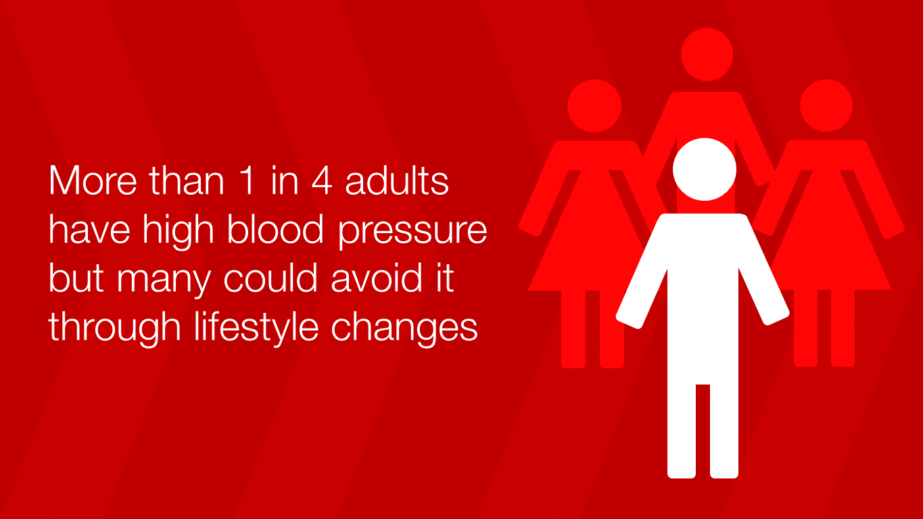
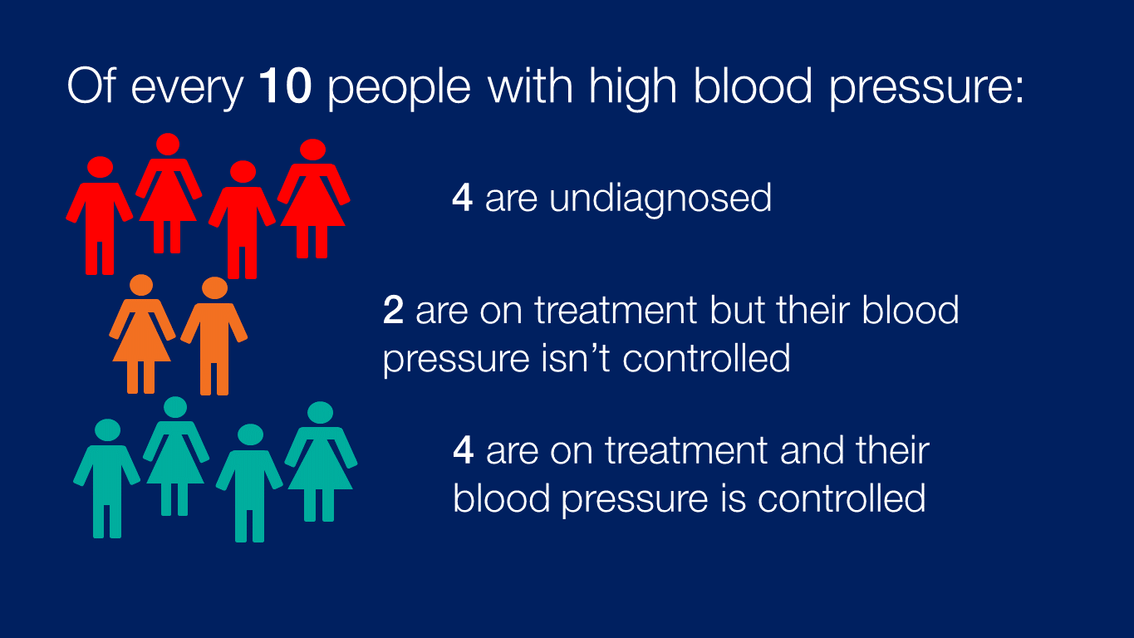
National performance
Positive change in last decade - slightly lower population average blood pressure (↓3mmHg systolic), 2 million people newly identified, 10% more on treatment achieving control), however:
Significant variation
      between CCGs (average BP control 61-94% / average proportion of hypertensives identified 37-66%)
      between income groups (30% more with hypertension in most-deprived areas versus least)
Notes:
Sources:
Positive change in the last decade: Health Survey for England
CCG variation: 2013/14 QOF variation at CCG level on HYP0003 (percentage of patients aged 79 and under with hypertension in whom the last blood pressure reading (measured in the preceding 9 months) is 140/90 mmHg or less)
Income group variation: Health Survey for England 2011
Outperformed abroad: Joffres M et al. Hypertension prevalence, awareness, treatment and control in national surveys from England, the USA and Canada, and correlation with stroke and ischaemic heart disease mortality: a cross-sectional study. BMJ Open 2013; 3(8).

Slide 10
Local performance
CREATE YOUR OWN SLIDE
NOTE TO PRESENTER: YOU MAY WISH TO INCLUDE LOCAL DATA FROM:
      Your CCG’s cardiovascular (CVD) intelligence pack, available at http://www.yhpho.org.uk/ncvinintellpacks/Default.aspx
      → see slides 11-19 on hypertension, which are fully formatted for use
      Your CCG’s profile on the healthier lives: hypertension site, available at http://healthierlives.phe.org.uk/topic/hypertension
      → data can be downloaded for all high blood pressure indicators by searching your CCG name, then selecting ‘download data’ via the link at the bottom left
      → data can also be viewed in interactive map form, and comparisons made with similar CCGs, more details on how to use this tool on the ‘about the data’ page

Slide 11

New national leadership
Since 2014, England’s Blood Pressure System Leadership Board (a cross-sector group) has overseen a programme of work improve the prevention, detection and management of high blood pressure, and reduce health inequalities
Published in November 2014 Tackling high blood pressure: from evidence into action

Slide 12
High blood pressure action plan
Intended to support partners at all levels to focus upon the work that will make the biggest impact in tackling high blood pressure
Contains advice specifically for NHS commissioners
Draws on the best evidence (including new economic analysis) and professional judgment of our group to:
      Recommend most pressing issues on blood pressure pathway to address
      demonstrate roles for a wide range of organisations to achieve this
      set out what key partners have already pledged to do in support of our ambition
Overarching themes:
      Tackling inequalities: identifying approaches and targeting to achieve this
      Partnership: need system leadership at all levels across government, health system, voluntary sector and beyond
      Local leaders: change and implementation is influenced and driven by local professionals
    www.gov.uk/government/publications/high-blood-pressure-action-plan

Slide 13
Prevention
High blood pressure is preventable, and risk of cardiovascular disease is reduced down to a threshold of 115/75mmHg
Prevention
Key approaches (plan sets out more fully how different groups contribute):
reducing salt consumption and improving overall nutrition at population-level
improving calorie balance to reduce excess body weight at population-level
personal behaviour change on diet, physical activity, alcohol and smoking, particularly prompted through individuals’ regular contacts with healthcare & other institutions
Detection
Management
Notes:
Action examples:
PHE dedicated programmes on diet and obesity, physical activity, alcohol and healthy places
British Heart Foundation 2014-2020 strategic ambition on prevention
Deliver NHS England Making Every Contact Count action plan

Slide 14
Detection
Prevention
    Testing advisable at least every five years, more frequent re-testing for those with high-normal blood pressure. Diagnosis never based on a single test, normally followed by ambulatory (24 hour monitor) or home testing
Detection
Key approaches (plan sets out more fully how different groups contribute):
more frequent opportunistic testing in primary care, achieved through using wider staff (nurses, pharmacy etc.), and integrating testing into the management of long term conditions
improving take-up of the NHS Health Check, a systematic testing and risk assessment offer for 40-74 year olds
targeting high-risk and deprived groups, particularly through general practice records audit and outreach testing
Management
Notes:
Action examples
PHE developing campaign toolkit for local use, based on its Wakefield testing pilot
Pharmacy Voice drive on increasing pharmacy testing role
British Hypertension Society developing hypertension diploma

Slide 15
Management
NICE recommend lifestyle treatment for all with hypertension –can achieve dramatic reduction. If drug therapy, 80% require 2+ agents to achieve blood pressure control. NICE treatment target (for adults under 80 years) 140/90mmHg
Prevention
Key approaches (plan sets out how different groups contribute):
local leadership and action planning for system change, to tackle particular areas of local variation, and achieve models of person-centric care
health professional support (communication, tools & incentives) to bring practice nearer to treatment guidelines
support adherence to drug therapy and lifestyle change, particularly through self-monitoring of blood pressure and pharmacy medicine support
Detection
Management
Notes:
Action examples:
RCGP/Primary Care CVD Leadership Forum working in partnership to raise standards and clinical leadership
NHS Choices refreshing hypertension contents
NICE collating info on uptake of recommendations & quality standards

Slide 16
Example actions for key H&WB groups
CCG reps
integrate lifestyle modification into clinical care pathways
Local authority reps
create an environment & incentives which promote physical activity & reduce likelihood of obesity
Voluntary & community sector reps
provide insight into under-served communities to support commissioning & development of the JSNA & H&W Strategy
identify the local size & distribution of the shortfall in detection & review testing provision
embed management of BP within communications about LTCs
provide high-quality supplementary testing opportunities
provide information & support to those managing/monitoring their own BP
consider scrutiny reviews to support improvements in detection
commission services to support risk assessment, awareness & management
    More actions and ideas are available in the action plan www.gov.uk/government/publications/high-blood-pressure-action-plan

Slide 17
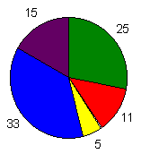
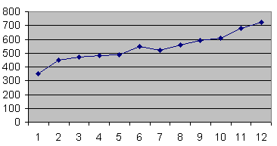
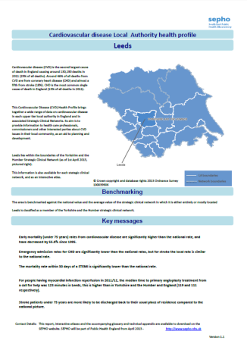
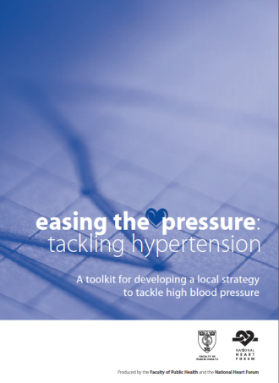
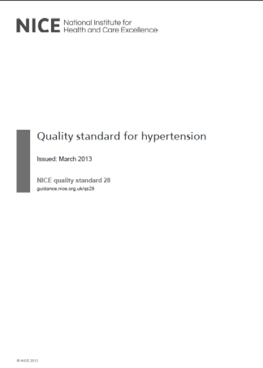
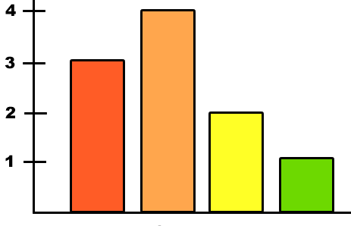
Resource hub
PHE wants to support local leadership in tackling high blood pressure, and has gathered resources in one hub to help those planning and delivering high blood pressure services and initiatives
Resources include data, guidance, tools, case studies and examples of emerging practice
The PHE team welcomes feedback and ideas for new resources to include, particularly any local case studies – please email bloodpressure@phe.gov.uk
www.gov.uk/high-blood-pressure-plan-and-deliver-effective-services-and-treatment

Slide 18
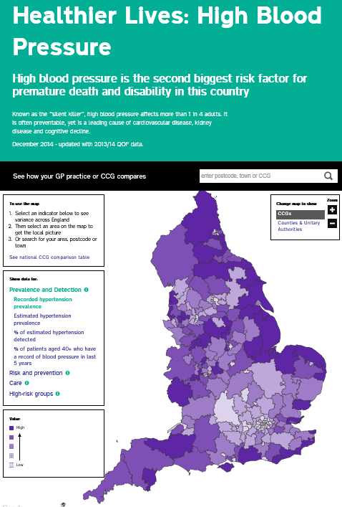
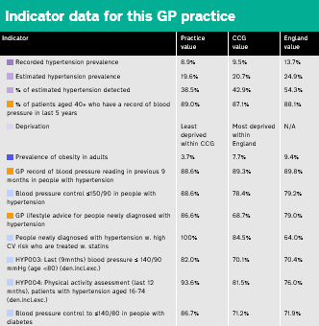
Healthier Lives variation atlas
Risk and prevention
Detection
Care
High risk groups
LA
CCG
GP
healthierlives.phe.org.uk/topic/hypertension
Notes:
This data can tell us about:
•What the local prevalence of key risk factors for high blood pressure is – to help us improve prevention
•How many of the missing millions of undiagnosed people with high blood pressure have been found in each area – to help us improve detection
•How well GPs look after people with high blood pressure, including people who also have another condition – to help us improve care
The data covers the whole of England and is broken down by:
•Clinical Commissioning Group
•Local Authority
•Individual General Practices
This data is not new, it has been available in the public domain but this is the first time it’s been published in this form making information easy to access, view and compare.
The majority of the data presented in Healthier Lives: High Blood Pressure has been drawn from the Quality Outcomes Framework (QOF), which is based upon general practice records. The QOF data is for the financial year 2013/14. They have not used the more usually published achievement scores, but the intervention rates which look at practices’ performance on all relevant patients without any exception.
This is supplemented with other data sources for individual indicators:
•Hypertension prevalence modelled estimates (2011, modelling by the former Eastern Region Public Health Observatory, now part of PHE, based on earlier data)
•Hospital Episode Statistics (2012/13)
•Health Survey for England modelled estimates (2011 modelling by National Centre for Social Research, based on earlier data)
•Active People Survey (2013)
•Index of Multiple Deprivation (2010)
The tool will be updated as new data becomes available, at least annually.

Slide 19
The future
  What is our role in tackling
  high blood pressure?
  What will we focus on
  Who will we work with
  How will we measure our impact

