Slide 1
GCSE Reform
HE Admissions Seminar
8 March 2016

Slide 2
Overview of session GCSE reform
Brief overview of context
Timeline for reform – what can you expect to see and when
Summary of main changes to GCSEs
New grading structure
2017 Awarding
Three country implications – leading into the panel session

Slide 3
Reminder of timeline - Reforms to A Level, AS and GCSE qualifications
September 2015
September 2016
September 2017
First teaching of 1st tranche of new GCSEs and A levels
2nd tranche of new GCSEs and A levels start to be taught
Remaining subjects at all levels start to be taught. Any subjects not reformed and approved by then will be withdrawn
First awarded 2017
Accreditation underway 45% accredited now
Specification development underway.
Accreditation to begin 2016 Spring/Summer
First awarded 2018
First awarded 2019

Slide 4

New GCSEs – Summary of Changes
Content – new, more demanding content, which government is responsible for
Structure – linear, with all exams in the summer at the end of the course. Resits of the whole qualification available in November for GCSEs in maths and English language only, for those aged 16+
Assessment – exam where possible, other forms of assessment only where necessary to assess essential subject skills
Tiered assessments – only where necessary when a single set of exams cannot assess students across the full ability range
Grading – new numbered scale from 9 to 1 (plus U), 9 is the highest. Clearer differentiation at the higher end of grading.

Slide 5
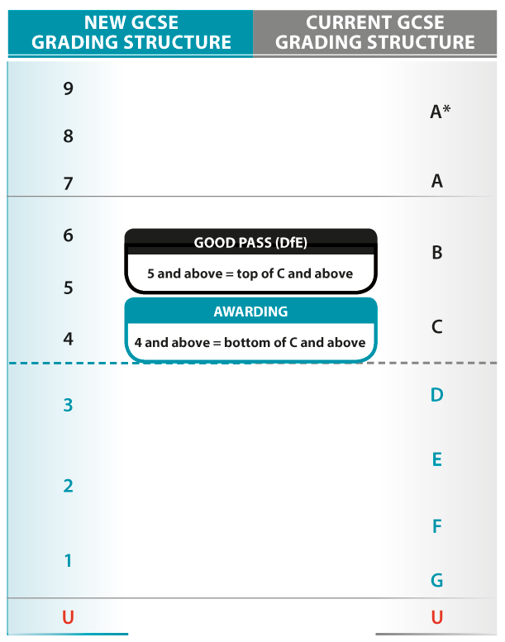
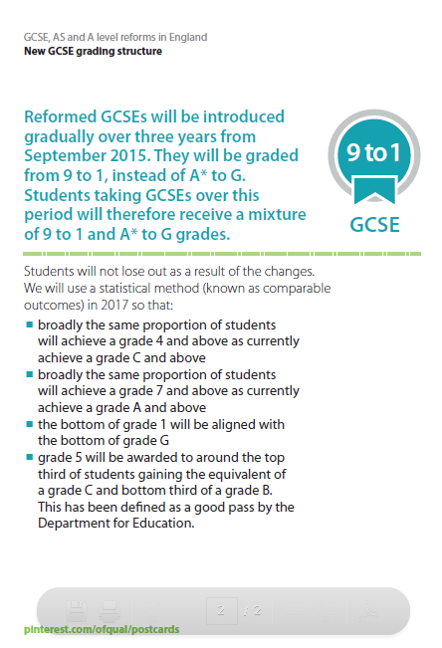
New GCSE grading structure from 2017

Slide 6
Setting standards – GCSEs
New grading scale
Anchor points between some of the new and old grades
  Grade 4 and above – grade C and above
  Grade 7 and above – grade A and above
  Grade 1 and above – grade G and above

Slide 7
An overview of the National Reference Test

Slide 8
2017 summer awarding
(September 2015 first teach)
GCSEs
    Maths
    English language
    English literature

Slide 9
GCSE English language
Spoken English
Externally and/or internally assessed.
Levels of achievement: Pass, Merit and Distinction.
One outcome if standard not met; Not Classified
All outcomes to be reported on certificates, including Not Classified.

Slide 10
2018 summer awarding
(September 2016 subject to accreditation of specifications)
GCSEs
    Geography
    History
    Biology
    Chemistry
    Physics
    Double science
    Ancient languages
    Modern foreign languages
    Music
    Art and design
    Physical education
    Computer science
    Religious studies
    Citizenship studies
    Cooking and nutrition
    Dance
    Drama
    Once specifications are accredited, they are listed on our website:
    www.gov.uk/government/publications/new-gcses-as-and-a-levels-accredited-to-be-taught-from-2016

Slide 11
2019 summer awarding
September 2017 first teach
GCSEs
Ancient History,
Astronomy,
Business,
Classical Civilisation,
Design and Technology,
Economics,
Electronics,
Engineering,
Film Studies,
Geology,
Media Studies,
Psychology,
Sociology,
Statistics.
GCSE Short Course in PE.
Content and assessment requirements are finalised and published. Exam boards are developing specifications ready for accreditation opening in Spring/summer 2016

Slide 12
Summary of GCSE changes
    A mixed economy
    A new grading system is being introduced 9-1 - with 9 being the highest grade available;
    Students will be awarded a combination of letters and numerical grades during the transition period;
    In different subjects, reformed qualifications will be offered alongside legacy qualifications.
    Linear qualifications mean students will take their qualifications at the end of the course;
    Subject content is changing and being made more demanding

Slide 13
GCSE qualification reform in three countries

Slide 14
General qualifications reform across England, Wales and Northern Ireland
The nature of GCSEs, AS and A levels is changing in each country in line with different policies in the different countries
The mixture of exam boards offering qualifications in each country is different, and there are important structural differences, particularly:
  the fact that assessment in AS qualifications is stand-alone and does not contribute towards A level grades in England, whereas in Wales and Northern Ireland it contributes to the A level grade
  the grading scale for GCSE will be different in England compared with Wales and Northern Ireland
There are other differences at subject level which vary in their nature and extent.
The 3 regulators are working together to produce information on areas of similarity or difference at a subject level – we think that that best supports you in understanding the reformed qualifications and considering your own subject entry requirements, alongside information from exam boards

