Slide 1
Vocational qualifications and HE entry in England
Jeremy Benson

Slide 2
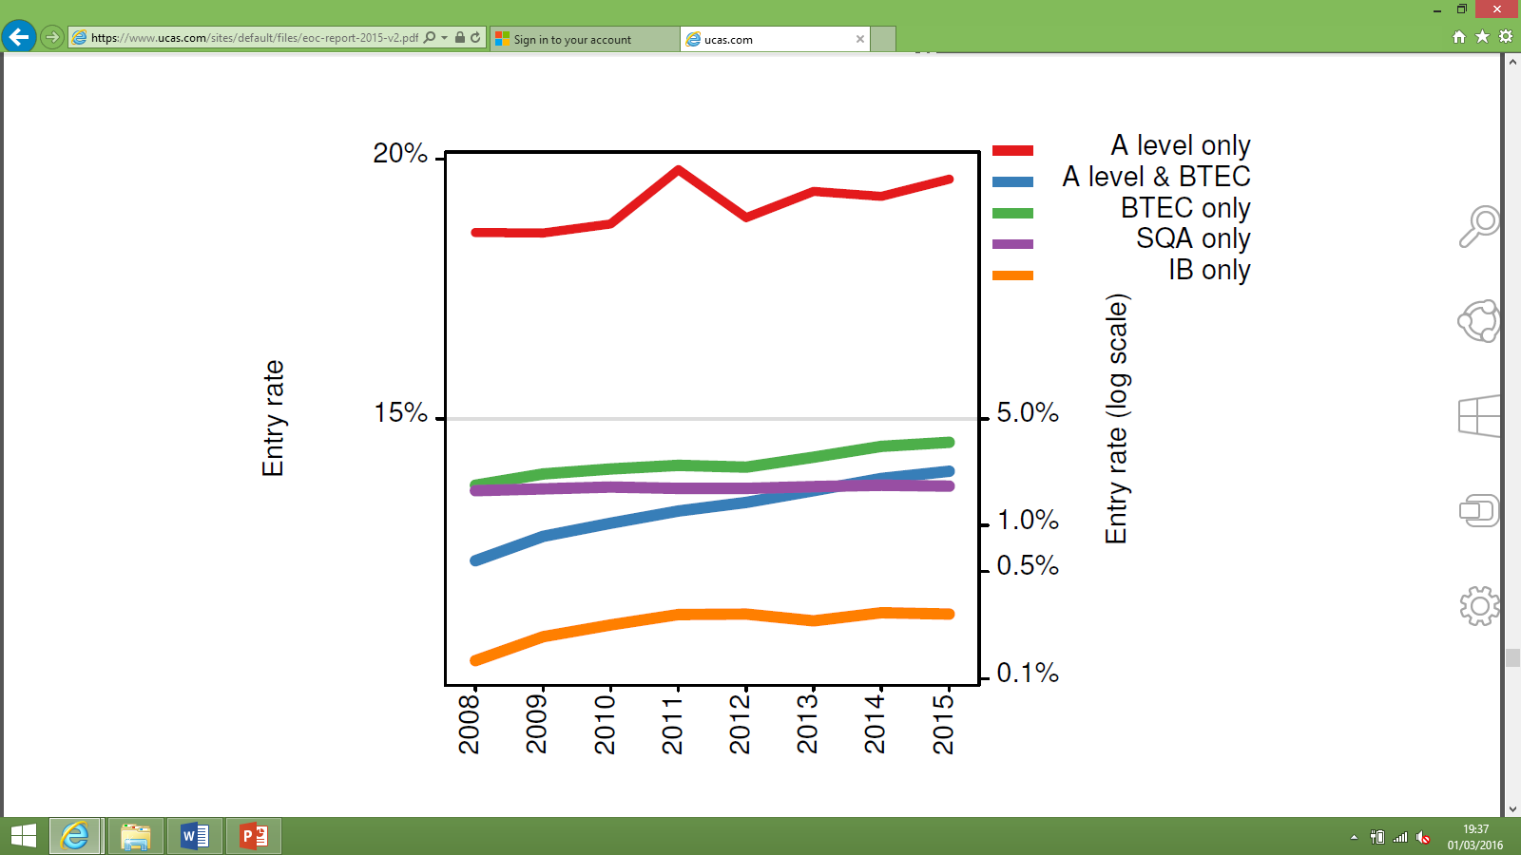
The story in numbers
UK 18 year old entry rate by type of qualification held (logarithmic scale)
Source: UCAS End of Cycle Report 2015, p135

Slide 3
What would you need to know if…
... you were an admissions tutor thinking about starting to use vocational qualifications to inform admissions decisions?
What skills do vocational qualifications recognise?
What is different about vocational qualifications compared to qualifications I’m more familiar with?
What other things might I need to consider if I want to start using vocational qualifications?

Slide 4
What skills do vocational qualifications recognise?
A wide range…
How can I find out?
Title
Ofqual’s Register of Regulated Qualifications
Check the specification
Ask the awarding body
Each vocational qualification is individually designed by the awarding body
Many are based on employer-designed skills standards
Others may be designed more to meet learner demand / school/college interest

Slide 5
Titles
Applied Generals |  | Tech Levels
Title | Cert no.s | Title | Cert no.s
Pearson BTEC Level 3 Extended Diploma in Health and Social Care | 12,670 | Pearson BTEC Level 3 Extended Diploma in Art and Design | 11,160
Pearson BTEC Level 3 Subsidiary Diploma in Business | 11,860 | Pearson BTEC Level 3 Extended Diploma in IT | 9,760
Pearson BTEC Level 3 Extended Diploma in Sport | 11,860 | City & Guilds Level 3 Diploma in Health & Social Care (Adults) for England | 8,660
Pearson BTEC Level 3 Subsidiary Diploma in IT | 11,530 | AAT Level 3 Diploma In Accounting | 8,010
Pearson BTEC Level 3 Subsidiary Diploma in Sport | 10,820 | Pearson BTEC Level 3 Extended Diploma in Creative Media Production | 7,350
Data from academic year 2013/14. Includes certifications taken by all learners, not just at 16-19. Figures rounded to nearest ten. All above qualifications in QCF.

Slide 6
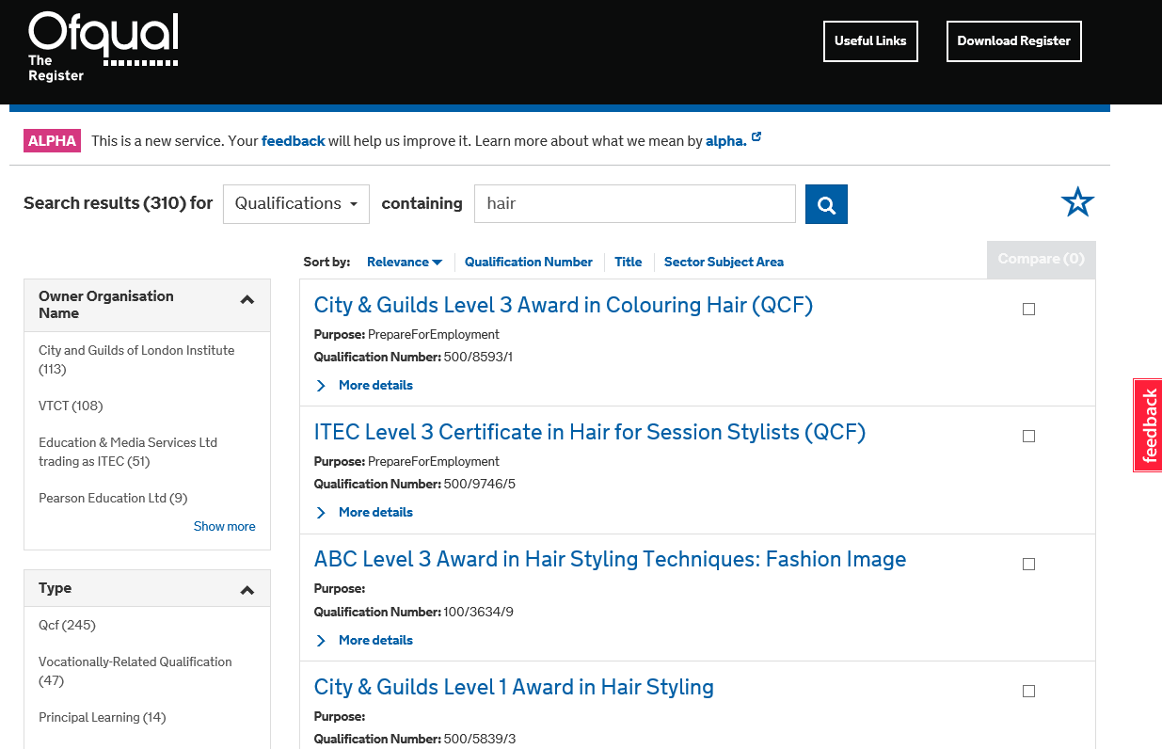
Improving our Register of qualifications
CURRENT VERSION

Slide 7
More details from specifications…
Type | Applied General | Tech Level
Qualification title | Pearson BTEC Level 3 Extended Diploma in Health and Social Care | Pearson BTEC Level 3 Extended Diploma in Art and Design
Enrolments 2013/14 | 12,670 | 11,160
Size | 1080 GLH | 1080 GLH
Assessment methods | Aural Examination, Coursework, Oral Examination, Portfolio of Evidence, Practical Demonstration/Assignment, Task-based Controlled Assessment | Aural Examination, Coursework, E-assessment, Multiple Choice Examination, Oral Examination, Portfolio of Evidence, Practical Demonstration/Assignment, Practical Examination, Task-based Controlled Assessment, Written Examination
Structure | Four different pathways can be taken. Each pathway has between 45% and 72% mandatory content, the remainder can be selected from 100+ different units. | Eight different pathways can be taken. Each pathway has 28% mandatory content, the remainder can be selected from 100+ different units.
Grading scale | P/M/D/D* | P/M/D/D*
Examples of skills that are assessed in one mandatory unit from each qual: | Explain potential hazards and the harm that may arise from each in a health or social care setting Outline how legislation, policies and procedures relating to health, safety and security influence health and social care settings Carry out a risk assessment in a health or social care setting Explain possible priorities and responses when dealing with two particular incidents or emergencies in a health or social care setting | Identify primary and secondary sources for recording Record visually Discuss visual recording in others’ work Review own visual recording Develop visual recording to produce effective outcomes

Slide 8
What are the differences between vocational and academic qualifications?
Some things to consider:
Vocational qualifications often do not assess typical ‘academic’ skills, e.g. analysis, extended writing (although some may)
Qualifications at the same level do not necessarily assess the same kinds of skills:
An NVQ in Hairdressing can be at Level 3
So is A level Physics
Level is a broad indicator – not an exact equivalence
Government does not set out the vocational skills it wants assessed in schools and colleges (unlike for GCSE and A level)
Ofqual doesn’t set detailed regulatory requirements for qualification ‘types’ as we do for GCSEs and A levels
There is huge diversity in vocational qualifications – in terms of size, assessment methods, skills tested, breadth

Slide 9
16-19 vocational education and assessment: some points to note
Qualifications in performance tables are changing
They will be required to meet new Department for Education Performance Table rules (first teaching this September)
Government review of Technical and Professional Education (TPE)
Department for Education is currently reviewing technical and professional education, with a focus on age 16-19
Aim for up to 20 sector-based routes to be established, leading to further study or employment
Content of each route to be defined with employer input
Steering Group under Lord Sainsbury – to report shortly
Could lead to further changes to qualifications

Slide 10
What other questions might I need to consider?
What skills and knowledge do we want our students to have on entry?
General level of overall academic ability?
Specific set of skills to support a particular route?
How far do particular qualifications recognise these?
What might we need to put in place if we want to accept students who have taken a vocational route, but need academic skills as well?
What strengths might students with vocational qualifications bring – either in general or for specific courses?
What can we tell prospective students about our expectations – and whether we will accept vocational qualifications?

Slide 11
Question for table discussions…
What questions might you need to ask if you were thinking about starting to use vocational qualifications to support admissions decisions...
… and how would you go about answering them?

Slide 12
Find out more…
Register of Regulated Qualifications
Current: http://register.ofqual.gov.uk Prototype: http://alpharegister.ofqual.gov.uk/
Department for Education – qualification types
https://www.gov.uk/government/publications/14-to-16-qualifications-technical-guidance &
https://www.gov.uk/government/publications/16-to-19-vocational-qualifications-technical-guidance
Regulating vocational qualifications
https://www.gov.uk/government/speeches/reforming-regulation-of-vocational-qualifications & https://ofqual.blog.gov.uk/2015/10/01/explaining-the-rqf/
Speeches about vocational qualifications
www.gov.uk/government/speeches/qualifications-place-in-a-high-performing-vocational-system &
https://www.gov.uk/government/speeches/regulating-vocational-qualifications-implementing-our-regulatory-strategy
jeremy.benson@ofqual.gov.uk

Slide 13
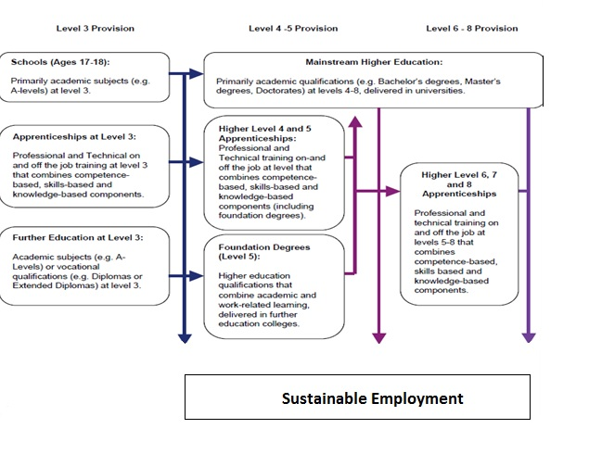
Other pathways to HE in Northern Ireland

