Slide 1
Introducing two new national meningococcal immunisation programmes in the UK: (i) Infant MenB Programme (ii) Teenage MenACWY programme Training the trainer slide set
Notes:
Background
In 2010, the Joint Committee on Vaccination and Immunisation (JCVI) convened a meningococcal sub-committee to conduct a comprehensive and detailed assessment of the evidence on the meningococcal B vaccine development and impact and cost-effectiveness of potential meningococcal B immunisation strategies. In June 2013, the Committee received a request from the Secretary of State for Health for JCVI to provide a recommendation on the possible introduction of a routine meningococcal B immunisation programme.
Since this time, the JCVI has regularly reviewed all the available evidence on the disease epidemiology, vaccine efficacy and safety and cost effectiveness of a meningococcal group B immunisation programme in the UK. As a consequence, in March 2014, the JCVI recommended the introduction of a routine infant meningococcal B immunisation programme following a 2+1 schedule at two, four and twelve months of age.
The aim of the routine childhood meningococcal B programme is to reduce the burden and severity of meningococcal meningitis and/or septicaemia caused by Neisseria meningitidis serogroup B in the UK.
Rationale of resource
This resource is designed to support healthcare professionals in raising the issue of the importance of immunising infants from two months of age against meningococcal serogroup B disease, providing evidence based information around the implementation and delivery of the meningococcal serogroup B programme in England.
Note: Meningococcal serogroup B is commonly known as MenB. For the purpose of this resource MenB is used throughout this document.

Slide 2
Contents
What is meningococcal disease?
What is MenB vaccine (Bexsero®)?
Who should we vaccinate with the MenB vaccine (Bexsero®)?
How are we implementing the new MenB infant immunisation programme?
How can we prevent fever after MenB vaccination?
How can we control the increase in MenW disease?
Which MenACWY conjugate vaccines will we use?
How are we implementing the MenACWY immunisation programme?
How will we monitor the new vaccine programmes?
Resources

Slide 3
What is meningococcal disease?

Slide 4
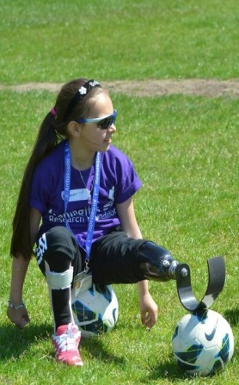
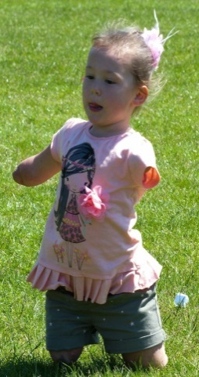
What is meningococcal disease?
Meningococcal disease occurs as a result of an invasive bacterial infection caused by Neisseria meningitidis, which is commonly known as the meningococcus
Important clinical and public health problem:
rare but serious
disease onset is sudden and often dramatic
The most common clinical presentations are meningitis and septicaemia: significant morbidity and mortality
Significant case fatality rate ~10% but varies with age, capsular group, and clinical presentation:
1 in 8 survivors have long term complications
Brain damage, deafness, epilepsy, limb/digit loss, cognitive deficit
Notes:
In 2015, PHE reported a continued increase in meningococcal capsular group W disease across all age groups and all regions in England
This increase demonstrated a year on year increase since 2009, indicating the strain had now become endemic
Meningococcal infection most commonly presents as either meningitis or septicaemia, or a combination of both
Highest rates of disease are in children under 2 years, particularly infants aged 5 months
Less commonly, individuals may present with pneumonia, myocarditis, endocarditis, pericarditis, arthritis, conjunctivitis, urethritis, pharyngitis and cervicitis.

Slide 5
Meningococcal Capsular Groups
There are 12 known meningococcal groups, each possessing a distinct outer polysaccharide (sugar) capsule.
The organism is associated with both asymptomatic carriage and invasive disease
>95% of cases are sporadic but occasional outbreaks occur, e.g. in families, schools, universities
Capsule:
Group specific polysaccharide
12 known capsular groups
A, B, C, W and Y are most common
Cell wall
Outer membrane proteins
Serotype / sero-subtype
Notes:
In 2015, PHE reported a continued increase in meningococcal capsular group W disease across all age groups and all regions in England
This increase demonstrated a year on year increase since 2009, indicating the strain had now become endemic
Meningococcal infection most commonly presents as either meningitis or septicaemia, or a combination of both
Highest rates of disease are in children under 2 years, particularly infants aged 5 months
Less commonly, individuals may present with pneumonia, myocarditis, endocarditis, pericarditis, arthritis, conjunctivitis, urethritis, pharyngitis and cervicitis.

Slide 6
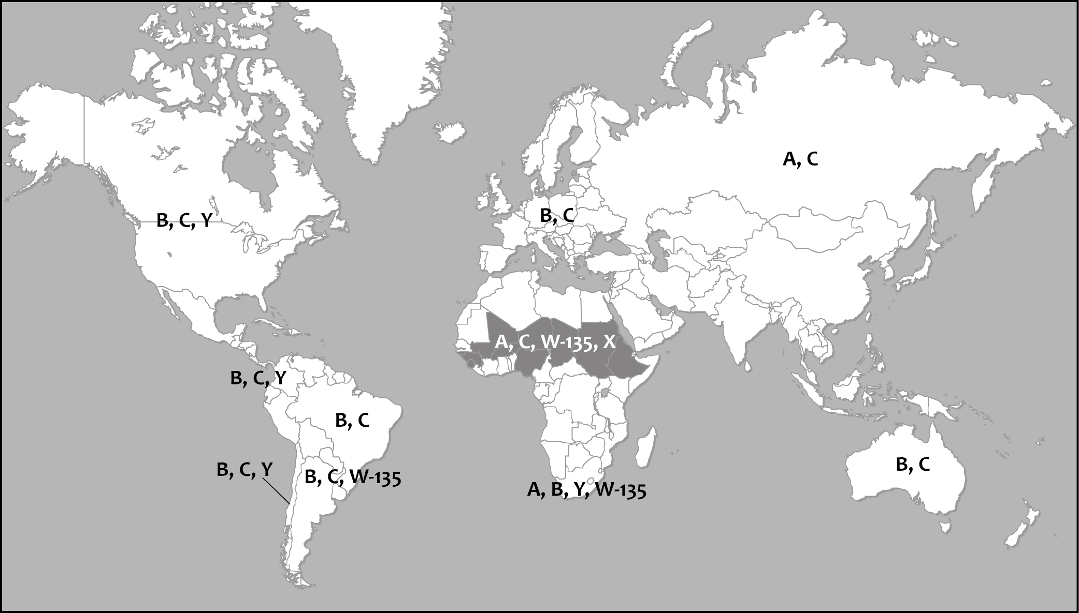
Global distribution of invasive meningococcal disease
Harrison LH, Trotter CL, Ramsay ME. Global Epidemiology of Meningococcal
Disease, in Vaccines against Meningococcus, 2009; 27 Suppl 2:B51-63.
Notes:
Major cause of meningitis, septicaemia and invasive disease globally
Causative organism associated with asymptomatic carriage or invasive disease
Ability to cause disease depends on host, environmental and organism characteristics
Endemic pattern seen in temperate climates such as US, Western Europe (rate 0.5-1.5 per 100,000)
6

Slide 7
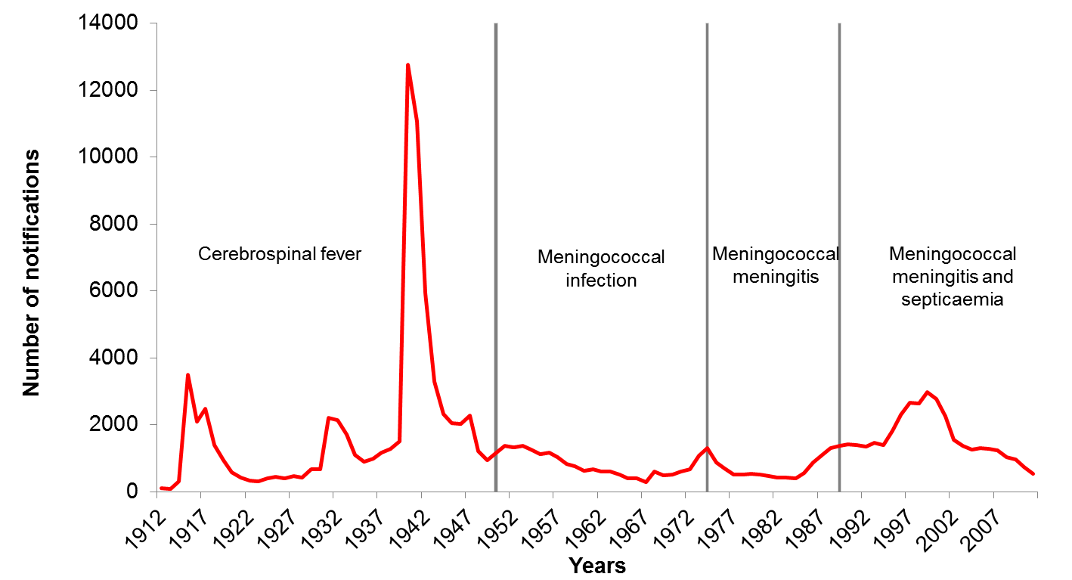
Long term trends in notified invasive meningococcal disease, England and Wales, 1912-2012

Slide 8
IMD incidence in Europe, 2009

Slide 9
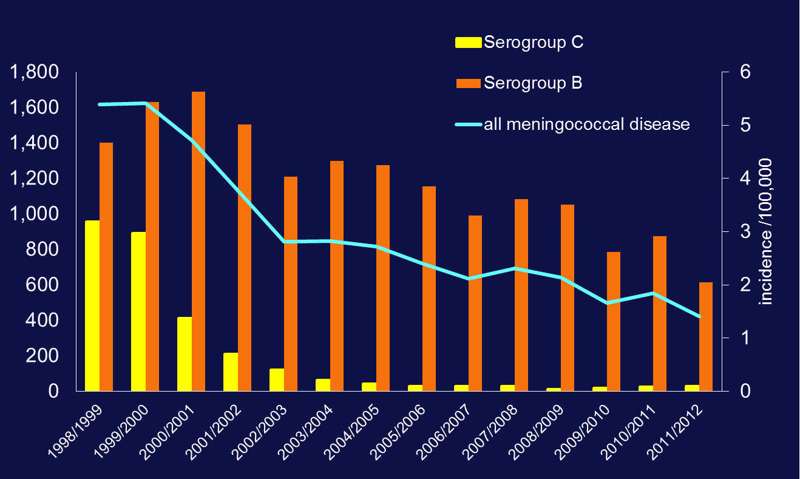
IMD Incidence and Cases in England & Wales (1998/99-2011/12)

Slide 10
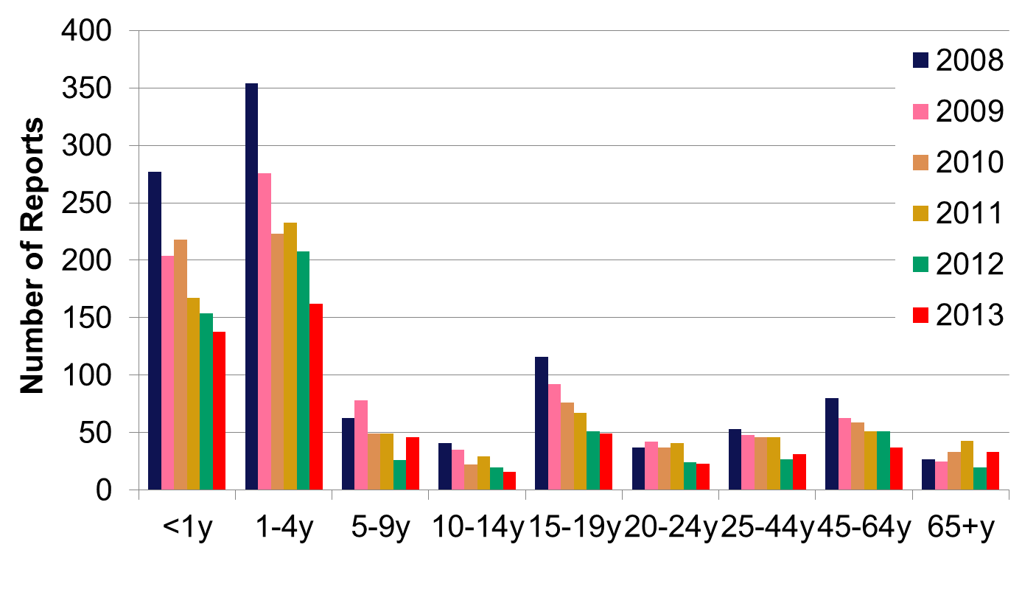
MenB disease by age-group (England & Wales, 2008-13)

Slide 11
Meningococcal Disease in England
The UK (and ROI) have the highest incidence of IMD in Europe
In England, capsular groups B, W and Y are responsible for nearly all meningococcal infections across all age groups
Routine meningococcal C (MenC) conjugate vaccination introduced in 1999 has nearly eliminated invasive MenC disease in England
Reduction in MenB disease from 2002 onwards
Significant decline in infants and toddlers in recent years
Secular decline towards historic baseline
MenB still accounts for 70% of all laboratory-confirmed meningococcal cases in England and >90% of cases in children and adolescents

Slide 12
What is MenB vaccine: Bexsero®?
Notes:
READ TITLE

Slide 13
Vaccines against MenB
MenB polysaccharide capsule is identical to that found on the surface of human foetal neuronal cells.
Consequently vaccines based on MenB polysaccharide
(i) are poorly immunogenic
(ii) have potential to induce an autoimmune response
MenB vaccines were developed from subcapsular antigens which:
(i) are surface-exposed
(ii) are conserved
(iii) induce bactericidal activity
Bexsero (= 4CMenB) developed with 4 antigens [GSK]
Outer membrane vesicle (OMV used as vaccine in New Zealand)
Three proteins discovered by “reverse vaccinology”
Not specific to MenB (can potentially protect against other groups)
Notes:
Unlike other meningococcal capsular groups, the MenB polysaccharide capsule is very similar to human nerve cells. Because of this, vaccines based on the MenB polysaccharide are likely to be poorly immunogenic and animal studies have raised concerns about polysaccharide-based vaccines against MenB potentially inducing an autoimmune response
Consequently, a novel technology using reverse vaccinology was developed, to identify immunogenic antigens on the surface of meningococci that were conserved across strains and induced bacterial killing or bactericidal responses.
It is important to note that these antigens are present on the surface of all meningococci and are not specific to MenB only

Slide 14
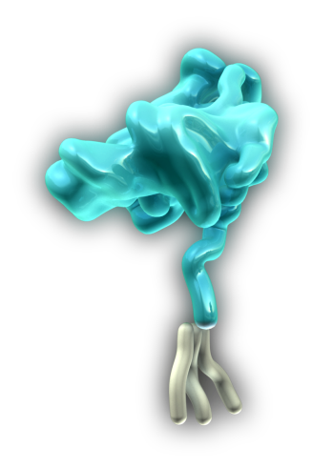
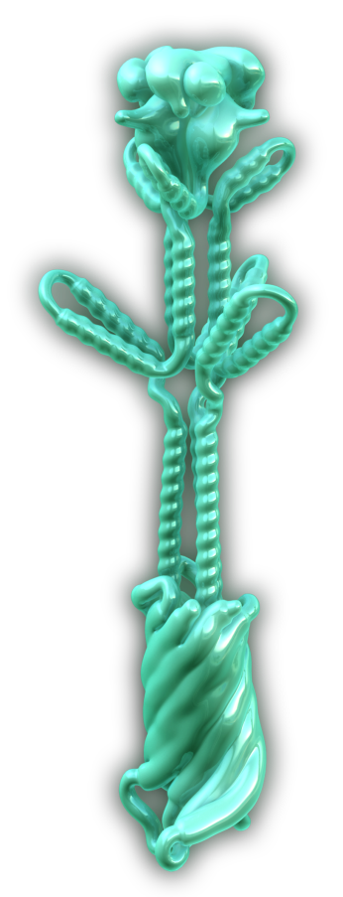
BEXSERO® consists of 4 antigenic components chosen to achieve broad protection
fHbp: factor H binding protein
Binds factor H, which enables bacterial survival in the blood^{1,2}
NHBA: neisseria heparin-binding antigen
Binds heparin, which may promote bacterial survival in the blood⁷
Present in virtually all strains^{6,7}
NadA: neisserial adhesin A
Promotes adherence to and invasion of human epithelial cells³⁻⁵
May be important for colonisation⁴
PorA
NZ PorA P1.4: porin A
Major outer membrane vesicle protein—induces strain-specific bactericidal response⁸
LPS
OMV*
Class 4
Class 5
PorB
Combining antigens that target different steps of meningococcal pathogenesis is likely to help optimize MenB vaccine effectiveness
Dose | fHbp fusion protein | NadA protein | NHBA fusion protein | OMV* | Al³⁺
0.5 ml | 50 µg | 50 µg | 50 µg | 25 µg | 0.5 mg
*From Neisseria meningitidis serogroup B strain NZ 98/254 measured as amount of total protein containing the PorA P1.4.
1. Madico G, et al. J Immunol. 2006;177:501-510; 2. Schneider MC, et al. Nature. 2009;458:890-893; 3. Comanducci M, et al. J Exp Med. 2002;195:1445-1454; 4. Capecchi B, et al. Mol Microbiol. 2005;55:687-698; 5. Mazzon C, et al. J Immunol. 2007;179:3904-3916; 6. Serruto D, et al. Proc Natl Acad Sci U S A. 2010;107:3770-3775; 7. Bambini S, et al. Vaccine. 2009;27:1794-2803; 8. Martin DR, et al. Clin Vaccine Immunol. 2006;13:486-491.
Notes:
BEXSERO is composed of 3 proteins on the surface of nearly all meningococci: factor H binding protein, NadA and NHBA, combined with the outer membrane vesicle (or OMV) of the New Zealand MenB outbreak strain
The 3 protein antigens were selected for the vaccine because of their importance for the survival, function, virulence or pathogenicity of the meningococci. Adding the OMV (which contains PorA P1.4) expands vaccine coverage to include important MenB clonal complexes
1. Madico J Immunol 2006/p501/col 2/para 2;
2. Schneider Nature 2009/p 890/col 1/para 1
3. Comanducci J Exp Med 2002/p 1451/col 1/para 2;
4. Capechi Med Microbiol 2005/p 687/Summary
5. Mazzon pg1/abstract/last line
4. Capecchi p694/col 1/para 2
6. Serruto PNAS 2010/p 3770/col1/abstract; p 3774/col 1/para 4
7. Bambini 2009 p 2796/col 2/para 6
8. Martin 2006 p486/abstract; col1/para 1
Bexsero SMPC p 2/sect 2

Slide 15
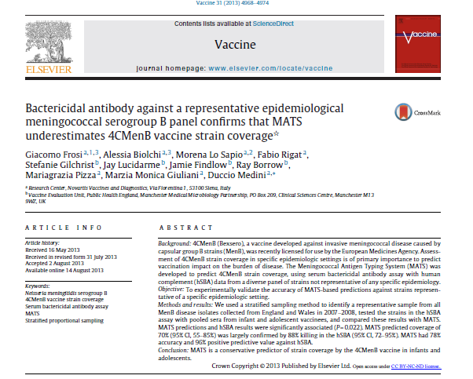
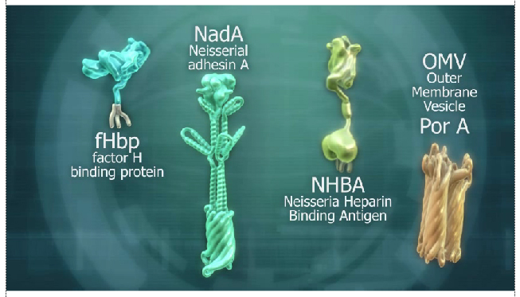
Meningococcal Antigen Typing System (MATS)
Are any of the Bexsero components in the circulating strains:
(i) expressed to a sufficient degree, and
(ii) similar enough to the antigens in the vaccine such that the antibodies generated by Bexsero will kill the bacteria?
UPDATED ESTIMATE OF COVERAGE 88%
Initial coverage estimate of 72.9% for England and Wales (95% CI 59.8-89.6)
Notes:
Bexsero was licensed on its ability to induce high concentrations of bactericidal antibodies against the proteins in the vaccine.
In order to assess whether the vaccine-induced antibodies protects against specific MenB strains causing invasive disease, a novel typing system known as MATS was developed.
For England and Wales, MATS predicted that Bexsero would protect against 73% of circulating MenB strains.
A subsequent serum bactericidal antibody study, however, predicted protection against up to 88% of circulating MenB strains
The protection offered by Bexsero against other meningococcal capsular groups is currently subject to ongoing investigations

Slide 16
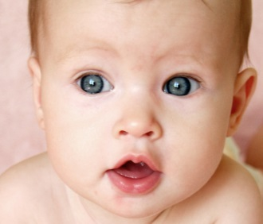
BEXSERO® has been studied in large clinical studies starting in early infants through adults
Approximately 7,800 subjects (from 2 months of age) received at least 1 dose of the vaccine*
Infants and children, 2 months to <2 years of age
5,850 received at least 1 dose of BEXSERO
3,285 received booster dose in second year of life
250 children 2 to 10 years of age
1703 adolescents and adults ≥11 years of age
*BEXSERO was evaluated in 13 studies, including 9 randomized controlled clinical trials
Data on file, Novartis Vaccines and Diagnostics.
Notes:
The safety and immunogenicity of BEXSERO® has been evaluated in many clinical studies and randomized controlled trials.
Prior to licensure, several thousand subjects were vaccinated with BEXSERO, including infants and toddlers, without any safety concerns

Slide 17
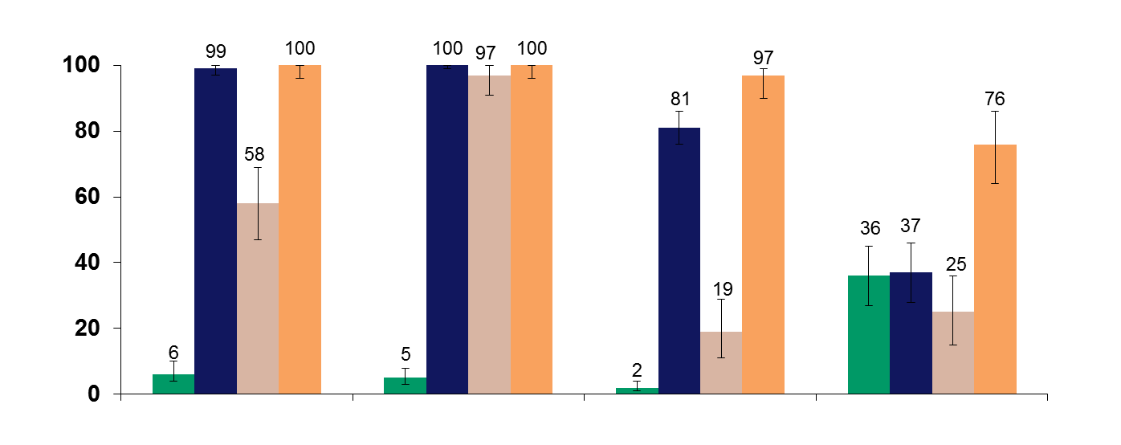
BEXSERO® induced a protective immune response in infants at a 2-3-4-12 month dosing schedule 2-3-4-12 month schedule with routine vaccines
Baseline
Post-primary (5 mo)*
Pre-booster (12 mo)
Post-booster (13 mo)†
% Subjects with bactericidal titers ≥1:5
fHbp
NadA
PorA P1.4
NHBA‡
*Blood drawn at 5 months, N=273–275.
†Blood drawn at 13 months, N=83–86.
‡Blood drawn at 5 months, N=112; blood drawn at 13 months, N=67.
1. Gossger N, et al. JAMA. 2012;307:573-582; 2. BEXSERO [summary of product characteristics]. Siena, Italy: Novartis Vaccines and Diagnostics S.r.l.; January 14, 2013.
Notes:
Bexsero has been demonstrated to be safe and immunogenic, inducing high concentrations of bactericidal antibodies against MenB
In infants immunised with BEXSERO® and their routine vaccines, more than 80% achieved protective antibody thresholds for the fHbp, NadA and PorA P1.4 antigens…. And …
After the 12-month booster, 100% of toddlers had sero-protective antibody titres for fHbp and NadA, 97% for PorA P1.4 and 76% for NHBA.
Bexsero SmPC/p9/Table 2 (col V72P12); p10/Table 3 (col 2,3,4,12 months)
Baseline/V72P12 Full CSR/p86/Table 11.4.1-1
Baseline NHBA/V72P12 tab NHBA/p2/Table 14.2.1.7

Slide 18
BEXSERO® licensed immunisation schedules EU
2–5 months
3 Doses
≥1 month
1 Dose age 12–23 mo
6–11 months
2 Doses
>2 months
1 Dose in the 2nd year of life ≥2 mo post–primary series
12–23 months
1 Dose 12–23 mo post–primary series
2–10 years
Need not established
11+ years
≥1 month
BEXSERO [summary of product characteristics]. Siena, Italy: Novartis Vaccines and Diagnostics S.r.l.; January 14, 2013.
Notes:
Based on the clinical trial data, the following is the licensed schedule for BEXSERO® in different age groups
The UK will, however, adopt a reduced 2+1 schedule at 2 and 4 months of age, with a booster at 12 months. This schedule should protect infants and toddlers when they are most vulnerable to meningococcal disease
Bexsero SMPC/ p 2-3/Table 1

Slide 19
Further experience with Bexsero®
Used in clinical trials in just over 24,000 individuals
includes response to two university outbreaks in the USA
Worldwide, between launch in November 2013 up to March 2015
999,196 doses sold in 20 countries
Estimated 545,092 subject received at least one dose
Used for population outbreak control in Quebec
Saguenay-Lac-St-Jean Region
Vaccination in schools and local public health units May-December 2014
Target: ≈ 57 000 persons aged 2 months to 20 years
Achieved 82% coverage
Cases declined in target area
Notes:
Since Bexsero was launched in 2013, almost a million doses have been distributed up until March 2013, with no reported safety concerns.
In one region in Quebec, Canada, a mass vaccination campaign in 2014 took place where all children from 2 months to 20 years were offered Bexsero because of a relatively higher incidence of MenB disease compared to other regions in Quebec and the rest of Canada

Slide 20
Summary: Bexsero®
Bexsero has potential to prevent around 73-88% of current MenB strains responsible meningococcal disease in the UK
Bexsero has been evaluated in multiple clinical trials involving infants, young children and adolescents. It is highly immunogenic, with development of bactericidal antibodies against the four vaccine antigens and evidence of persistence following booster
Bexsero can be given with the other routine infant vaccinations without affecting any of the vaccine responses.
Evidence of protection is based on serological criteria only. However, the OMV component has been shown to provide ~73% protection against matching strains in New Zealand

Slide 21
Who should we vaccinate with the MenB vaccine (Bexsero®)?

Slide 22
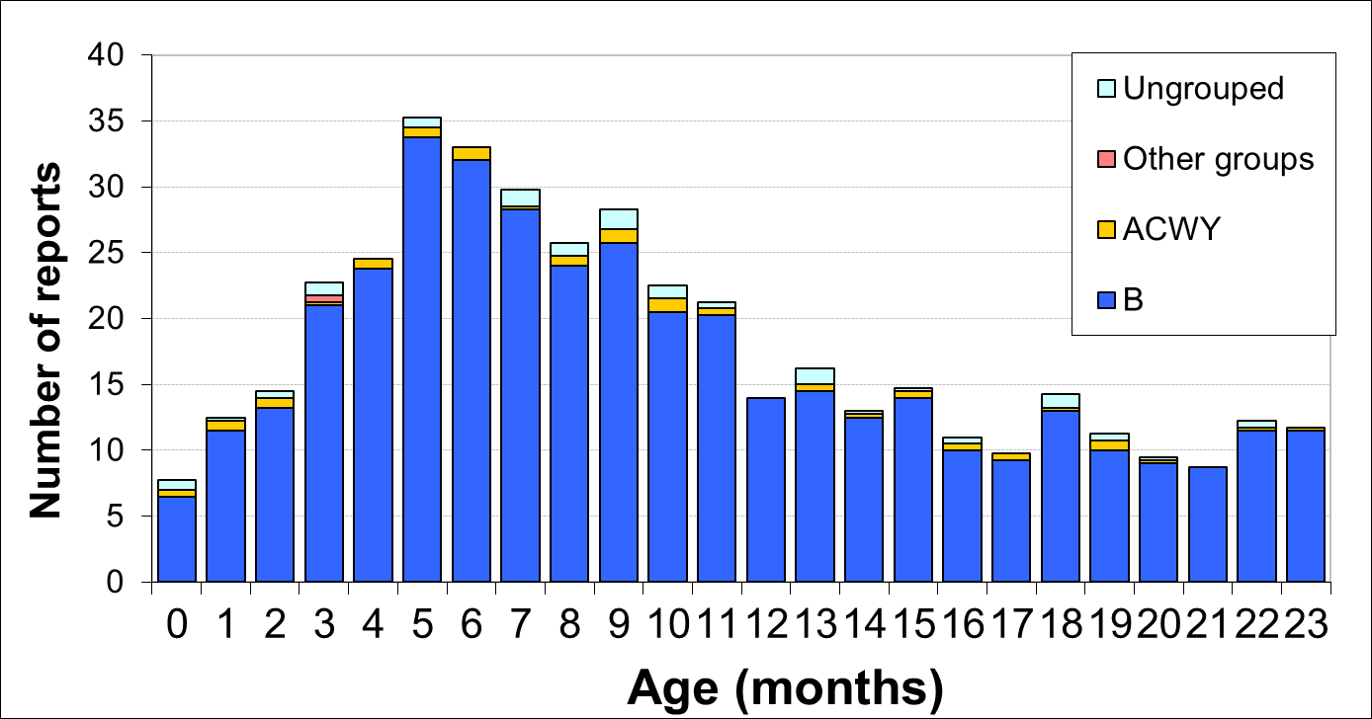
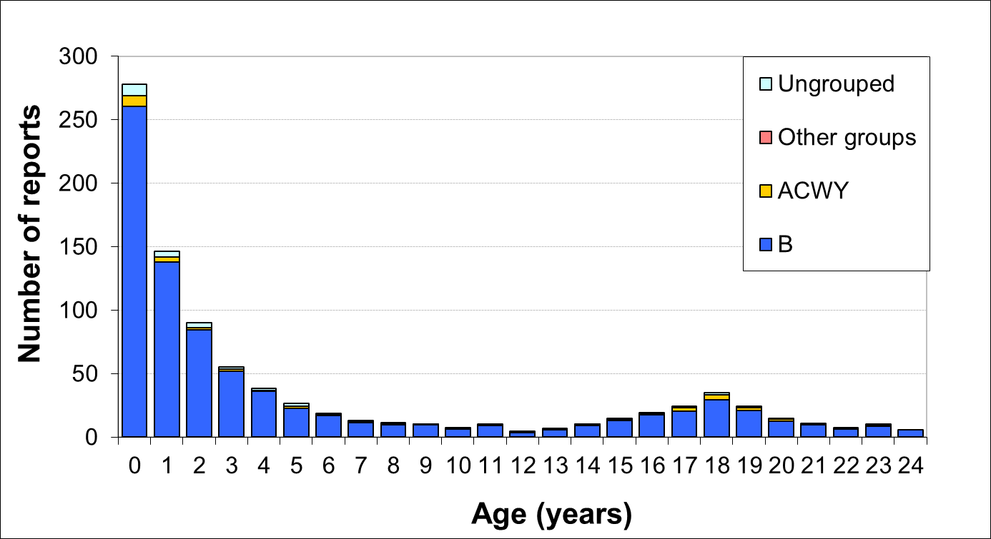
Invasive meningococcal disease by age England & Wales (2006/07-2010/11)

Slide 23
The role of Bexsero®
For direct protection against invasive meningococcal disease:
Prevent MenB disease in infants and young children
Need to achieve protection by 5 months of age (peak age)
Protection needs to last into second year of life
MenB carriage in infants and toddlers is very low, so there is no expectation of indirect (protection) from the programme
Teenagers form a less important target group:
Unless vaccine also offers indirect protection from reduced carriage rates
Impact of MenB on carriage currently uncertain

Slide 24
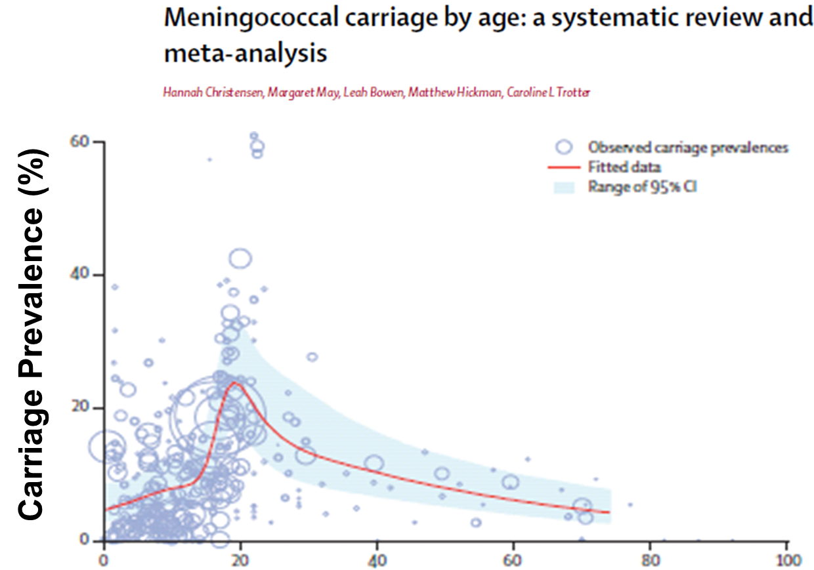

Slide 25
Cost-effective? Modelling scenarios
 | Undiscounted |  | 3·5% discounting for costs and benefits
Scenario description | Cases averted | Deaths averted | Cost per QALY gained | Vaccine price to reach threshold
2,3,4+12 months | 52152 | 1117 | £221,000 | £3
2,4+12 months | 51789 | 1110 | £163,100 | £7
13 years | 62165 | 2511 | £104,900 | £14
13 years PLUS CU in 14-17 years | 64667 | 2613 | £102,700 | £14
2,4+12 months and 13 years | 91118 | 3178 | £163,300 | £6
2,3,4+12 months and 13 years switching after 10 years to 2,4+12 months and 13 years | 91154 | 3178 | £174,000 | £5
Infant immunisation at 2 + 4 and 12-13 months could be cost-effective if Bexsero® can be obtained at a very low price

Slide 26
JCVI 2014 MenB recommendation
Concluded that the infant vaccine could be cost-effective but at a very low price
current low incidence does not favour vaccination
Teenage vaccination may be more cost-effective but the impact is much less certain
carriage protection and duration of protection could be crucial
no immediate impact on disease, would take >20 years to determine if vaccine was effective
Negotiations to procure at cost-effective price were concluded in late March 2015
Official Bi-partite letter announcing programme published on 21 June 2015

Slide 27
Summary: Bexsero® vaccination
Although MenB disease is declining, it is still a major public health problem: cause of mortality, severe morbidity and high anxiety in parents
UK will be the first country to use Bexsero® vaccine in routine infant programme
UK has higher incidence, large population, established surveillance programme and success of demonstrating impact of MenC vaccination programme
The 2-4-12 month schedule has been chosen to provide maximal protection in infants before the peak at 5 months

Slide 28
How are we implementing the new MenB infant immunisation programme?

Slide 29
Meningococcal B programme
Start date! 1 September 2015
Routine cohort: infants born on or after the 1 July 2015
Schedule: 2, 4 and 12-13 months (2+1)
Catch-up cohort: infants born from 1 May to 30 June 2015
Schedule: 3, 4 and 12-13 months (2+1)
Schedule: 4 and 12-13 months (1+1)
MenB vaccine should only be given with routine immunisation appointments due after 1st September
Children no longer eligible once they are 2 years old
Notes:
Bexsero® should be offered routinely to all babies born on or after 1 July 2015, when they attend for their first and third routine childhood immunisations, at the age of two months and again at four months. A booster should also be offered at 12-13 months of age together with current routine immunisations.
A limited one-off catch-up programme for infants born between 1 May 2015 and 30 June 2015 will also be offered. So any children born on or after 1 May 2015 should be vaccinated as below:
those who have not already received any routine vaccinations, should have MenB at the same time as their first and third routine infant vaccinations
those who have already received their first dose of routine vaccinations should have MenB at the same time as their second and third routine infant vaccinations
those who have already received their first and second dose of routine vaccinations should have MenB at the same time as their third routine infant vaccinations
a booster of MenB should also be offered at 12-13 months

Slide 30
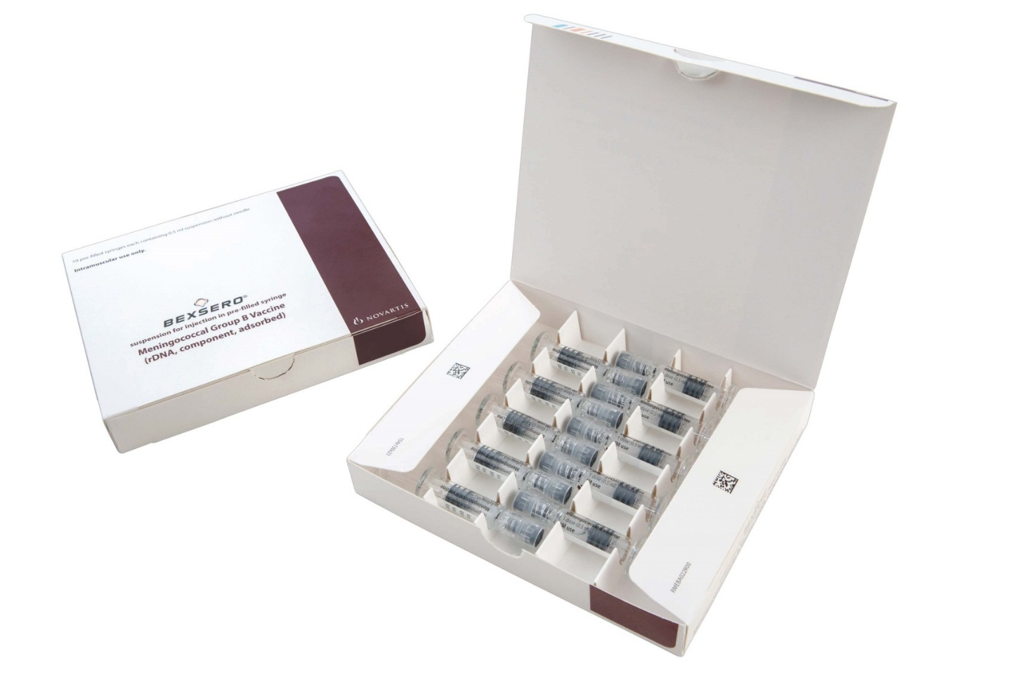
The MenB vaccine: Bexsero®
Bexsero® is the recommended vaccine for the routine infant immunisation programme and is the only market authorised MenB vaccine in the UK
Image courtesy of GlaxoSmithKline
Notes:
Bexsero® is the recommended vaccine for the routine infant immunisation programme and is the only market authorised meningococcal B vaccine in the UK. Bexsero® will be centrally supplied through Immform in packs of 10 pre-syringes.
** GlaxoSmithKline recently acquired Novartis global vaccine business which includes Bexsero® vaccine. Bexsero® is now owned and supplied by GlaxoSmithKline.

Slide 31
Bexsero® (GSK) supply
Vaccine ordering likely to commence early August via ImmForm*
Supplied by GSK (initially packaging will say ‘Novartis’ but this is likely to change in 2016).
Pack of 10 doses without needles, one PIL per pack
Additional PILs will be supplied with each pack of 10 ordered
Initial stocks will be relatively short dated (Apr 16) – don’t over order
The vaccine is ready to use (no reconstitution or dilution is required). *ImmForm website: www.immform.dh.gov.uk
Notes:
Confirmed date for opening ordering will be provided through ImmForm news item and in Vaccine Update in due course
Paracetamol – provided until systems to advise parents on the need to have paracetamol in advance of the vaccination appointment are well established.
Paracetamol will be (125mg/5ml)

Slide 32
Vaccine stock management
Ensure sufficient fridge space is available for the new vaccines
Don’t over-order – 2 to 4 weeks of stock is usually adequate
Remember the different pack sizes
Effective management of vaccines throughout the supply chain is essential to reduce vaccine wastage.
Small percentage reductions in vaccine wastage will have a major impact on the financing of vaccine supplies.
Any cold chain failures must be documented and reported to the local immunisation co-ordinator and reported through the ImmForm website on the stock incident page.

Slide 33
How is Bexsero® administered?
Bexsero® is a newly licensed vaccine that is subject to additional monitoring under the black triangle labelling scheme (MHRA)
The vaccines are supplied in packs containing 10 pre-filled syringes each with a volume of 0.5mls of suspension per syringe
During storage, the contents of the syringe may settle with off-white deposits being noticeable
Before use, the pre-filled syringe must be shaken well forming an homogenous suspension that should be administered immediately
Notes:
As Bexsero® is a newly licensed vaccine that is subject to additional monitoring under the black triangle labelling scheme by the Medicines and Healthcare Regulatory Agency (MHRA), it is recommended that Bexsero be administered on its own in the left thigh so that any local reactions can be monitored more accurately and reported to the MHRA using the Yellow Card Scheme. Other routine vaccines administered at 2, 3 and 4 months should be administered in the right limb. Where it is not practically possible to administer Bexsero® on its own, other routine vaccines can be administered in the left thigh at the same time as Bexsero rather than delaying immunisations. If more than one vaccine needs to be administered in the same limb, then it must be given at least 2.5cm apart. The sites at which each vaccine was given should be noted in the individual’s health records.
Bexsero® will be centrally supplied through Immform in packs containing 10 pre-filled syringes.
Healthcare professionals should chose the correct needle size to ensure intramuscular administration.
The vaccine must not be injected intravenously or intradermally and must not be mixed with other vaccines in the same syringe. For individuals with a bleeding disorder, vaccines normally given by an IM route should be given by deep subcutaneous injection to reduce the risk of bleeding .
For the composition and full list of excipients of the vaccine, please refer to the manufacturer’s Summary of Product Characteristics https://www.medicines.org.uk/emc/medicine/28407#EXCIPIENTS

Slide 34
How is Bexsero® administered?
The vaccine should not be administered where there are variations in physical appearance (i.e. not an homogenous suspension) or signs of foreign particulate are observed after shaking
Bexsero® has a shelf life of two years when stored in its original packaging in a refrigerator at the recommended temperatures of +2ºC and +8ºC. N.B. First batches have SHORT expiry date!!
Healthcare professionals are encouraged to familiarise themselves with Public Health England’s protocol for ordering, storing and handling of vaccines to ensure vaccines are stored and monitored as per national recommendations
Notes:
https://www.gov.uk/government/uploads/system/uploads/attachment_data/file/300304/Protocol_for_ordering__storing_and_handling_vaccines_March_2014.pdf

Slide 35
Where is Bexsero® administered?
It is recommend that Bexsero® be administered intramuscularly (IM) in the left thigh, ideally on it’s own, so that any local reactions can be monitored more accurately
If another vaccine needs to be administered in the same limb, then it must be given at least 2.5cm apart
The sites at which each vaccine was given should be noted in the individual’s health records
Bexsero® can be given at the same time as the other vaccines administered as part of the routine childhood immunisation programme, including pneumococcal, measles, mumps and rubella (MMR), diphtheria, tetanus, pertussis, polio and Hib.

Slide 36
Administration of Bexsero®
Bexsero® should only be administered:
Against a prescription written manually or electronically by a registered medical practitioner or other authorised prescriber
Against a Patient Specific Direction
Against a Patient Group Direction

Slide 37
Contraindications
Bexsero® should not be administered to those who have had:
a confirmed anaphylaxis to a previous dose of the vaccine OR
a confirmed anaphylaxis to any constituent or excipient of the vaccine
There are very few infants who cannot receive meningococcal vaccines . Where there is doubt, appropriate advice should be sought rather than withholding immunisation
Notes:
For the composition and full list of excipients of the vaccine, please refer to the manufacturer’s Summary of Product Characteristics https://www.medicines.org.uk/emc/medicine/28407#EXCIPIENTS
There are very few infants who cannot receive meningococcal vaccines. Where there is doubt, appropriate advice should be sought from a consultant paediatrician with immunisation expertise, a member of the screening and immunisation team or from your local health protection rather than withholding immunisation.

Slide 38
Precautions
Minor illnesses without fever or systemic upset are not valid reasons to postpone immunisation
Pregnancy and breast-feeding
Meningococcal vaccines may be given to pregnant women when clinically indicated. There is no evidence of risk from vaccinating pregnant women or those who are breast-feeding with inactivated virus or bacterial vaccines or toxoids
Premature infants
It is important that premature infants have their immunisations at the appropriate chronological age, according to the schedule
Immunosuppression and HIV infection
Those with immunosuppression or human immunodeficiency virus (HIV) infection (regardless of CD4 count) should be given meningococcal vaccines in accordance with the routine schedule
Notes:
Minor illnesses without fever or systemic upset are not valid reasons to postpone immunisation. If an individual is acutely unwell, immunisation may be postponed until they have recovered fully. This is to avoid confusing the differential diagnosis of any acute illness by wrongly attributing any signs or symptoms to the adverse effects of the vaccine.
Pregnancy and breast-feeding
Meningococcal vaccines may be given to pregnant women when clinically indicated. There is no evidence of risk from vaccinating pregnant women or those who are breast-feeding with inactivated virus or bacterial vaccines or toxoids (Granoff et al., 2008). In cases where meningococcal immunisation has been inadvertently given in pregnancy, there has been no evidence of harm to the foetus.
Premature infants
It is important that premature infants have their immunisations at the appropriate chronological age, according to the schedule. The occurrence of apnoea following vaccination is especially increased in infants who were born very prematurely.
Very premature infants (born 28 weeks of gestation) who are in hospital should have respiratory monitoring for 48-72 hrs when given their first immunisation, particularly those with a previous history of respiratory immaturity. If the child has apnoea, bradycardia or desaturations after the first immunisation, the second immunisation should also be given in hospital, with respiratory monitoring for 48-72 hrs (Ohlsson et al., 2004; Pfister et al., 2004; Schulzke et al., 2005; Pourcyrous et al., 2007; Klein et al., 2008). As the benefit of immunisation is high in this group of infants, immunisation should not be withheld or delayed.
Immunosuppression and HIV infection
Individuals with immunosuppression and human immunodeficiency virus (HIV) infection (regardless of CD4 count) should be given meningococcal vaccines in accordance with the routine schedule. These individuals may not make a full antibody response. Re-immunisation should be considered after treatment is finished and recovery has occurred. Specialist advice may be required.
For further information on contraindications and precautions, please refer to the meningococcal Green Book chapter online at https://www.gov.uk/government/collections/immunisation-against-infectious-disease-the-green-book

Slide 39
Summary: Bexsero® Programme
The MenB vaccination programme will start on 01 September 2015
Infants will be immunised at 2-4-12 months with their routine immunisations
Limited catch-up for those attending for their 3 and 4 month vaccinations
Bexsero® should be given in the left thigh, ideally on it’s own, so that any local reactions can be monitored more accurately
Precautions and contra-indications are similar to the other vaccines in the infant programme
Storage requirements, vaccine administration and prescribing are the same as the other vaccines in the infant programme

Slide 40
How can we prevent fever after MenB vaccination?

Slide 41
Adverse reactions to 4CMenB
Bexsero® is associated with higher rates of local and systemic reactions when give with other routine infant vaccinations
similar to those seen with whole cell pertussis vaccines
Systemic effects tend to be additive when given with other vaccines
For example, any fever was seen following:
26-41% of Bexsero® doses when administered alone,
23-36% after routine vaccines given alone
51-61% after Bexsero® and routine vaccines administered together
Notes:
Most commonly reported adverse events following Bexsero® vaccination include: Fever (>38ºC), tenderness at the injection site (including severe tenderness), rash, swelling or induration at the injection site, irritability, change in feeding/eating, sleepiness and unusual crying
When Bexsero was administered with routine vaccinations, between 51 and 61% of infants developed a fever, compared to a quarter to a third of infants receiving Bexsero alone or the routine vaccines alone

Slide 42
BEXSERO® Tolerability in Infants Solicited local reactions when BEXSERO is given separately from routine vaccines—post–dose 1
BEXSERO 2-4-6 + Routine 3-5-7† | Injection-site data shown in figure
BEXSERO 2-4-6 | BEXSERO
Routine 3-5-7† | PCV7
Routine 3-5-7† | DTaP-HBV-IPV/Hib
% of infants
Erythema
Tenderness
Induration
Swelling
Post–dose 1*
*No increase in the incidence or severity of the adverse reactions was seen with subsequent doses of the vaccination series; Hatched lines represent severe (erythema, swelling and induration were categorized as severe if local reaction was >50 mm). Tenderness was categorized as severe if subject cried when injected limb was moved).
†Routine vaccines: PCV7 and DTaP-HBV-IPV/Hib; BEXSERO: N=626; Routine: N=613.
1. Gossger N, et al. JAMA. 2012;307:573-582; 2. Data on file, Novartis Vaccines and Diagnostics.
Notes:
V72P12study report/pdf/p 138/Table 12.2.3-1a; p 140/Table 12.2.3-1b; p 141/Table 12.2.3-1c
Gossger supplement/p 2/eTable
Severity footnote/ V72P12study report/pdf/p 83/Table 9.5.1.2.1-1: Local and Systemic Reaction Grading
In this clinical trial in infants, when BEXSERO® was given separately from routine vaccines, the rates of local reactions to BEXSERO were slightly higher compared with routine vaccines alone.
For all vaccines, however, the majority of injection-site reactions was mild or moderate and all reactions were transient.

Slide 43
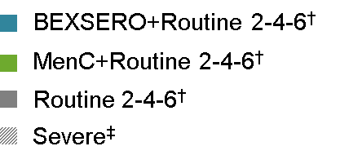
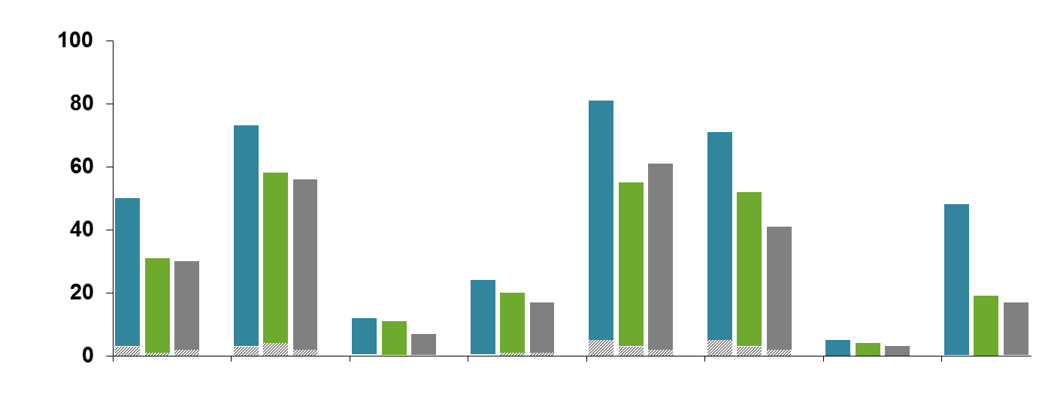
BEXSERO® Tolerability in Infants Solicited systemic reactions when BEXSERO is given with routine vaccines—post–dose 1
% of infants
Changed eating habits
Sleepiness
Vomiting
Diarrhea
Irritability
Unusual crying
Rash
Fever ≥38.5°C
Post–dose 1
*No increase in the incidence or severity of the adverse reactions was seen with subsequent doses of the vaccination series.
†Routine vaccines: PCV7 and DTaP-HBV-IPV/Hib; BEXSERO+Routine: N=2478; MenC+Routine: N=490; Routine: N=659.
‡ Fever was categorized as severe if temperature was ≥40°C. All other reactions were categorized as severe if subject was unable to perform normal daily activities.
1. Vesikari T, et al. Lancet. 2013;381:825-835; 2. Data on file, Novartis Vaccines and Diagnostics; 3. BEXSERO [summary of product characteristics]. Siena, Italy: Novartis Vaccines and Diagnostics S.r.l.; January 14, 2013.
Notes:
V72P13 study report/pdf p168-169/Table 12.2.3-8 (Vaccine #1 any)
P431/Table 14.3.1.1.3.6 for fever
P13 CSR/p35 pdf/safety highlight (for “routine vaccines”
Bexsero SMPC p 6/Sect 4.8/para 5 (for footnote)
Severity footnote: P13 CSR/p93 pdf and p 95/Table 9.5.1.2.1-1 for fever
In infants and children toddlers, the most common solicited systemic adverse reactions observed in clinical trials were fever and irritability.
These reactions were generally a little more common in infants receiving Bexsero with their routine vaccinations compared with other vaccines given without Bexsero
In general, all reactions were mild to moderate in severity and of limited duration; most occurred within 3 days following vaccination.
The most notable difference was the higher rates of fever following Bexsero vaccination with routine infant vaccines

Slide 44
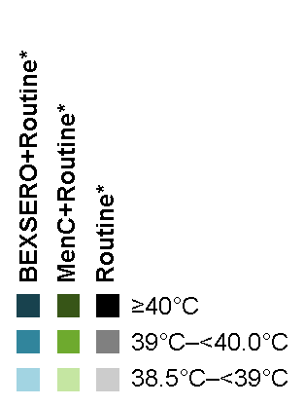
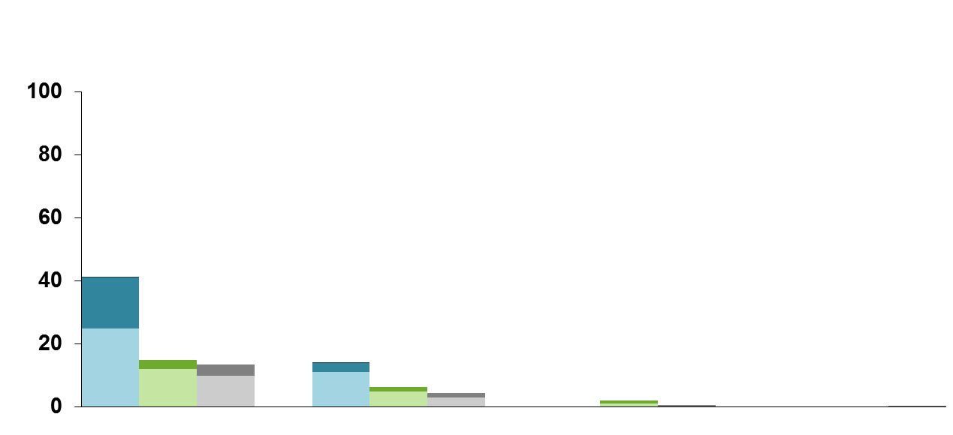
When fever occurred, it generally followed a predictable pattern, with the majority resolving the day after vaccination BEXSERO® given with routine vaccines—post–dose 1
Post–dose 1
(2-4-6 month dosing schedule)
% of infants
6 hrs
24 hrs
48 hrs
72 hrs
Time
*Routine vaccines: PCV7 and DTaP-HBV-IPV/Hib; BEXSERO+Routine: N=2433–2478; MenC+Routine: N=486–490; Routine only: N=643–659.
Fever was defined as rectal temperature ≥38.5°C.
1. Vesikari T, et al. Lancet. 2013;381:825-835; 2. Data on file, Novartis Vaccines and Diagnostics; 3. BEXSERO [summary of product characteristics]. Siena, Italy: Novartis Vaccines and Diagnostics S.r.l.; January 14, 2013.
Notes:
In clinical trials in infants, fever occurred more frequently when BEXSERO® was co-administered with routine vaccines compared with routine vaccines only.
When fever occurred, it generally followed a predictable pattern, with the majority resolving by the day after vaccination.
Temperatures in infants receiving BEXSERO plus routine vaccines were highest 6 hours post-vaccination, declined the day after vaccination and were normal by 2 days after vaccination.
Fever ≥40°C was uncommon (frequency (≥1/1000 to <1/100).
Febrile convulsions too were rare. Typically, febrile convulsions occur from 6 months to 5 years of age
In one of the largest infant Bexsero® trials, where 1885 infants were recruited and vaccinated at four different visits without paracetamol prophylaxis, only one infant developed a febrile convulsion two days after receiving Bexsero®.
In the subsequent study of 364 infants receiving Bexsero® with or without paracetamol, there wasn’t a single case of febrile convulsion after any of the vaccination visits
V72P13 study report/pdf p570, 582, 630/Table Table 14.3.1.1.4.3 (Vaccine #1)
V72P13 study report/p36 pdf/yellow highlight
Bexsero SMPC p 6/Sect 4.8/para 5; p 6/para 6,7
V72P13 /p35 pdf/safety highlight (for “routine vaccines”
Bexsero/SmPC/p6/sect 4.8/para 3

Slide 45
In general, the frequency of medically attended fever was low
Percentage of Subjects With Medically Attended Fever (Number of Subjects With Medically Attended Fever/Total Number of Subjects)
 |  | BEXSERO® Vaccine + Routine Vaccines* | MenC+ Routine Vaccines*
Observer-Blind Subset | Any dose | 5.3% (26/493) | 2.8% (13/470)
 |  | BEXSERO Vaccine + Routine Vaccines* | Routine Vaccines*
Open-Label Subset | Any dose | 1.4% (28/1966) | 1.8% (12/659)
Medical intervention less likely with knowledge
of vaccine received
*Routine vaccines: PCV7 and DTaP-HBV-IPV/Hib.
Vesikari T, et al. Lancet. 2013;381:825-835.
Notes:
V72P13 study report/pdf p170/Table 12.2.3-9 (row: all)
For footnote:
V72P13 study report/p92 and p93 pdf/highlight
In a large clinical trial involving more than 3600 participants, the higher rates of fever did not result in increased rates of medical attention.
The reduced rate of medically-attended fever in the open-label subset suggests that informing parents of an expected fever pattern may reduce concern.
The education of parents regarding the management of fever associated with vaccines is important.
Vesikari The Lancet 2013/p 831/col 1/para 2

Slide 46
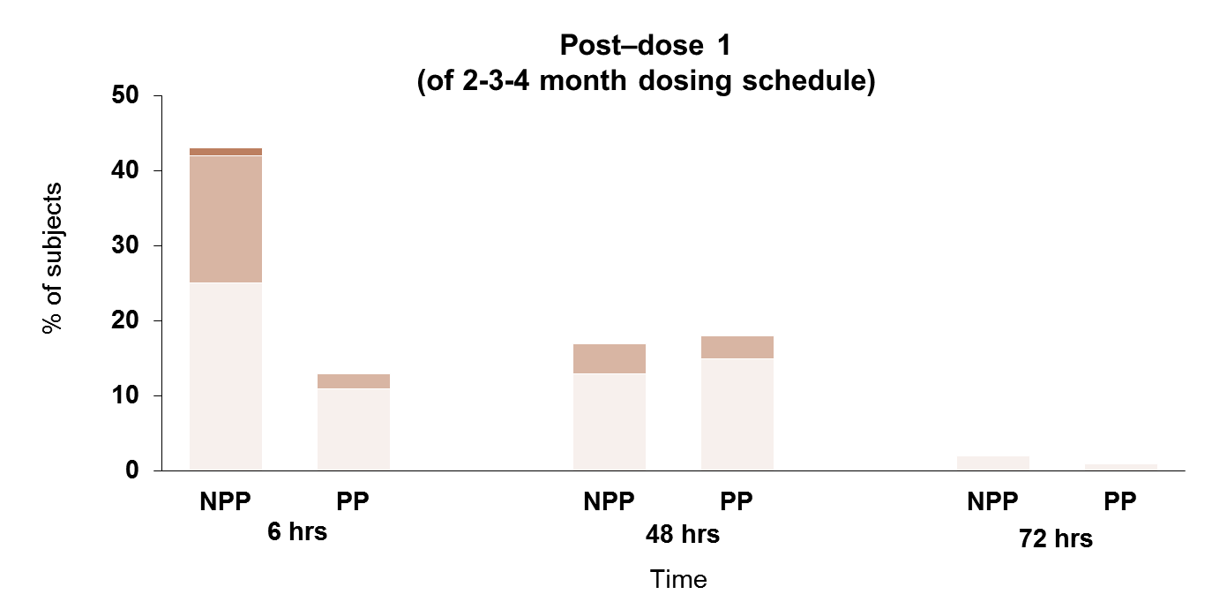
Prophylactic Paracetamol at the Time of and Closely After Vaccination Reduced Fever When BEXSERO® is given concomitantly with routine infant vaccines
≥40°C
39°C–<40.0°C
38.5°C–<39°C
NPP: no prophylactic paracetamol (N=182); PP: with prophylactic paracetamol (N=178-179). Routine vaccines: PCV7 and DTaP-HBV-IPV/Hib.
1. Prymula R, et al. Presented at: 29th Annual Meeting of the European Society for Paediatric Infectious Disease (ESPID); June 7-10, 2011; The Hague, The Netherlands. Poster #631; 2. Data on file, Novartis Vaccines and Diagnostics; 3. BEXSERO [summary of product characteristics]. Siena, Italy: Novartis Vaccines and Diagnostics S.r.l.; January 14, 2013.
Notes:
The administration of paracetamol at the time of vaccination has been shown to significantly reduce the rate and intensity of fever after vaccination
In one clinical study in infants, paracetamol administered prophylactically before vaccination with BEXSERO® was shown to reduce the fever associated with concomitant administration of BEXSERO and routine vaccines.
The greatest benefit was observed in the first 6 hours after vaccination
V72P16 CSR/p 1165/Table 14.3.1.1.3.29; p 1291/Table 14.3.1.1.3.29
For routine vaccines: V72P16 CSR/p 72/para 2

Slide 47
NICE guidance on management of feverish illness in children under 5 years (2007/2013)
Use of antipyretic agents
Antipyretic agents do not prevent febrile convulsions and should not be used specifically for this purpose.
Do not use antipyretic agents with the sole aim of reducing body temperature in children with fever.
Consider using either paracetamol or ibuprofen in children with fever who appear distressed.
JCVI recommended that paracetamol should not be routinely offered prophylactically to infants at the time of their primary immunisations because it may interfere with vaccine responses
Notes:
The NICE guidance on management of feverish illness in young children recommends that ……
In 2009, one randomised controlled trial found that, while prophylactic paracetamol reduced the rates of fever after vaccination in infants, it also affected the immune response to several of the vaccine antigens. More importantly, the impaired immune responses persisted ever after the booster in the second year of life.
Because of this study, the Joint Committee on Vaccination and Immunisation recommended that …

Slide 48
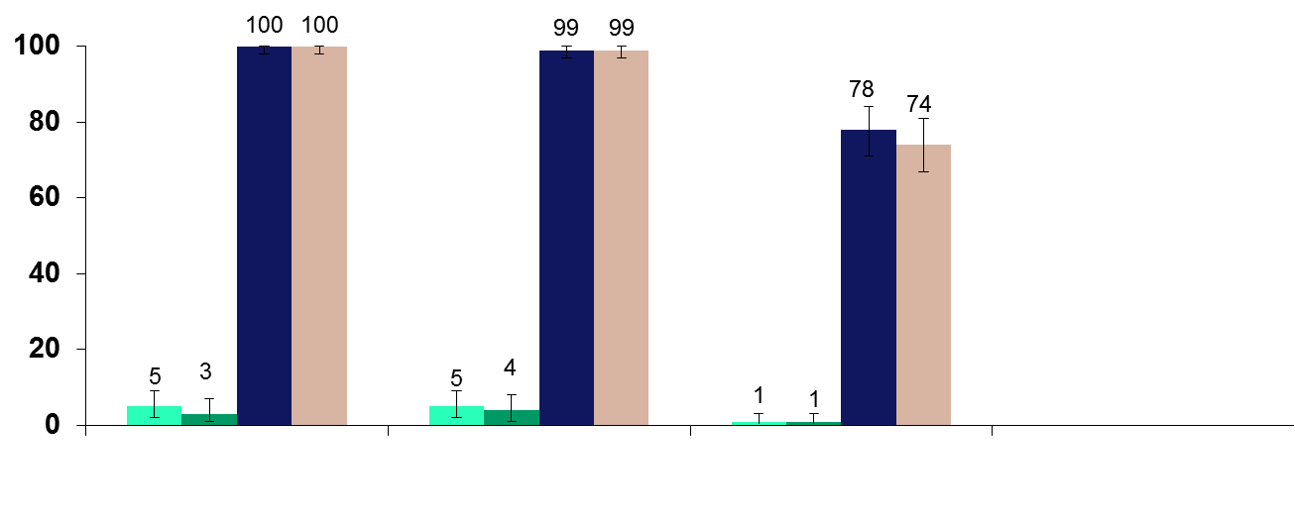
Prophylactic Paracetamol at the Time of and Closely After Vaccination Did Not Impact Immunogenicity of BEXSERO® BEXSERO given concomitantly with routine infant vaccines 2-3-4 month schedule
BEXSERO+routine at baseline*
BEXSERO+routine+paracetamol at baseline†
BEXSERO+routine at 1 month post‒final dose*
BEXSERO+routine+paracetamol at 1 month post‒final dose†
Infants with hSBA ≥1:5 (%)
NT
fHbp
NadA
PorA P1.4
NHBA
*N=165–171; †N=160–169. Routine vaccines: PCV7 and DTaP-HBV-IPV/Hib.
NT=not tested.
1. Prymula R, et al. Presented at: 29th Annual Meeting of the European Society for Paediatric Infectious Disease (ESPID); 7-10 June 2011; The Hague, The Netherlands; Poster #631; 2. BEXSERO [summary of product characteristics]. Siena, Italy: Novartis Vaccines and Diagnostics S.r.l.; January 14, 2013.
Notes:
However, the clinical trial assessing the effect of prophylactic paracetamol on fever after Bexsero is given with the routine infant vaccinations found that the bactericidal antibody responses against the Bexsero antigens were not affected
Prymula ESPID 2011/col 1/Background/bullet 4 (For “routine vaccines”)
V72P16 CSR/p 129-130/Table 11.4.1-2
SmPC/p 9/Table 2

Slide 49
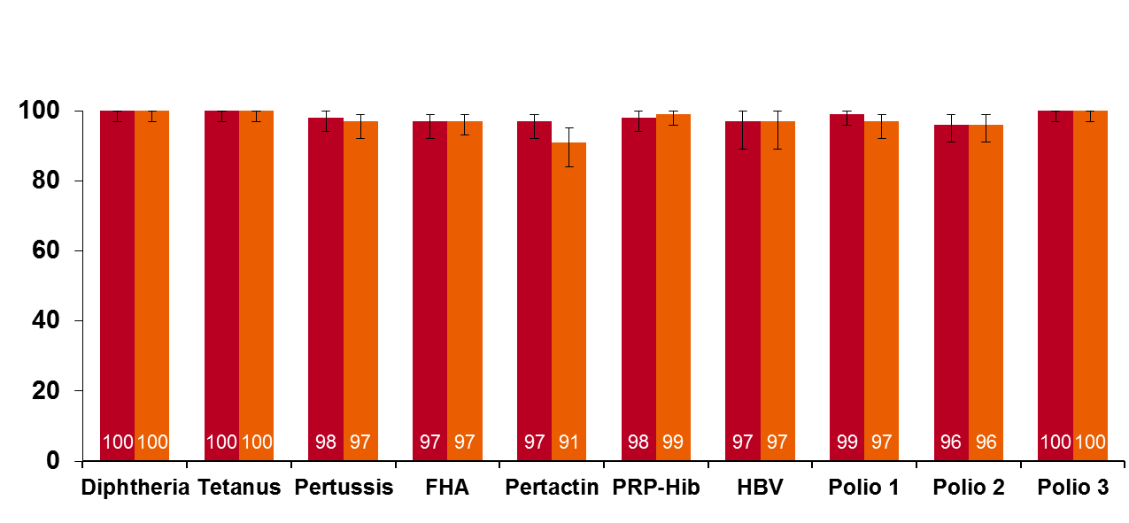
Prophylactic Paracetamol Did Not Impact Immunogenicity of Routine Vaccines BEXSERO® given concomitantly with routine infant vaccines 2-3-4 month schedule
BEXSERO plus routine vaccines
BEXSERO plus routine vaccines and paracetamol
0%
(–3, 3)
0%
(–3, 3)
–2%
(–7, 3)
1%
(–4, 6)
–6%
(–13, 0)
1%
(–2, 5)
0%
(–8, 8)
–3%
(–8, 1)
0%
(–6, 6)
0%
(–3, 3)
% Seroresponders
% ≥0.1 IU/mL
N=135–140
% ≥0.1 IU/mL
N=135–140
toxin
% ≥0.15 mcg/mL
% ≥10 mIU/mL
% ≥1:8
N=119–124
N=119–125
N=119–125
N=135–140
N=65–66
N=120–123
N=120–123
N=120–123
Antigens
Blood draw at 5 months. Routine vaccines: PCV7 and DTaP-HBV-IPV/Hib.
1. Prymula R, et al. Presented at: 29th Annual Meeting of the European Society for Paediatric Infectious Disease (ESPID); 7-10 June 2011; The Hague, The Netherlands; Poster #631; 2. BEXSERO [summary of product characteristics]. Siena, Italy: Novartis Vaccines and Diagnostics S.r.l.; January 14, 2013.
Notes:
The same study also showed that vaccine responses to the routine infants vaccinations were comparable in infants receiving prophylactic paracetamol at the time of vaccination with Bexsero and the routine infant vaccines
Prymula ESPID 2011/col 1/Background/bullet 4 (For “routine vaccines”)
Col 3/para 1 (for blood draw at 5 mo)
V72P16 CSR/p 146/Table 11.4.1-5; p 148/Table 11.4.1-7; p 150/Table 11.4.1-9; p 153/Table 11.4.1-11; p 155/Table 11.4.1-13; p 157/Table 11.4.1-15

Slide 50
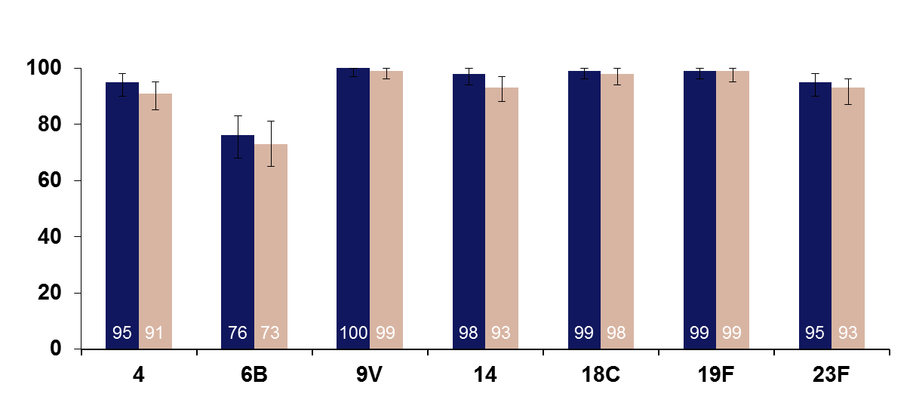
Prophylactic Paracetamol Did Not Impact Immunogenicity of PCV7 BEXSERO® given concomitantly with routine infant vaccines 2-3-4 month schedule
BEXSERO plus routine vaccines*
BEXSERO plus routine vaccines* and paracetamol
4%
(–11, 2)
–1%
(–4, 2)
–5%
(–10, 0)
–2%
(–6, 2)
–1%
(–5, 3)
–2%
(–9, 4)
–2%
(–13, 8)
% Seroresponders (≥0.35 mcg/mL)
†
Pneumococcal serotype
*N=135–140.
Blood draw at 5 months. Routine vaccines: PCV7 and DTaP-HBV-IPV/Hib.
1. Prymula R, et al. Presented at: 29th Annual Meeting of the European Society for Paediatric Infectious Disease (ESPID); 7-10 June 2011; The Hague, The Netherlands; Poster #631; 2. BEXSERO [summary of product characteristics]. Siena, Italy: Novartis Vaccines and Diagnostics S.r.l.; January 14, 2013.
Notes:
Similarly, vaccine responses to the 7-valent pneumococcal conjugate vaccines were also not affected
Prymula ESPID 2011/Col 1/Background/bullet 4 (for “routine vaccines”)
Col 3/para 1 (for blood draw at 5 mo)
V72P16 CSR/p 159-160/Table 11.4.1-17

Slide 51
Notes:
Most importantly, the medical attendance rate for fever after vaccination was very low in this clinical trial

Slide 52
Systematic review in 2014 The effect of prophylactic antipyretic administration on adverse reactions and antibody response in children
Also reduction in
Pain, swelling and redness at injection site
Irritability, drowsiness, persistent crying and loss of appetite
Although reduction in antibody was observed, size of reduction was considered unlikely to result in clinically significant reduction in protection
Das RR et al PLoS ONE 9(9): e106629. doi:10.1371/journal.pone.0106629
Notes:
The effectiveness of prophylactic paracetamol, but not ibuprofen, in reducing rates of fever after vaccination was recently assessed in a systematic review.
The systematic review also showed significant benefits of prophylactic paracetamol against Pain, swelling and redness at injection site, Irritability, drowsiness, persistent crying and loss of appetite

Slide 53
Timing of paracetamol doses with other infant vaccines
 | PCV13 + Infanrix Hexa + Paracetamol Twice Daily | PCV13 + Infanrix Hexa + Ibuprofen Twice Daily | PCV13 + Infanrix Hexa + Paracetamol Thrice Daily | PCV13 + Infanrix Hexa + Ibuprofen Thrice Daily | PCV13 + Infanrix Hexa
Number of Participants | 149 | 157 | 147 | 155 | 187
Percentage of Participants Reporting Fever Within 4 Days:
Fever ≥38 - ≤39 ºC | 32.9 | 45.2 | 18.4 | 34.2 | 41.7
Fever >39, ≤40 ºC | 1.4 | 1.4 | 0.7 | 0.7 | 1.2
Fever >40 ºC | 0.0 | 0.0 | 0.0 | 0.0 | 0.0
Clinical Trials .gov: Study Assessing the Effect of Medications to Prevent Fever on Prevenar 13® https://www.clinicaltrials.gov/ct2/show/NCT01392378?term=vaccine+paracetamol+ibuprofen&rank=2
Notes:
In another, as yet unpublished clinical trial, three doses of prophyliactic paracetamol, with the first dose of paracetamol given around the time of vaccination led to significantly lower rates of fever compared to two doses of prophylactic paracetamol with the first dose given at 6 hours after vaccination

Slide 54
Summary of evidence on paracetamol
Fever is common after Bexsero® and fever rates are additive to those normally seen after infant vaccines
Concern about high rate of medical attendance
Fever peaks at six hours after vaccine, uncommon after 48 hours
Rates and intensity of fever reduced by prophylactic paracetamol
Bexsero® only tested with three doses of paracetamol
Immunogenicity of concomitant infant vaccines not reduced when given with paracetamol and Bexsero®
Studies with other infant vaccines (Infanrix-Hexa and PCV13)
Paracetamol preferable to ibuprofen at preventing fever
Paracetamol also reduces other systemic and local reactions
three doses of paracetamol starting immediately is better than two doses starting at 6 hours (suggests first dose is the most important)
Notes:
READ SUMMARY

Slide 55
Product information: Infant paracetamol
Current product label: only indication for paracetamol in children aged 2 months is for post-vaccination fever
Only 2 doses should be given before seeking medical care
Rationale is NOT about toxicity, it's about potential to miss serious bacterial infection
MHRA Submission made to Commission on Human Medicines
Higher doses of paracetamol are used routinely in hospital setting
Incidence of serious bacterial infection falls after the first month of life and does not differ significantly between 2 and 3 months of age
Fever following vaccination will be common, but usually resolves by 48 hours after vaccination
Notes:
The current product label states that the only indication for paracetamol in infants aged 2 months is for post-vaccination fever.
The label also states that only tow doses can be given before seeking medical care
This recommendation was made not because of concerns about toxicity but because of potential to miss a serious underlying infection
Therefore, the MHRA made a submission to the commission on human vaccines to amend the current label since …..

Slide 56
Commission on Human Medicines (Conclusion – ratified on 18th June)
No concern about toxicity in 2 month old infants
Happy to accept JCVI advice for three prophylactic doses
Also safe to use paracetamol for treatment of fever for up to 48 hours after vaccination
This recommendation does not extend to fever at any other time: if the infant is unwell, parents should trust their instincts and not delay seeking medical attention
It is hoped that infant paracetamol suspension manufacturers will update product packaging and literature in due course
“Healthcare professionals are reminded that in some circumstances the recommendations regarding vaccines given in the Green Book chapters may differ from those in the Summary of Product Characteristics (SPC). When this occurs, the recommendations in the Green Book are based on current expert advice received from the JCVI and should be followed”
Notes:
The conclusions of the submission were that:
1. ….

Slide 57
Implementation: proposed approach to paracetamol
Need to alert parents before the immunisation session that paracetamol is recommended, so plan is to
Flag in red book and any baby literature (e.g. Bounty)
Reinforced by health visitors at 10 day visit, GPs at 6 week check
Patient information leaflets should be given before 8 week appointment
In interim, given proposed start date of September, need to avoid parental concern – especially if late afternoon and pharmacy may be closed
will offer one sachet and syringe at first visit only for first year
long term, we hope parents will source their own supply
Notes:
The implementation of paracetamol prophylaxis at 2 and 4 months of age will require alerting parents of the need to buy some infant oral paracetamol suspension before their first immunisation clinic appointment
In the meantime, however, given that the programme is supposed to start imminently, Gp surgeries will be able to offer single paracetamol sachets with a syringe at the first clinic visit only for the first year of the programme
After this time, we hope that parents will source their own supply

Slide 58
Dosage & timing of infant Paracetamol suspension (120mg/5ml) for the routine immunisation programme at 2 + 4 months
Age of baby | Dose 1 | Dose2 | Dose 3
2 months / 4 months | 2.5ml as soon as possible after vaccination | 2.5ml,4-6 hours after 1st dose | 2.5ml, 4-6 hours after 2nd dose
If baby still febrile after the first three doses of paracetamol but is otherwise well, parents can continue giving paracetamol at recommended intervals up to 48 hours post-vaccination. Do not exceed four doses in a day.
If any concern at all speak to GP or call NHS 111.
Notes:
The recommended dose and schedule for prophylactic paracetamol is summarised in this table.
At their two and four month immunisation clinic visit, parents should be advised to give the first dose of paracetamol as soon as possible after vaccination followed by two further doses at 4-6 hour intervals.
If their infants still has fever after the three doses but is otherwise well, then parents can continue giving paracetamol at recommended intervals up to 48 hours post-vaccination without exceeding four doses in a 24 hour period.
Parents should also be advised to speak to their GP or call NHS 111 if their baby looks unwell or if they are concerned about their child at any time

Slide 59
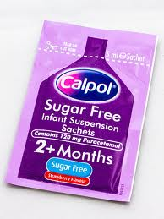
Ordering paracetamol and syringes
GP practices will be able to order paracetamol oral suspension sachets and accompanying syringes via ImmForm for an initial period of a few months (likely in boxes of 12 sachets). PHE ‘paracetamol’ leaflets will be supplied alongside
Single 5ml sachet of paracetamol suspension (120mg/5ml) should be offered to parents who do not have timely access to over-the-counter paracetamol
Parents should be instructed to buy some infant strength paracetamol suspension to complete the two remaining recommended doses at home
X1 Sachet + syringe
Notes:
GP surgeries will be able to order liquid infant paracetamol and syringes via Immform during the first few months of the programme
The sachets should be offered to parents who do not have timely access to over the counter paracetamol
Most local pharmacies, supermarkets and many local stores stock liquid infant paracetamol suspension

Slide 60
Do nurses need a PGD to supply or administer paracetamol
Despite liquid infant paracetamol being available to purchase from pharmacists and supermarkets, nurses and midwives can only supply or administer medicines using a recognised process as set out in the Nursing and Midwifery Council’s Standards for Medicines Management
To enable nursing colleagues to practice in accordance with this standard, Public Health England (PHE) will make available a Homely Remedy Protocol for the supply of liquid infant paracetamol
A PGD is not a legal requirement for the supply or administration of over-the-counter medicines
Notes:
Although paracetamol is available to purchase over the counter, nurses and midwives can only supply or adminster medicines using a recognised process
For the purposes of prophylactic paracetamol with Bexsero vaccination, public health england will make available a HOMELY REMEDY protocol.
A PGD is not a legal requirement for the supply or administration of over the counter medicines

Slide 61
Summary: reducing fever after vaccination
Fever after vaccination with or without Bexsero® is common and usually <39ºC
Fever is a normal and expected response of the immune system against the vaccine antigens and not harmful
Parents are often concerned about the risk of febrile convulsions or “fever fits”
Parents should be reassured that febrile convulsions generally occur in infants from 6 months to 5 years of age and are very uncommon in younger age groups
It is important that parents are reassured and are advised of the importance of administering prophylactic paracetamol to reduce the risk and intensity of post-immunisation fever
Notes:
Summarise slide

Slide 62
How can we control the increase in Meningococcal group W disease?
Notes:
Background
In 2015, Public Health England (PHE) reported a continued, year on year increase in meningococcal capsular group W (MenW) cases in England. The rise was initially recorded in 2009 and since this time, cases have steadily increased, rising from 11 cases in 2009 to 117 cases in 2014. In January 2015, 34 laboratory confirmed cases were notified to PHE, compared to 18 cases in 2014 and 9 cases in 2013 in the same period.
Although cases of meningococcal disease overall have been in decline since 2000, cases of meningococcal W were first observed in previously healthy adults in 2009 and by 2011, cases had extended across all age groups and across all regions in England, indicating that the strain had become endemic. For the first time in a decade, meningococcal W related deaths have been observed in young children and an increase in meningococcal W cases among students attending universities across the country suggests that carriage and transmission of the bacteria has become established.
In February 2015, the Joint Committee on Vaccination and Immunisation (JCVI) agreed that the current increase in meningococcal W cases in England and Wales constituted an outbreak situation and recommended a vaccination programme aimed at protecting adolescents against meningococcal capsular groups ACW and Y strains. This was felt to be the best option to generate population level herd protection, which should provide protection to all age groups.
Rationale of resource
This resource is designed to support and inform healthcare professionals around the importance of immunising adolescents against meningococcal capsular group W disease, providing evidence based information around the implementation and delivery of the meningococcal capsular group W programme in England.
Note: Meningococcal capsular group W is commonly referred to as MenW. For the purpose of this resource MenW is used throughout this document.

Slide 63
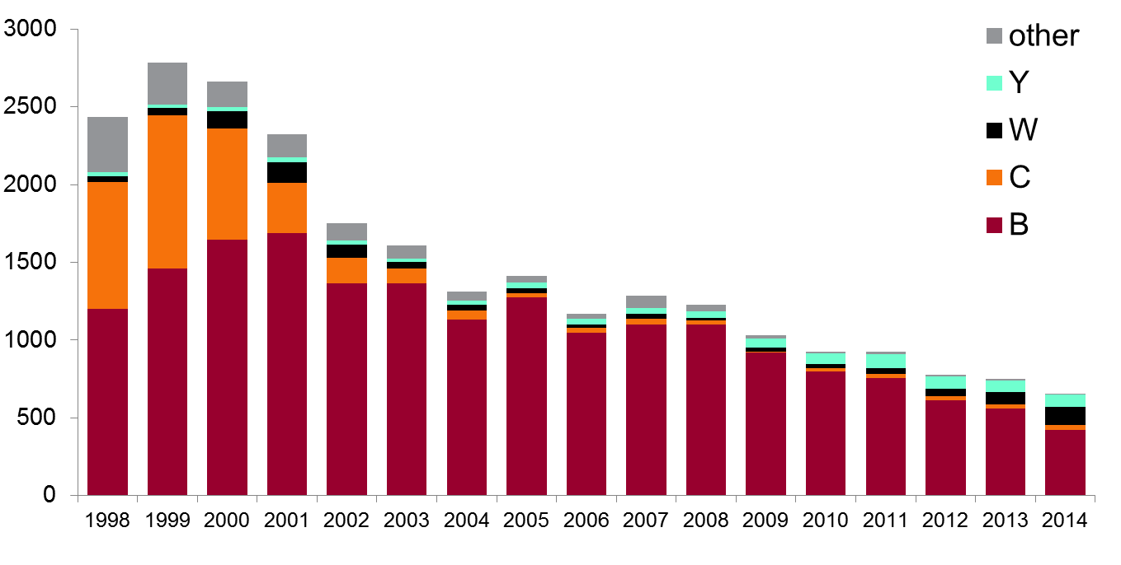
Outline
Laboratory confirmed cases
invasive meningococcal disease
England and Wales

Slide 64
MenW cases in England
MenB infections continue to decline
MenW infections have increased since 2009
Year | MenW
2009 | 23
2010 | 27
2011 | 33
2012 | 46
2013 | 78
2014 | 119

Slide 65
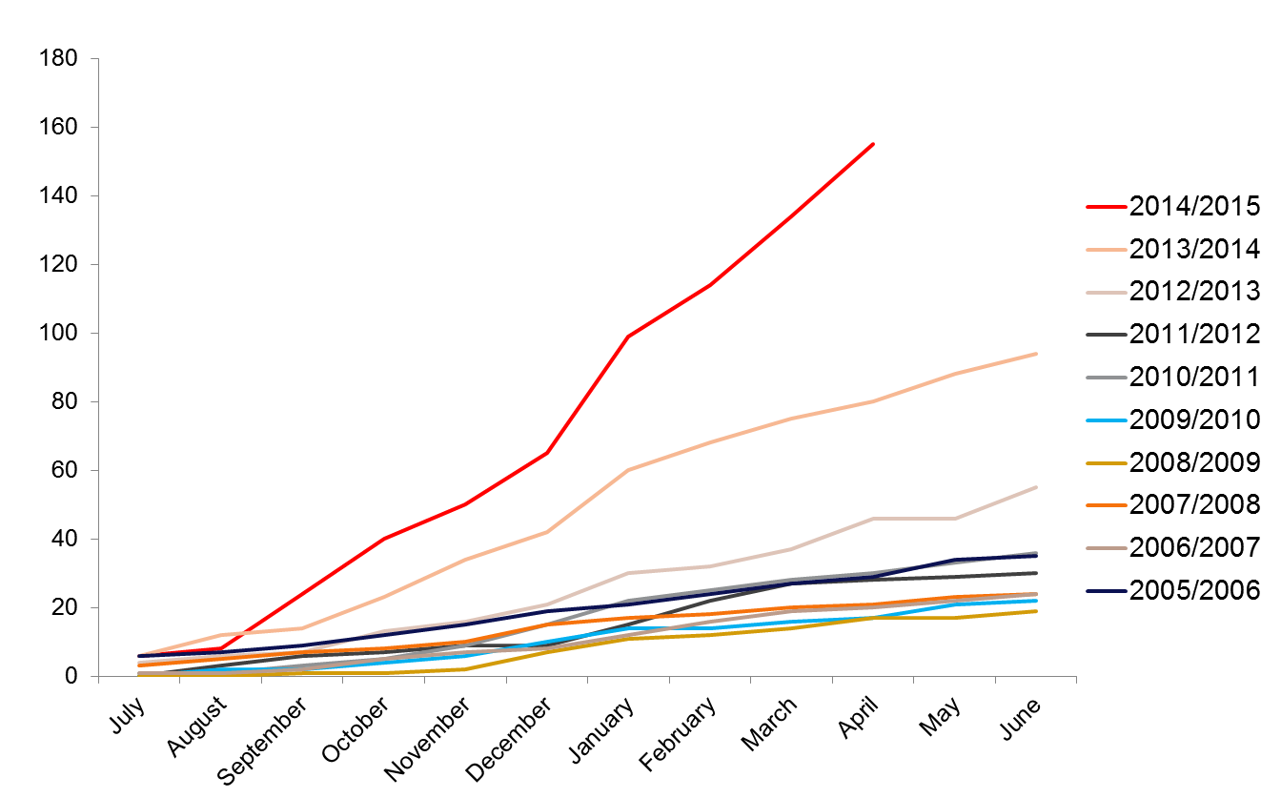
Cumulative MenW cases by
epidemiological year (July to June) in England

Slide 66
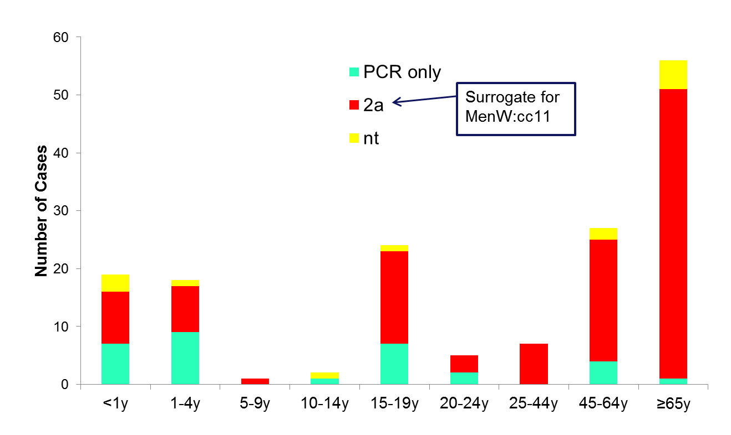
Typing of MenW cases in 2014/15

Slide 67
Emergence of MenW in England
Increase associated with emergence of a specific virulent clone since 2008 (phenotyped as 2a:1.5,2)
Incidence doubled in each of past two years
Emerging strain is member of ST-11 clonal complex, associated with increase in disease incidence and high case fatality ratios in recent years
As group C, in UK and Europe in late 1990s
As group W, Hajj-associated outbreak early 2000s
As group W, African epidemics 2002-2004
As group W, in S. America and S. Africa
Sequencing shows current strain is similar to that causing disease in South America

Slide 68
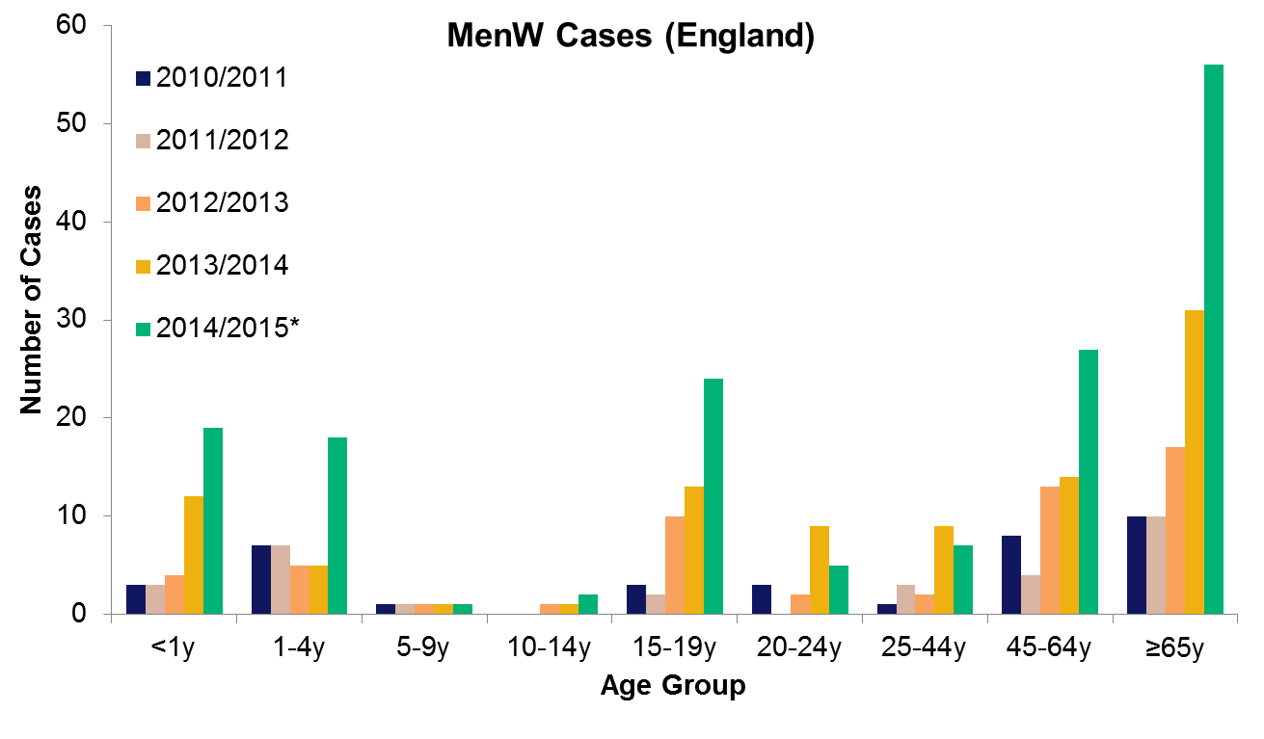
MenW cases by age group England, 20110/11-2014/15*
* data available until end May 2015

Slide 69
Strategy to control MenW disease
Wide age range affected
Incidence highest in infants and adolescents
Still high number of cases in older adults
Strategy in Chile of vaccinating children, only impacted on vaccinated age group
Failed to control overall disease rates
Only feasible strategy is to target carriers with conjugate ACWY vaccine
plan to immunise adolescents
vaccinating older cohorts in catch up will accelerate control

Slide 70
Age (years)

Slide 71
JCVI recommendations: February 2015
In view of rapid increase in cases, known virulence of clonal complex 11 and international experience
JCVI considered situation a public health emergency
Optimal strategy difficult to decide based on wide age distribution
Option to replace MenC doses with quadrivalent conjugate (ACWY) warrant urgent consideration
Infants at highest risk but current MenC – single dose of quadrivalent not sufficient
Toddler dose is given as Hib-MenC – still need the Hib booster
Teenagers are at high risk AND known to have high carriage rates
Vaccination for school years 10-13 should have rapid impact on carriage and therefore have impact on disease in all age groups
Speed of effect will depend on speed of catch-up campaign

Slide 72
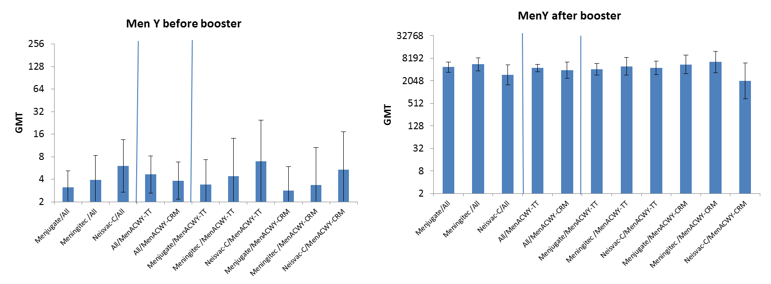
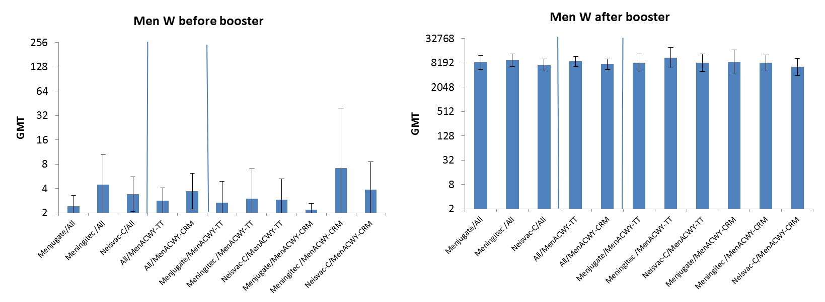
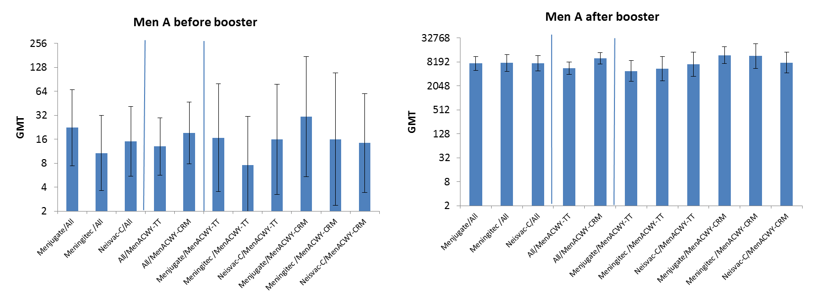
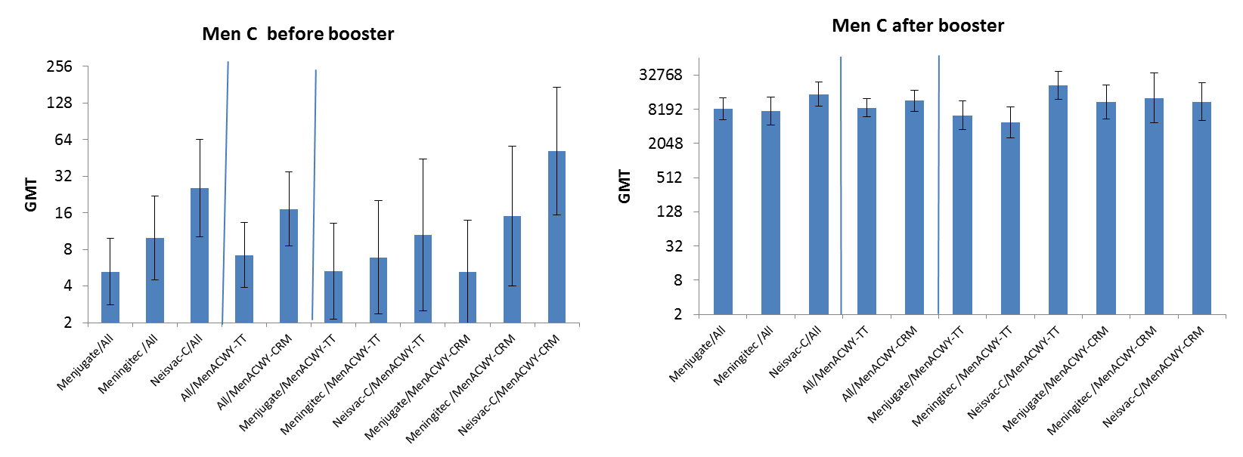
Capsular group-specific SBA GMTs, pre- and post-quadrivalent conjugate
Both ACWY vaccines induce very high serum bactericidal antibody titres after a single dose in adolescents

Slide 73
Serum bactericidal antibody killing of UK MenW cc11 strains by serum from infants immunised with Bexsero®
Lab number | Site | Type | Pre-vacc | Pool1 Post 3rd | Pool2 Post 3rd | Pool3 Post 4th | Pool4 Post 4th
M11-240417 | CSF | W:2aP1.5,2 cc11 | <2 | 64 | 128 | >128 | >128
M11-240427 | Blood | W:2aP1.5,2 cc11 | <2 | 32 | 32 | 64 | 64
M11-240802 | Blood | W:2aP1.5,2 cc11 | <2 | 32 | >64 | >64 | >64
M12-240016 | Blood | W:2aP1.5,2 cc11 | <2 | 32 | 32 | 64 | 128
M11-240798 | Blood | W:NT:P1.5,2 cc11 | <2 | >64 | >64 | >64 | >64
M12-240754 | Blood | W:NTP1.5,2 cc11 | <2 | 64 | 64 | >64 | >64
This work suggests that children immunised with Bexsero may have some protection against the emerging strain of MenW
Submitted To Emerg Infect Dis.

Slide 74
Summary: control of MenW disease
Even though the number of cases is low, JCVI considered this situation a public health emergency
rapid increase in MenW
known virulence of cc11 (previous MenC emergence in 1990s)
international experience (e.g. South America)
The MenACWY programme will have direct impact on vaccinated cohorts (second highest incidence group)
Excellent protection expected after a single dose
Importance of completing catch-up quickly: to generate herd protection across the age range and slow the rate of increase
Highest incidence group (infants) may not benefit for several years
Bexsero® may provide protection against this strain of MenW, and therefore mitigate against the immediate risk in infants

Slide 75
Which MenACWY conjugate vaccines will we use?

Slide 76
MenACWY vaccine supply
Menveo® and Nimenrix® will be supplied, both GSK.
A certain volume of Nimenrix® will be supplied in general export pack (and will come with a separate PIL).
Nimenrix® - single pack as a powder in a vial (MenACWY) and 0.5ml solvent in a pre-filled syringe. Two needles are included.
Menveo® - 5 dose pack (powder in a vial and solution in a vial = 10 vials per pack), no needles. Additional PILs will be supplied with each pack of 5 vaccines ordered, as there is only one PIL in each pack.
We will have less buffer stock than usual for a national programme
Increased risk of temporary ordering restrictions or vaccines may become temporarily unavailable
We will aim to ensure that any periods of supply disruption are minimised
Notes:
Confirmed date for opening ordering will be provided through ImmForm news item and in Vaccine Update in due course

Slide 77
Recommended vaccines: Menveo®
Brand name: Menveo®
Generic Name: meningococcal group A oligosaccharide; meningococcal group C; meningococcal group W135 oligosaccharide; meningococcal group Y oligosaccharide
Multi-component group A, C, W and Y conjugate vaccine marketed by GlaxoSmithKline
Licensed for use in children from 2 years , adolescents and adults at risk of invasive disease from Neisseria meningitidis A, C, W and Y and be safely given with other routine adolescent vaccines
Recommended for adolescents and adults as part of a routine and catch-up immunisation programme

Slide 78
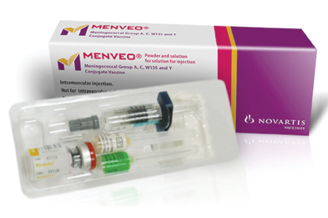
Recommended vaccines: Menveo®
Menveo® is one of two vaccines recommended for the routine MenACWY immunisation programme for adolescents
Menveo® will be centrally supplied through Immform
It is important immunisers familiarise themselves with the vaccine and its product information to avoid administration errors
AWAITING APPROVAL and UPDATED IMAGE FROM GSK
Notes:
Vaccine supply dates- vaccines can be ordered online via Immform.
July 2015- Urgent catch-up and Freshers programme
August 2015- Routine adolescent programme
January 2016- Second catch up programme
** GlaxoSmithKline recently acquired Novartis global vaccine business which includes Menveo® vaccine. Menveo® is now owned and supplied by GlaxoSmithKline.

Slide 79
Administration of Menveo®
Menveo® should be administered via intramuscular injection (IM) into the arm (deltoid muscle)
The vaccine is supplied containing two separate vials: MenA (powder) and MenCWY (solution)
The MenCWY solution should be injected into the MenA powder to reconstitute
Invert and shake the solution and powder vigorously and withdraw 0.5 ml of reconstituted product. It is normal for a small amount of liquid to remain in the vial following withdrawal of the dose
One dose equals 0.5mls
Notes:
Menveo® will be centrally supplied through Immform in packs containing 5 doses (10 vials).
For the composition and full list of excipients of the vaccine, please refer to the manufacturer’s Summary of Product Characteristics http://www.medicines.org.uk/EMC/medicine/27347/SPC/Menveo+Group+A,C,W135+and+Y+conjugate+vaccine/
Healthcare professionals should chose the correct needle size to ensure intramuscular administration.
The vaccine must not be injected intravenously or intradermally and must not be mixed with other vaccines in the same syringe

Slide 80
Administration of Menveo®
After reconstitution, the solution should be clear, colourless to light yellow and free from visible foreign particles
Prior to administration, healthcare professionals should change the needle for a suitable need for IM administration into the deltoid muscle
The vaccine should not be administered where there are variations in physical appearance or signs of foreign particulate are observed after shaking

Slide 81
Recommended vaccines: Nimenrix®
Brand name: Nimenrix®
Generic Name: Neisseria meningitidis group A polysaccharide, Neisseria meningitidis group C polysaccharide, Neisseria meningitidis group W polysaccharide, Neisseria meningitidis group Y polysaccharide
Multi-component group A, C, W and Y conjugate vaccine marketed by GlaxoSmithKline (GSK)
Licensed for use in children from 12 months, adolescents and adults at risk of invasive disease from Neisseria meningitidis A, C, W and Y and be safely given with other routine adolescent vaccines
Recommended for adolescents and adults as part of a routine and catch-up immunisation programme

Slide 82
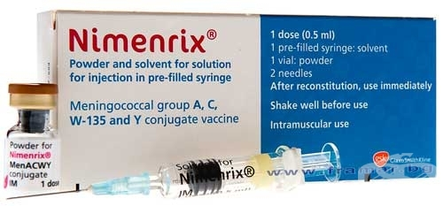
Recommended vaccines: Nimenrix®
Nimenrix® is one of two vaccines recommended for the routine MenACWY immunisation programme for adolescents
Nimenrix® will be centrally supplied through Immform
It is important immunisers familiarise themselves with the vaccine and its product information to avoid administration errors
Notes:
Vaccine supply dates- vaccines can be ordered online via Immform.
July 2015- Urgent catch-up and Freshers programme
August 2015- Routine adolescent programme
January 2016- Second catch up programme

Slide 83
Administration of Nimenrix®
Nimenrix® should be administered via intramuscular injection (IM) into the arm (deltoid muscle)
The vaccine is supplied containing one vial of powder and one pre-filled syringe
The contents of the pre-filled syringe should be vigorously mixed with the contents of the vial prior to administration providing one dose: 0.5mls
After reconstitution, the solution should be clear, colourless to light yellow and free from visible foreign particles
The vaccine should not be administered where there are variations in physical appearance or signs of foreign particulate are observed after shaking
Notes:
For the composition and full list of excipients of the vaccine, please refer to the manufacturer’s Summary of Product Characteristics https://www.medicines.org.uk/emc/medicine/26514
Healthcare professionals should chose the correct needle size to ensure intramuscular administration.
The vaccine must not be injected intravenously or intradermally and must not be mixed with other vaccines in the same syringe

Slide 84
Menveo® OR Nimenrix ® Administration
Menveo® or Nimenrix® should only be administered:
Against a prescription written manually or electronically by a registered medical practitioner or other authorised prescriber
Against a Patient Specific Direction
Against a Patient Group Direction

Slide 85
Contraindications
Menveo® OR Nimenrix® should not be administered to those who have had:
A confirmed anaphylaxis to a previous dose of the vaccine OR
A confirmed anaphylaxis to any constituent or excipient of the vaccine
There are very few individuals who cannot receive meningococcal vaccines
Where there is doubt, appropriate advice should be sought rather than withholding immunisation
Notes:
For the composition and full list of excipients of the vaccine, please refer to the manufacturer’s Summary of Product Characteristics
https://www.medicines.org.uk/emc/medicine/26514
http://www.medicines.org.uk/EMC/medicine/27347/SPC/Menveo+Group+A,C,W135+and+Y+conjugate+vaccine/
There are very few individuals who cannot receive meningococcal vaccines. Where there is doubt, appropriate advice should be sought from a consultant paediatrician with immunisation expertise, a member of the screening and immunisation team or from your local health protection rather than withholding immunisation.

Slide 86
Precautions
Minor illnesses without fever or systemic upset are not valid reasons to postpone immunisation
Pregnancy and breast-feeding
Meningococcal vaccines may be given to pregnant women when clinically indicated. There is no evidence of risk from vaccinating pregnant women or those who are breast-feeding with inactivated virus or bacterial vaccines or toxoids
Immunosuppression and HIV infection
Individuals with immunosuppression and human immunodeficiency virus (HIV) infection (regardless of CD4 count) should be given meningococcal vaccines in accordance with the routine schedule
Notes:
Minor illnesses without fever or systemic upset are not valid reasons to postpone immunisation. If an individual is acutely unwell, immunisation may be postponed until they have recovered fully. This is to avoid confusing the differential diagnosis of any acute illness by wrongly attributing any signs or symptoms to the adverse effects of the vaccine.
Pregnancy and breast-feeding
Meningococcal vaccines may be given to pregnant women when clinically indicated. There is no evidence of risk from vaccinating pregnant women or those who are breast-feeding with inactivated virus or bacterial vaccines or toxoids (Granoff et al., 2008). In cases where meningococcal immunisation has been inadvertently given in pregnancy, there has been no evidence of harm to the foetus.
Immunosuppression and HIV infection
Individuals with immunosuppression and human immunodeficiency virus (HIV) infection (regardless of CD4 count) should be given meningococcal vaccines in accordance with the routine schedule. These individuals may not make a full antibody response. Re-immunisation should be considered after treatment is finished and recovery has occurred. Specialist advice may be required.
For further information on contraindications and precautions, please refer to the meningococcal Green Book chapter online at https://www.gov.uk/government/collections/immunisation-against-infectious-disease-the-green-book

Slide 87
Possible adverse reactions
In adolescents, possible adverse reactions include:
Pain, tenderness, swelling or redness at the injection site and mild fever
Older children and adults: headaches, nausea, rash and malaise
Neurological reactions such as dizziness, febrile/afebrile seizures, faints, numbness and hypotonia are very rare

Slide 88
Summary: MenACWY Vaccines
Two licensed MenACWY conjugate vaccines are available for the adolescent programme
Both vaccines are highly immunogenic and a single dose of either vaccine will provide protection against all 4 groups in teenagers
The vaccines have an excellent safety profile and serious side-effects are rare
We will have less buffer stock than usual for a national programme, which may lead to temporary ordering restrictions or the vaccines may become temporarily unavailable
We will aim to ensure that any periods of supply disruption are minimised

Slide 89
How will we implement the teenage MenACWY immunisation programme?

Slide 90
MenACWY immunisation programme
an urgent catch-up campaign for current school year 13 age adolescents through general practice using a call and recall system
a catch-up campaign for current school year 10 students through schools from January 2016
adding MenACWY vaccine to the routine adolescent schools programme (school year 9 or 10) from Autumn 2015, as a direct replacement for the MenC vaccination
adding MenACWY vaccine to existing time-limited ‘freshers’ programme (i.e. older first-time university entrants who have not already received MenACWY through school year 13) that will be offered through general practice, as direct replacement of MenC vaccination
a further element of the catch-up campaign to cover the current school years 11 and 12 is also required when these students reach year 13. Delivery route of vaccination will be confirmed before the end of 2015.

Slide 91
Meningococcal ACWY programme
Urgent catch-up programme commencing August 2015
Adolescents in the 2014/15 academic school year 13 (DOB 01/09/1996- 31/08/1997) i.e. those aged 17-18 years should be offered MenACWY conjugate vaccine from 1 August 2015 as part of a GP led call and recall immunisation programme in England. Those eligible to receive the vaccine should be called and recalled on the basis of age.
It is strongly recommended that adolescents in this cohort are immunised as soon as practically possible once the vaccine is available and prior to the start of the 2015/16 academic year.
The catch up programme will run from 1 August 2015 until 31 March 2015
The vaccine should offered to all adolescents in the eligible cohort regardless of their intention to continue into further education.

Slide 92
Meningococcal ACWY programme
2. First time university entrants up to 25 years commencing August 2015
From the 1 August 2015, GP practices should opportunistically offer the MenACWY conjugate vaccine to older first-time university entrants up to the age of 25 years
Vaccine directly replaces the MenC vaccine as part of the “freshers” programme. This includes those who may have previously received the MenC vaccine at 10 years or older
First time university entrants younger than 25 years who have previously received a dose of MenACWY conjugate vaccine after the age of 10 years do not require an additional dose of vaccine
Vaccines for the urgent catch-up and “freshers” programme can be ordered via Immform from July 2015
Notes:
University is defined as any University of College that is a member of the University and Colleges Admissions Services (UCAS).
It is anticipated that MenACWY vaccine supplies for the urgent catch up and “freshers” programme will be available to order online via Immform from July 2015.

Slide 93
Meningococcal ACWY programme
3. Routine cohort commencing September 2015
Commencing on 01 September 2015, adolescents in the current academic year (2014/15) in years 9 or 10 or both (i.e. those aged between 13-15 years), will be offered the MenACWY conjugate vaccine as part of the routine adolescent school based immunisation programme in England
The vaccine will directly replace the MenC vaccine offered as part of the adolescent programme.
Notes:
Depending on local arrangements.
The implementation of the routine adolescent MenACWY programme will be locally determined. Areas will offer MenACWY conjugate vaccine to those in the current academic year 9 or 10 or both in areas planning to transition from year 10 to year 9. Local health care providers should aim to immunise the academuc year for which the routine cohort has been planned for the forthcoming 2015/16 academic year.

Slide 94
Meningococcal ACWY programme
4. Second catch-up cohort commencing January 2016
Additionally, a further catch up programme is also scheduled to commence from January 2016 for adolescents aged 15-16 years (DOB 01/09/1999 -31/08/2000) in the 2015/16 academic school year 11 (current school year 10) delivered as part of a school based catch-up immunisation programme in England
It is anticipated that MenACWY vaccine supplies for the second catch-up programme will be available to order online via Immform from January 2016

Slide 95
Current Schedule: MenC in Y9
Birth cohort | 2014/15 year - age | Academic year
 |  | 2014/15 | 2015/16 | 2016/17 | 2017/18 | 2018/19
01/09/2003-31/08/2004 | Y6 – 10/11 |  |  |  | Y9 ACWY
01/09/2002-31/08/2003 | Y7 - 11/12 |  |  | Y9 ACWY
01/09/2001-31/08/2002 | Y8 - 12/13 |  | Y9 ACWY
01/09/2000-31/08/2001 | Y9 - 13/14 | Y9 MenC |  | Y11 ACWY
01/09/1999-31/08/2000 | Y10 - 14/15 |  | Y11 ACWY
01/09/1998-31/08/1999 | Y11 - 15/16 |  |  | Y13 ACWY
01/09/1997-31/08/1998 | Y12 - 16/17 |  | Y13 ACWY
01/09/1996-31/08/1997 | Y13 – 17/18 | Y13 ACWY
Current Schedule: MenC in Y10 with planned transition to Y9 in 15/16
Birth cohort | 2014/15 year - age | Academic year
 |  | 2014/15 | 2015/16 | 2016/17 | 2017/18 | 2018/19
01/09/2003-31/08/2004 | Y6 – 10/11 |  |  |  | Y9 ACWY
01/09/2002-31/08/2003 | Y7 - 11/12 |  |  | Y9 ACWY
01/09/2001-31/08/2002 | Y8 - 12/13 |  | Y9 ACWY
01/09/2000-31/08/2001 | Y9 - 13/14 |  | Y10 ACWY
01/09/1999-31/08/2000 | Y10 - 14/15 | Y10 MenC |  | Y12 ACWY
01/09/1998-31/08/1999 | Y11 - 15/16 |  |  | Y13 ACWY
01/09/1997-31/08/1998 | Y12 - 16/17 |  | Y13 ACWY
01/09/1996-31/08/1997 | Y13 – 17/18 | Y13 ACWY
Key
Routine schedule MenC
Routine schedule ACWY
School based catch-up ACWY
Primary care catch-up cohorts
Delivery mechanism to be decided
Completed

Slide 96
How will we monitor the vaccine programmes?

Slide 97
Monitoring meningococcal infection
Meningococcal meningitis and septicaemia are notifiable infections
Clinician has statutory duty to report suspected cases to the PHE local health protection team
Cases are followed up locally and contact tracing recommended
Invasive meningococcal disease (Neisseria meningitides identified from normally sterile site) is notifiable infection
Laboratory director has statutory responsibility to report to PHE
PHE meningococcal reference unit (MRU)
Conducts additional typing on all isolates referred to them
Offers free diagnostic PCR on clinical specimens from suspected cases

Slide 98
Follow up of meningococcal cases
All cases will be followed up via local health protection unit
Obtain clinical and demographic information
Cases eligible for MenB or MenACWY vaccine will be followed with general practitioners (as for MenC)
To determine whether or not child was vaccinated
To capture dates and batches of vaccine received
Follow up of all cases to maximise microbiological information available
Ensure isolate from throat or sterile site is referred to the MRU
Obtain clinical specimens for DNA amplification and typing

Slide 99
Microbiological investigation of suspected cases
Blood culture
EDTA blood for PCR
Note often negative in pure meningitis so send CSF also
CSF for culture and PCR
Throat swab for culture
So that meningococci isolated from throat of PCR positive cases is available for typing
Now recommended by NICE
Other specimens for culture as appropriate
rash fluid, joint aspirate etc

Slide 100
Additional typing undertaken at MRU
Any meningococci isolated from suspected cases should be referred to the MRU
serogrouping, sero-sub typing
whole genome sequencing
Group B isolates should be referred to MRU
MATs – assays specific for the vaccine antigens
Clinical samples sent to MRU
Species and serogroup specific PCR
PCR positive samples from MRU and from other laboratories (e.g. Warwick, Leeds)
PorA typing, fHBP characterisation to determine if vaccine preventable

Slide 101
Reporting suspected adverse reactions
Yellow Card Scheme
Suspected adverse reactions with any meningococcal vaccine should be reported to the MHRA using the yellow card scheme
Success depends on early, complete and accurate reporting
Report even if uncertain about whether vaccine caused condition
https://yellowcard.mhra.gov.uk/
New smartphone/tablet App now launched
See Chapter 8 of Green Book for details
Notes:
Healthcare professionals and patients are encouraged to report suspected adverse reactions to the Medicines and Healthcare products Regulatory Agency (MHRA) using the yellow card reporting scheme
Please note: To open hyperlinks from the slide set, right click on your mouse and select open hyperlink

Slide 102
Men B vaccine scheduling via CHIS / GP
NHS England commissioners need to instruct:
GPs
CHIS* IT suppliers and CHIS managers
of the eligible cohorts, schedule and programme start date
Changes need to be made to the IT systems at the local level to ensure the correct cohorts are invited for vaccination at the correct time
Please note that Bexsero® will only be offered with routine immunisation appointments. Infants born before 1st May 2015 are not eligible to receive the meningococcal B vaccine.
*CHIS – Child Health Information System
Notes:
MenB vaccine scheduling via CHIS and GP systems
NHS England commissioners of the national immunisation programmes and the CHIS are instructed to directly contact local CHIS providers to ensure that they are ready and able to include the MenB vaccine on their schedules. If in your area scheduling is done by GP practices and not the CHIS then you will need to communicate with primary care colleagues to make sure they too are ready for this change. CHIS IT suppliers and CHIS managers should be instructed of the eligible cohorts and schedule recommended by the JCVI and the start date of the programme.
As the commissioners of the national immunisation programmes and the Child Health Information System (CHIS), it is now important that you have direct contact with your local CHIS providers to ensure that they are ready and able to include the MenB vaccine on their schedules. If in your area scheduling is done by GP practices and not the CHIS then you will need to communicate with primary care colleagues to make sure they too are ready for this change

Slide 103
MenB vaccine coverage : COVER
November 2014: new COVER Information Standards Notice (ISN) included MenB
CHIS IT suppliers already been instructed to add a new field to record a MenB vaccine
NHS England commissioners are required to check that this change has been implemented locally
MenB data flows for the quarterly and annual COVER collection should be activated from the 1 September 2015 although the first cohort will not be evaluated until they reach 12 months
Notes:
The April to June 2016 COVER report to be published in Sept 2016 includes the first babies offered vaccine (born from 1 May 2015) as part of catch-up cohort and will only include partial data. So this is the test quarter where we should start seeing some MenB data coming through in the returns but will not be applicable for all children in the cohort. Hopefully we’ll have some ImmForm data for the same cohort when evaluated at 6 months to compare it to.

Slide 104
MenB vaccine coverage : ImmForm
Aim: early monitoring of the programme
Temporary automated monthly data collection is being implemented via ImmForm
Monthly ‘snapshot’ surveys extract data directly from GP systems for children who reach 26 weeks (6 months) in the evaluation month
First data expected to start flowing in early March 2016
Similar to collection for rotavirus
No burden to NHS
Notes:
47. In order to facilitate timely monitoring of vaccine uptake once the programme is introduced, a temporary automated monthly data collection is being implemented via ImmForm. Monthly automated surveys will extract vaccine coverage data from GP systems for children who reach six months (26 weeks) in the evaluation month. The first cohort routinely offered the vaccine at two and four months of age will be aged six months in February 2016 and provisional vaccine coverage for each of the priming doses will be collected in early March 2016. This approach poses minimal or no burden to the NHS.
Can be aggregated up to CCGs, former NHS England Area Teams, NHS England local teams and Local Authorities

Slide 105
MenACWY Yr13 GP programme: coverage
Programme delivered through general practice using ‘call and recall’ system: the cohort should be vaccinated during a period from August 2015 to the 31st March 2016.
NUMERATOR: registered patients born between 1/9/1996 and 31/8/1997 who have been vaccinated with the MenACWY vaccine at any time up to the end of the survey month
DENOMINATOR: registered patients born between 01/09/1996 – 31/08/1997
Automated ImmForm survey: minimal burden to NHS
Monthly vaccine coverage estimates - cumulative collection
Can be aggregated up to CCGs, former NHS England Area Teams, NHS England local teams and Local Authorities
Notes:
An automated ImmForm survey for the priority catch-up cohort of current year 13 students being offered vaccination through general practice will be implemented. The survey will collect monthly vaccine coverage estimates for those born between 1/9/1996 and 31/8/1997. The automated surveys will run from the start of the programme and the first data (to 31/09/2015 inclusive) will be collected in early October 2015 on ImmForm. The automated collection poses minimal or no burden to the NHS and provides timely uptake figures for monitoring the programme.

Slide 106
MenACWY school-based catch-up programme: vaccine coverage
Annual survey collated at the end of each academic year
School immunisers need to collect data for each cohort immunised:
Routine adolescent schools programme (Year 9 or 10)
Catch-up campaign starting with Year 11 (2015/16)
IMP: this needs to be included in local contract variations with providers.
SIL collates a return for their geography and submits to PHE via ImmForm upload (as for HPV)
Areas that opt to use primary care for the delivery of the catch-up campaign will be required to estimate denominators and vaccine coverage locally and submit a collated figure for each cohort to PHE.
Notes:
There will be a separate vaccine coverage collection for the schools programme. This will take the form of a manual ImmForm survey at the end of each academic year, similar to what is currently in place for the HPV adolescent girls’ programme. The survey will aim to capture vaccine coverage data for the routine school cohort and the catch-up cohort being delivered in schools. School based delivery of the catch-up campaign will thus facilitate monitoring of the impact of the programme as it allows for a standardised data return for each cohort offered vaccine. Areas that opt to use primary care for the delivery of the catch-up campaign will be required to estimate denominators and vaccine coverage locally and submit a collated figure for each cohort to PHE.

Slide 107
Resources for healthcare professionals and patients

Slide 108
PHE Website
Notes:
Chris Owen

Slide 109
MenB resources for health professionals and patients
PHE, NHS England Bi-partite Letter: Introduction of meningococcal B immunisation for infants https://www.gov.uk/government/publications/menb-vaccination-introduction-from-1-september-2015
PHE. Immunisation against infectious diseases: meningococcal chapter 22. https://www.gov.uk/government/publications/meningococcal-the-green-book-chapter-22
PHE. JCVI recommendation to introduce new MenB vaccine if available at a low price will protect young babies and children. [internet] https://www.gov.uk/government/news/phe-welcomes-prospect-of-new-meningitis-b-vaccine
PHE Health Care Worker Q+A PHE MenB vaccine leaflet (long version)
PHE MenB vaccine leaflet: 3 minute guide
PHE Paracetamol Patient Information Leaflet
Meningitis Research Foundation: http://www.meningitis.org/
Meningitis Now. https://www.meningitisnow.org/
NHS Choices. http://www.nhs.uk/conditions/Meningitis/Pages/Introduction.aspx
Please note that some of the PHE resources are still in development and will become available on the website in July. https://www.gov.uk/government/collections/immunisation

Slide 110
MenACWY resources for health professionals and patients
Public Health England, NHS England Official Bi-partite Letter announcing programme. Meningococcal ACWY conjugate vaccination (MenACWY). https://www.gov.uk/government/publications/menacwy-vaccine-introduction
Public Health England. Immunisation against infectious diseases: meningococcal chapter 22. https://www.gov.uk/government/publications/meningococcal-the-green-book-chapter-22
Public Health England. Meningococcal group W (MenW) immunisation advised for 14 to 18 year-olds. https://www.gov.uk/government/news/meningococcal-group-w-menw-immunisation-advised-for-14-to-18-year-olds
Public Health England. MenACWY vaccination programme patient information leaflet and posters
PHE MenACWY Health Care Worker Q+A
Meningitis Research Foundation: http://www.meningitis.org/
Meningitis Now. https://www.meningitisnow.org/
NHS Choices. http://www.nhs.uk/conditions/Meningitis/Pages/Introduction.aspx
Please note that some of the PHE resources are still in development and will become available on the website in July. https://www.gov.uk/government/collections/immunisation

Slide 111
MenB References (1)
ClinicalTrials.gov (2014). Study assessing life effect of medications to prevent fever on Prevenar13 (outcomes 18-21). [internet] accessed on 29 April 2015. https://clinicaltrials.gov/ct2/show/results/NCT01392378?term=paracetamol+vaccine&rank=3&sect=X01256#all
2. Nursing and Midwifery Council (2008) Standards for Medicines Management. [internet] accessed 11 June 2015. http://www.nmc.org.uk/standards/additional-standards/standards-for-medicines-management/
3. Gossger N, Snape MD, Yu LM, Finn A, Bona G, Esposito S, Principi N, Diez-Domingo J, Sokal E, Becker B, Kieninger D, Prymula R, Dull P, Ypma E, Toneatto D, Kimura A, Pollard AJ; European MenB Vaccine Study Group ( 2012). Immunogenicity and tolerability of recombinant serogroup B meningococcal vaccine administered with or without routine infant vaccinations according to different immunization schedules: a randomized controlled trial. JAMA. 2012 Feb 8;307(6):573-82. doi: 10.1001/jama.2012.85.

Slide 112
MenB References (2)
Prymula R1, Esposito S, Zuccotti GV, Xie F, Toneatto D, Kohl I, Dull PM (2014). A phase 2 randomized controlled trial of a multicomponent meningococcal serogroup B vaccine. Hum Vaccin Immunother. 2014;10(7):1993-2004. doi: 10.4161/hv.28666
5. Novartis Vaccines (2015). Bexsero Meningococcal Group B vaccine for injection in pre-filled syringe. [internet] accessed on 11 June 2015. https://www.medicines.org.uk/emc/medicine/28407/SPC/Bexsero+Meningococcal+Group+B+vaccine+for+injection+in+pre-filled+syringe/
6. Centre for Disease Control (CDC) 2012. Frequently Asked Questions about Multiple Vaccinations and the Immune System. [internet] accessed 11 June 2015. http://www.cdc.gov/vaccinesafety/Vaccines/multiplevaccines.html

Slide 113
MenACWY References
Ladhani, S. Beebeejaun, K. Lucidarme, J. Campbell, H. Gray, S. Kaczmarkski, E. Ramsay, M.E, Borrow, R. (2015). Increase in Endemic Neisseria meningitidis Capsular Group W Sequence Type 11 Complex Associated With Severe Invasive Disease in England and Wales. Clin Infect Dis. (2015) 60 (4): 578-585. [internet] accessed 15 June 2015. http://cid.oxfordjournals.org/content/60/4/578.long
2. Public Health England (2015) Health Protection Report: Continuing increase in meningococcal group W (MenW) disease in England. Weekly report. Vol 9. No.7. Published 27 February 2015. [internet]. Accessed 15 June 2015. https://www.gov.uk/government/uploads/system/uploads/attachment_data/file/407865/hpr0715_men-w.pdf
3. Joint Committee on Vaccination and Immunisation (2015). Minutes of the meeting 4 February 2015. [internet] accessed 15 June 2015. https://www.gov.uk/government/groups/joint-committee-on-vaccination-and-immunisation

Slide 114
Acknowledgements
MenB Project Board
Matthew Olley, Mary Ramsay, Shamez Ladhani, Vanessa Saliba, Helen Campbell, Ray Borrow, at PHE
Jim Wassil, Novartis Vaccines
Phil Bryan MHRA
Hannah Christensen, University of Bristol
Philippe De Wals, Department of Social and Preventive Medicine, Laval University & ‘Institut national de santé publique du Québec’

Slide 115
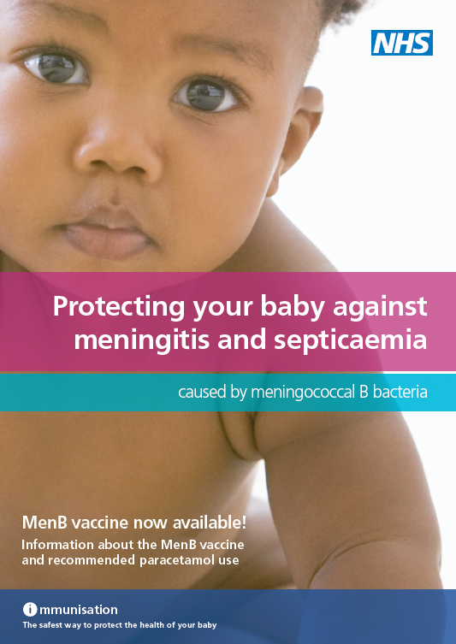

Slide 116
