Slide 1
The Newton Fund
Research and Innovation for Growth and Prosperity

Slide 2

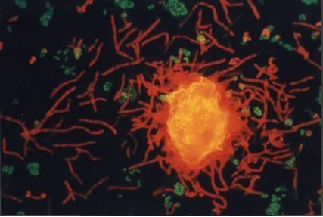


The Vision
The UK will use its strength in research and innovation to promote the economic development and social welfare of partner countries. By working together on bi-lateral and multi-lateral programmes with a research and innovation focus, the UK will build strong, sustainable, systemic relationships with partner countries. This will support the continued excellence of the UK research base and innovation ecosystem and act as a golden key to unlock opportunities for wider collaboration and trade.

Slide 3
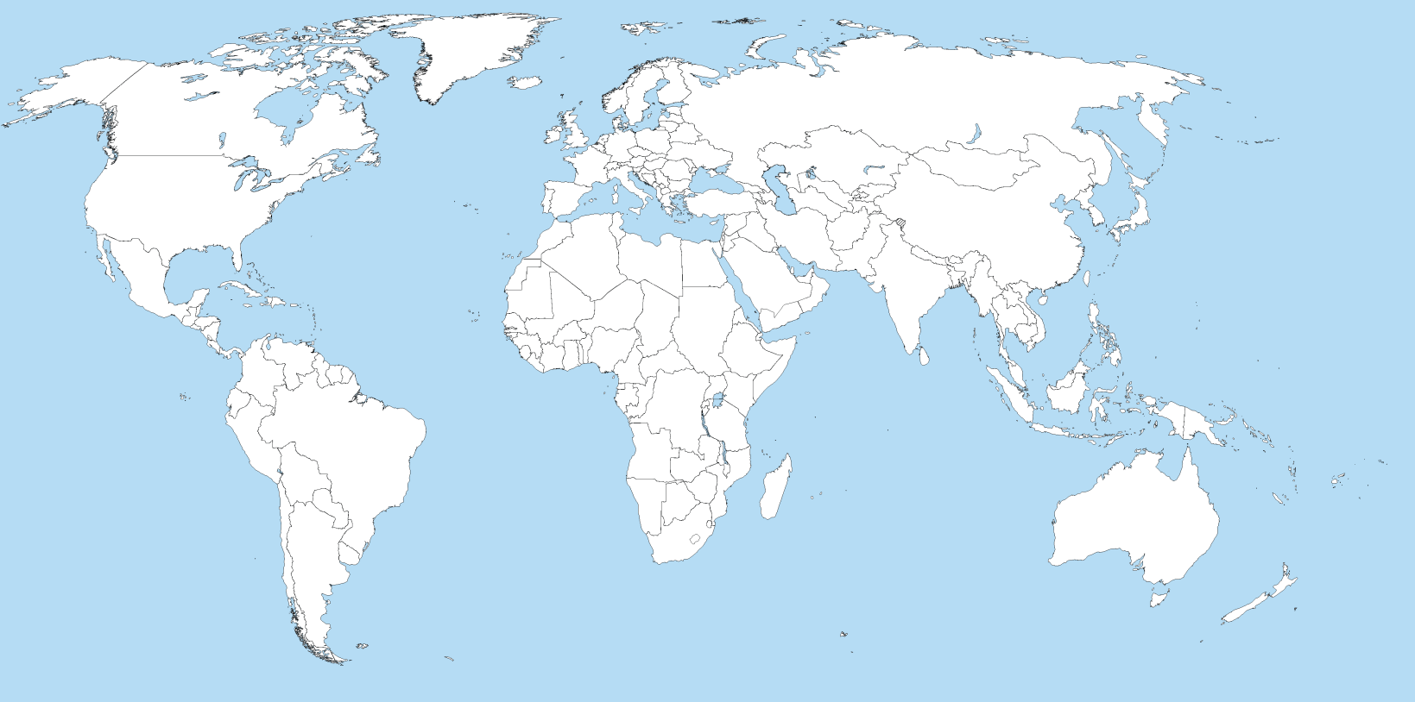
Our partner countries
Egypt
Turkey
Kazakhstan
Mexico
China
Colombia
Philippines
Vietnam
Brazil
Thailand
Chile
Malaysia
Indonesia
South Africa
India

Slide 4













The UK Delivery Partners
Our aim is to build strong, sustainable and systemic links between every part of our research base and innovation ecosystem – and every part of yours

Slide 5
The Partnership
We want a genuinely bilateral partnership where both sides – and global knowledge and innovation - gain significant benefit.
The UK and [x] already collaborate on a wide-range of research & innovation topics – we want to use the Newton Fund to take this to the next level
We have some ideas for work we might take forward together based on things that have worked in the past – but we want to hear yours and to leave space to try something new
Everything we fund should be chosen through an open, transparent and competitive process – so we fund the best people and projects
Both sides should make an equivalent contribution
Build evaluation in from the start

Slide 6

The Pillars
PEOPLE
RESEARCH
TRANSLATION
Notes:
6

Slide 7

People
School Student PhD Postdoc Young Prof Academician
STEM Pipeline
PhD
Partnerships
Newton International
Fellowships
Newton Advanced
Fellowships
Technical Training
& Employability
Developing People’s
Science & Innovation Capability
Leadership in Innovation
Researcher Mobility Schemes
Notes:
7

Slide 8

Current People activity with [x] – highlights
Notes:
Royal Society activity includes:
UK Brazil Frontier of Science meetings:
Sao Paulo State in 2010
Hosted by Society at Chicheley Hall, UK, in 2014
RS Foreign Secretary, Prof Martyn Poliakoff, and Tracey Elliott attended IAP General Assembly in Rio de Janeiro, working with the Brazilian Academy and other national academies on wide-ranging issues
A Royal Society delegation attended the Rio+20 United Nations Conference on Sustainable Development in Rio de Janeiro in June 2012
Royal Society hosted FAPESP week London, promoting Brazil-Europe collaborations in October 2013
The Royal Society of Chemistry signed a co-operation agreement with the Sociedade Brasiliera de Quimica in 2007. Since then there have been more than 20 bilateral and multilateral symposia, workshops and conferences.
Examples of these include:
Supporting innovation in the chemical sciences e.g. SBQ/RSC Symposium: Chemistry Innovation – from spin-out to market
FAPESP-RSC-MMV-DNDI collaboration (2014) to bring together leaders in the field in the areas of neglected diseases for drug discovery and product delivery/innovation and to establish an international collaboration between FAPESP, the RSC, MMV and DNDI to deliver new candidates for Malaria, Chagas Disease and Leishmaniasis
ABIQUIM meeting Sept 2014 - a workshop on industry-academia collaboration. RSC presenting on Open Innovation as a driver of economic growth and social benefit
Open Science – a partnership with UNESP to increase access to NuBBE Natural products database – new bioactive candidates for medicine.

Slide 9

Potential Newton Fund people activity - examples
Newton Fund Advanced Fellowships: The Royal Society, Academy of Medical Sciences and British Academy would offer fellowships to develop research capacity in partner countries by linking early- to mid-career research group leaders with UK research groups.
Newton International Fellowships: The Royal Society, Academy of Medical Sciences and British Academy would offer early career researchers fellowships
Newton Leaders in Innovation Fellowships: The Royal Academy of Engineering would offer fellowships focussed on developing academia and industry links
Newton International Exchanges: The Academies and British Council would organise shorter exchanges for UK and [x] researchers e.g. summer placements in labs
PhD Partnerships: British Council and RCUK would broker PhD Partnerships between UK and [x] institutions

Slide 10
Potential Newton Fund people activity - continued
Newton Researcher Links British Council and UK National Academies would offer a programme to stimulate initial links between, and support capacity building among, ‘rising star’ early career researchers in partner countries and the UK.
Professional development and engagement (skills for researchers and research support staff, including English skills; community engagement; support for research governance and strategies at institutional level etc.)
STEM (Science, Technology, Engineering and Maths) Education – support for STEM learning at the schools level
Technical training and employability – building the science and innovation workforce outside academia
10

Slide 11






Research
Collaborative research programmes
Joint research calls
Joint centres
Access to research and innovation infrastructure
Food Security
Big Data
Living With Environmental Change
Global Uncertainties
Health
Energy
11
Notes:
Background to Ind. Strategy.
Just over a year ago the SoS set out the overarching rational.
Context
Need to act to avoid a return to old growth model….
Increasing competition, need to act / danger if we stand still
- UK Growth Strategy – strong, sustainable & balanced growth
- Importance of stable macro business economy to enabling growth
Ind Strategy is about long term partnership with business……
Int’l Ed is the 10th of 11 key sector strategies – (other such as Info economy, life sciences, offshore wind, construction…..)
Brings together all UK’s Ed sub-sectors for the first time: H&FE, sch, Ed Tech, products and services.
Ed a bit different – not like auto or aero. It also has significant diplomatic value, as well as economic. Engagement in Int’l Ed important to developing trust and opportunity, underpins our political & trading relationships around the world.
Also the Strategy is for England, as Ed is devolved. Does not commit DA to action or policy positions. We will work closely with the DAs on areas of shared interest.

Slide 12

Current Research activity with [x] – highlights
Notes:
RCUK works in partnership with FAPESP, the Research Council for the State of São Paulo, to strengthen the existing research links between the UK and Brazil to help encourage and support proposals that involve international collaborative teams. The MoU was first signed in 2009 and an amendment was signed in September 2012 to extend the agreement for a further three years to build on the success of the partnership.
BBSRC Partnering Awards – Brazil introduced in 2011. Within the Food Security priority area, two Brazil Partnering Awards have been joint-funded with CNPq, with a further four applications funded by the UK alone. (as of 2013)
The International Centre for Lifecourse Studies investigates process throughout the life course that relate to the development of personal and professional skills to health and wellbeing and to patterns of employment and social participation. The Centre makes extensive use of the unique longitudinal birth cohort studies that have been carried out in the UK and the availability of comparative national and international data.
Biodiversity and Ecosystem Processes in Human-modified Tropical Forests aims to significantly improve our understanding of the links between biodiversity and biogeochemical cycles in tropical forests, and the impact that forest modification (loss, fragmentation and degradation) have on these cycles and in turn on the associated ecosystem services. The Brazil-based part of the programme is jointly funded by NERC and FAPESP and has been allocated funding of up to £3.2m (£1.6m from NERC and R$5m from FAPESP).
Belmont Forum awards support transdisciplinary, multinational consortia to engage in global change research through a 14-country joint research initiative supported by the Belmont Forum and the Joint Programming Initiative on Agriculture, Food Security and Climate Change (FACCE-JPI). Consortia are comprised of natural scientists, social scientists and end-users, policy makers, and associated stakeholders.

Slide 13


Potential Newton Fund research activity – examples
Global Health Research Call (MRC lead)
International Wheat Yield Partnership (BBSRC lead)
Sustainable Development in Urban Areas (ESRC lead)

Slide 14


Translation
Climate Science for Service Partnership: China
Research and Innovation Bridges
Global Innovation Capacity Building
Developing entrepreneurial skills in S&I small and medium sized enterprises
14
Notes:
Background to Ind. Strategy.
Just over a year ago the SoS set out the overarching rational.
Context
Need to act to avoid a return to old growth model….
Increasing competition, need to act / danger if we stand still
- UK Growth Strategy – strong, sustainable & balanced growth
- Importance of stable macro business economy to enabling growth
Ind Strategy is about long term partnership with business……
Int’l Ed is the 10th of 11 key sector strategies – (other such as Info economy, life sciences, offshore wind, construction…..)
Brings together all UK’s Ed sub-sectors for the first time: H&FE, sch, Ed Tech, products and services.
Ed a bit different – not like auto or aero. It also has significant diplomatic value, as well as economic. Engagement in Int’l Ed important to developing trust and opportunity, underpins our political & trading relationships around the world.
Also the Strategy is for England, as Ed is devolved. Does not commit DA to action or policy positions. We will work closely with the DAs on areas of shared interest.

Slide 15
Current Translation activity with x– highlights
x

Slide 16
Potential Newton Fund translation activity - examples
Global Innovation Capacity Building Bodies such as the Technology Strategy Board could work with government ministries and innovation agencies to share effective policies and practice.
Research and Innovation Bridges Institutional “bridges” between UK Catapults and centres of innovation focusing on particular challenge areas
Newton Institutional Links University-University programmes aiming to bring new technologies that can be spun-out potentially creating enterprises that can offer practical solutions to address particular needs affecting partner country’s low income communities

Slide 17
Mechanism for in-country co-ordination
While our individual Delivery Partners will be forging links with their opposite numbers in-country, our Embassy, Consulate or High Commission will be making sure the whole programme really does represent a “whole system” partnership between the UK and our partner country.
[Photo of Newton Fund country team in post]

Slide 18
Thank you

