Slide 1
Technology and Skills in the Aerospace and Automotive Industries
Notes:
These slides summarise the findings of a UKCES study into the role of technology in driving high-level skills needs in the aerospace and automotive industries.
The broad definition of the aerospace and automotive sectors used in these slides is:
Automotive:
SIC 29 - Manufacture of motor vehicles
Aerospace:
SIC 30.30 - Manufacture of air and spacecraft and related machinery
SIC 33.16 - Repair and maintenance of aircraft and spacecraft

Slide 2
Introduction
The UK Commission is working to transform the UK’s approach to investing in the skills of its people as an intrinsic part of securing jobs and growth. Key to our ambition is the need to encourage greater employer ownership of skills, working to secure long term sustainable partnerships.
This slide pack and accompanying evidence report present the case for more employers to invest in developing higher level skills in the aerospace and automotive industries. It explores the skills required to meet the demands created by emerging technologies in advanced manufacturing. The main focus is on Additive Manufacturing, Composites and Plastic Electronic technologies.
Slide packs and reports are also available for a number of other sectors from: www.ukces.org.uk Each of the sectors are important to the economy in terms of driving up higher level skills through technological advancements.
For information about this slide pack and accompanying report please contact:
Rebecca Jones (Rebecca.Jones@ukces.org.uk)
Source information can be found in the notes section of each slide.

Slide 3
Storyboard
The UK Aerospace and Automotive industries
Recruitment problems for additive manufacturing, composites and plastic electronics
Additive manufacturing, composites and plastic electronics: why these technologies are important and practical applications
Qualifications and training in the 3 technology areas
Conclusions
Future jobs and skills requirements for additive manufacturing, composites and plastic electronics
Core skills and knowledge for additive manufacturing, composites and plastic electronics

Slide 4
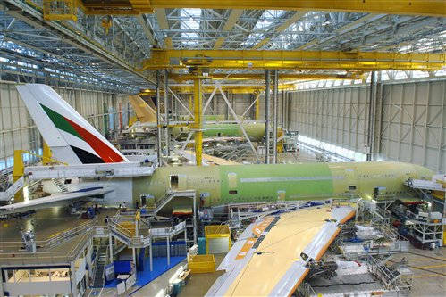
The UK aerospace and automotive industries today
The UK Aerospace sector:
1st in Europe and 2nd to the US worldwide in aerospace revenues with a 17% global market share
Annual revenues of over £24 billion, 1% of total UK GVA
Exports 75% of production
Annual R&D spend of £1.4 billion (13 % of total UK manufacturing R&D spend)
Highly skilled workforce, high productivity and strong science and research base
n
The UK Automotive sector:
4th largest vehicle producer in Europe, making 1.6 million vehicles in 2012
Annual revenues of over £54 billion, 2% of total UK GVA
Exports 80% of production
Annual R&D spend of £1.5 billion (14 % of total UK manufacturing R&D spend)
High skills base, high productivity, R&D capabilities and support
Notes:
Business Enterprise Research and Development (BERD), 2011

Slide 5
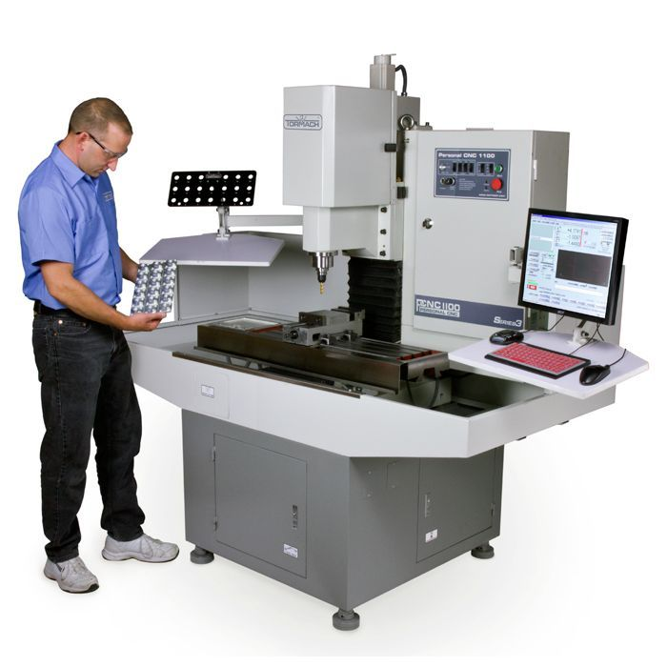
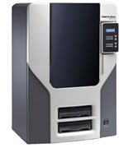
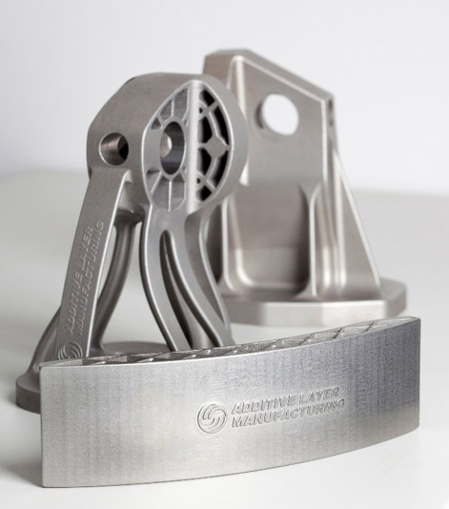
Additive Manufacturing – What is it and why use it?
Traditional Machining:
Subtractive tool room methods involve machining materials such as metals to produce a part - typically slow, expensive and wasteful (scrap).
Additive Manufacturing (AM):
The manufacture of products using digitally-controlled machine tools and is often termed 3D printing. The approach differs from traditional manufacturing in that all AM processes use a layer-by-layer approach to build up components rather than through machining from a solid, mould or casting.
Advantages of Additive Manufacturing:
Enables the manufacture of components with extremely complex geometries and in-built moving parts to be constructed with very little waste.
A key technology to achieve weight reduction efficiency, particularly in aerospace.
Notes:
Definition of Additive Manufacturing - Materials Knowledge Transfer Network, 2012.
http://www.add3d.co.uk/What-is-3D-printing

Slide 6
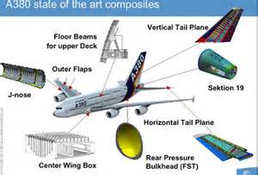
Composites – what are they and why use them?
Composites consist of a bulk material (the ‘matrix’) and a reinforcement of some kind such as fibres, particles or flakes, usually added to increase strength and stiffness. Composites are becoming widely used as a direct substitute for metal components and injection moulded plastics
Advantages of Composites
Aerospace:
+ Weight reduction
+ Increased strength,
+ High stiffness
+ Good fatigue and corrosion resistance.
Automotive:
+ Cost reduction
+ Weight reduction
+ Recyclability.
Notes:
Department of Business Innovation and Skills, 2009

Slide 7
Plastic Electronics – what is PE technology and why use it?
Plastic Electronic techniques allow the printing of electronic materials onto both rigid and flexible surfaces. Organic electronic materials such as polymers can be printed on any substrate surface using printing techniques. New products can be created using plastic electronic techniques where traditional silicon (an inorganic semi-conductor) cannot be used.
Advantages of Plastic Electronics
+ weight reduction
+ low cost manufacture of electronic products
+development of new applications not accessible using rigid electronics technology.
7
Notes:
Plastic Electronics: A strategy for success (BIS, 2009).

Slide 8
Practical applications of technologies
Composites - Applications include:
Aerospace: Fin, tail-plane; wing; fan; engine components
Automotive: Cosmetic parts such as spoilers, trim accents and wheels; tailgates; use in alternative vehicles such as electric/hybrid and fuel cell vehicles.
Additive Manufacturing – Applications include:
Aerospace: Range of complex metal and polymer ‘niche’ parts
Automotive: Concept cars; tooling; live parts on ‘high end’ cars
Plastic Electronics – Potential applications include:
Aerospace: Flexible, lightweight passenger displays; embedding passenger controls; use of embedded sensors.
Automotive: Flexible displays; embedded interior controls; seat sensor and exterior safety applications.

Slide 9
Additive Manufacturing Core skills and knowledge
Aerospace
Automotive
Apprentices with CAD and rapid machine skills
AM supply chain
Research and Development
Manufacturing Bureaus Management, R&D, Sales, Quality, CAD, Traditional engineering, Finishing, Production engineering, IT, Support staff.
Material engineers
Design engineers with optimised design and process solutions skills
Process engineers with an understanding of the Additive Manufacturing process
Post-process engineers (finishing)
Operatives with traditional engineering skills
Assembly staff
Quality-related engineering staff
Powder supply and analysis Engineering and Material scientists, Technicians, Sales, Support staff
Finishing Experienced engineering apprentices
CAD Software engineers
Highly-qualified Engineers
Quality-related engineering staff

Slide 10
Composites Core skills and knowledge
Aerospace
Automotive
Volume Automotive: Relatively small core of very specialist and highly qualified people, focussed predominantly on R&D
Wider composite workforce base depending upon business model and supply chain arrangements.
Composites supply chain
High-level Research & Development
Higher-level occupations: R&D (Materials Scientists & Composites Engineers), Quality, Plant & Site Managers, Resource Planners & Business Directors
Engineering staff: Process, Plant, Production, Product, Project, Stress, Maintenance and CAD
Technical staff: Lab Technicians, CNC machinists and Non Destructive and Destructive Testing
Operational staff: Fitters & Laminators
High end low volume automotive
Process, Plant Engineers
Fitters, Laminators
Engineering staff
Quality related staff
Operational staff
Notes:
Composites Supply chain skill requirements:
Higher level occupations/specialists including research and development (R&D) staff (including Material Scientists and Engineers with specialist composite experience), Quality, Plant and Site Managers/Directors, Resource Planners and Business Directors
Engineering staff including Process, Plant, Production, Product, Project, Stress, Maintenance and CAD Engineers
Technical staff including Lab Technicians, CNC machinists and Non Destructive and Destructive Testing staff
Operational staff including Fitters and Laminators

Slide 11
Plastic Electronics Core skills and knowledge
Plastic Electronics in Advanced Manufacturing
Material Scientists
Electronic engineers
Physicists
Chemists
Electrical engineers
Sales staff with relevant Technical knowledge.
Process and Mechanical Engineers;
Working in Plastic Electronics requires a multi-disciplined skill-set, with many employees undertaking a variety of roles within the business such as:
Business Development
Graphic design
Problem-solving
The workforce is dominated by high level Research and Development staff including:
Experienced staff are predominantly drawn from the Semiconductor, Display and Print industries
Process Development and pilot production activities include:

Slide 12
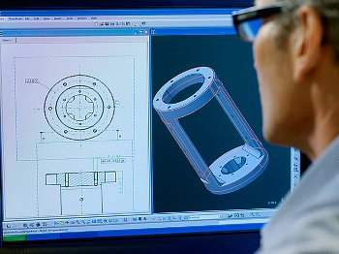
Recruitment problems in Additive Manufacturing
Specific recruitment issues relate to:
Experience in Additive Manufacturing
Process Design Engineers
Project Management staff
CAD staff
Traditional Engineering skills (i.e. Apprenticed Toolmakers)
Collaboration or merger & acquisition have been used to gain access to complementary technological know-how:
“The reason why General Electric bought Morris Technologies was for the people and their skills, not the machines. They recognise that the skills are in very short supply,” Industry expert, Additive Manufacturing.
Notes:
Additive Manufacturing – Wide ranging recruitment problems:
People with experience in Additive Manufacturing;
Process Design Engineers;
Project Management staff;
CAD staff; and
Other: Such as apprenticed toolmakers; CAD software developers.

Slide 13
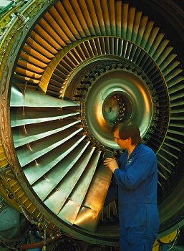
Recruitment problems in Composites
Specific recruitment issues relate to:
Higher level occupations/specialists - Operational & Site Managers, Resource Planners and R&D staff with relevant industry experience
Engineering staff - experience in Precision engineering & CAD Designers
Technical staff – Quality and CNC Machinists
Operatives
“We have struggled to find people with the right skills, with the right backgrounds and the right kind of ability to work...You can get university researchers and university graduates in composites, but we want people who have had their hands dirty, know what it’s like and can translate it into our thinking,” (Large automotive manufacturer).
Larger composite employers recruit from a global skills pool and forge strong relationships with HE and FE to secure top talent.
SMEs don’t have these resources and influence and therefore face greater recruitment challenges.

Slide 14
Rolls Royce Case study
Tackling emerging skills needs
The problem:
5 years ago competitors were able to develop lighter weight solutions in composites for aero engine fan blades. Rolls-Royce recognised the need to increase composite capabilities in this area.
The solution:
A team within Rolls-Royce came together to develop a composite strategy for the company including a ‘University Technology Partnership’ arrangement with Bristol University and Dresden University.
The benefits:
Enhanced composite capability and increased ability to recruit appropriate high level skills.
Composite fan blade developed by GKN Aerospace and Rolls-Royce

Slide 15
Recruitment problems in Plastic Electronics
Specific recruitment issues relate to:
Electronic Engineers
Vacuum Process Engineers
Software developers
Chemists
UK resident graduates
Clean room skills
Multi-disciplined graduates
Many specialist firms face difficulties in finding suitably qualified staff with a plastic electronics background. One firm noted that only 20% of its research staff are recruited from the UK:
“Maybe that is the biggest story – We are finding the people, but not necessarily from the UK,” (Plastic Electronics employer).
Notes:
Clean room skills are those needed to operate in an environment where the level of environmental pollutants such as airborne microbes, aerosol particles and chemical vapours are strictly controlled. Typically this will include adhering to strict rules in relation to protective clothing, procedures for entry and exit and handling of materials

Slide 16
Future jobs and skills – Additive Manufacturing in aerospace
An increased requirement for:
Design and optimisation skills
Research and Development staff
Research Engineers who understand Additive Manufacturing techniques
Quality-related functions
Project Management staff
Technicians with finishing skills
“It is the design side in our organisation where we need to be able to exploit. Without the design improvement we don’t get the weight savings. So it is design and optimisation skills,” (Large aerospace employer).

Slide 17
Future jobs and skills – Additive Manufacturing in automotive
An increased requirement for:
Technicians with finishing skills
Knowledge of Additive Manufacturing and Rapid Production techniques
Growth of Additive Manufacturing in high volume automotive is thought to have a slightly longer trajectory. As the technology moves from Research and Development stage to production, skills needs are likely to change in the automotive industry.
“What we are seeing is a divide, where the technical jobs are becoming more technical and the manual jobs are becoming less skilled,” (Automotive employer).
Notes:
The term Rapid Tooling (RT) is typically used to describe a process which either uses a model to create a mould or uses the Rapid Prototyping process directly to fabricate a tool for limited volume prototypes. Tooling time using this technique is much shorter than for a conventional tool. Rapid Tooling has grown out of the use of Rapid Prototyping to improve processes. Rapid Manufacturing has developed as the next stage, eliminating the need for tooling.

Slide 18
Future jobs and skills – Composites in aerospace and automotive
Across both aerospace and automotive, there is likely to be an increased requirement for:
R&D related roles such as Scientists and Test engineers
Design Engineers, higher-level CAD skills
Project Engineers, New Business Development Managers
Multi-skilled Craft and Technician level workers with both CNC and composite experience
Maintenance Engineers
Fitters & Laminators
“There is a finite size of skill pool (in relation to composites), and it’s starting to move around. That skill pool has to be supplemented, so that the movement of that talent pool is not subject to the highest bidder. That’s in no one’s best interests,” (Composite technology company, automotive).
Notes:
There is expected to be a shortage of necessary skills at nearly all levels from operator, craft, technician, professional and management roles. Higher level technical skills will in particular be at a premium as these are the roles that are also in high demand from other sectors within Advanced Manufacturing.
The increasing use of composites will create a demand for more R&D related roles such as scientists and test engineers. The creation of new design options will lead to an increased requirement for design engineers and people with higher level CAD skills. The move into new products and design using composites will also require project engineers at all levels and new business development managers. As processes become more automated it is expected that will be a growing need for multi-skilled craft and technician level workers with both CNC and composite experience and maintenance engineers to keep plant running at optimum levels.

Slide 19
Future jobs and skills – Plastic Electronics
Although future UK growth in relation to aerospace and automotive is unclear, an increased requirement is expected for:
Process Engineers, Micro Electronics Engineers, Manufacturing Engineers together with those with the required scientific backgrounds (Chemists, Physicists, Material Scientists)
Operative and Technician level employees on the production line
R&D staff will remain core to business growth
Future employment growth largely depends upon market demand and location of production among many Plastic Electronics firms:
“If that [new application] takes off, it only takes one company to take an interest. That would change things dramatically…Overnight I would have to find ways of increasing the staff…” (Plastic Electronics company).

Slide 20
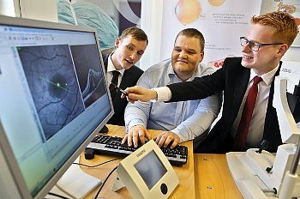
Qualifications and training – Additive Manufacturing
Concerns with existing education, training and qualification provision:
Scope for Additive Manufacturing modules for degree and Masters courses
Scope for the development of an Additive Manufacturing Apprenticeship framework
Potential to provide more training on design for manufacture using AM techniques
Need for improvement to CAD training within university degrees
Need for training provision in relation to powder management and machine operation
Much training takes place in-house
And on-the-job
Important to raise awareness of Additive Manufacturing techniques among customers
“At the moment the training courses are not there. At the moment there is no book on how to design for additives. No rules anywhere,” (Industry Expert).

Slide 21
EADS Case study
Overcoming training issues in Additive Manufacturing.
The problem:
A major increase in the demand for Design Engineers with Additive Manufacturing skills is expected.
The solution:
EADS are talking with universities about how to introduce course provision with some company-specific knowledge embedded to meet these needs.
The potential benefits:
Ensure graduate Design Engineers are equipped with the appropriate CAD and Additive Manufacturing design skills.
Computer Aided Design (CAD) software for Additive Manufacturing

Slide 22
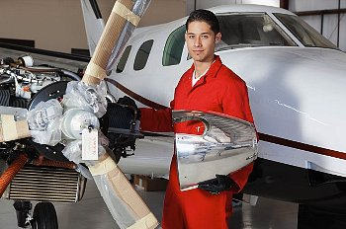
Qualifications and training – Composites
Concerns with existing education, training and qualification provision:
New Composites Apprenticeship framework underpins the supply of composite skills
Strong links between industry and HE/FE vital in developing bespoke composites training programmes
Training provision currently driven primarily by major aerospace companies
Need to improve SME access to composites training provision
Training provision in the UK remains largely fragmented
“I know there are a few companies trying to break into composites, just from having to try and sell my business, and they are all lacking the training side of things,” (SME composites company)

Slide 23
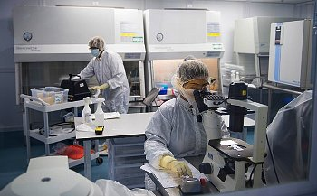
Qualifications and training – Plastic Electronics
Concerns with existing education, training and qualification provision:
Potential scope for Plastic Electronics modules for Masters courses
Scope for the development of an Apprenticeship framework to support the Plastic Electronics sector
Size of the sector limits the influence of Plastic Electronics companies on potential providers
External provision often involves the use of specialist conferences or events accessed via academic networks
Much training takes place
in-house
“The Plastic Electronics sector doesn’t have large enough companies to invest heavily [in designing HE/FE courses],” (Industry Expert).

Slide 24
Plastic Logic case study
Overcoming training issues in Plastic Electronics
The problem:
External training provision in relation to Plastic Electronics is not well developed. Problems being solved involve a wide range of different skills.
The solution:
“Staff are brought together in informal project teams, where they can learn from their more experienced colleagues.” (Plastic Logic)
The potential benefits:
More experienced staff pass on knowledge and experience to new staff as an integral part of their work.
Flexible colour display from Plastic Logic

Slide 25
Conclusions
Additive Manufacturing
Currently, highly qualified people outweigh those at a production level
A move to volume manufacturing will require experienced production staff, retraining of existing staff and some increase in machine operatives
There is a general lack of Additive Manufacturing training available as expertise is currently ‘locked up’ in specialist Bureaus, certain aerospace and automotive OEMs and Tier 1 manufacturers.
Composites
Increasing use of Composites will create a demand for more R&D related roles
Increased automation will also lead to the requirement for more multi-skilled craft and technician level workers
Large Composites employers are sufficiently well resourced to develop their own training programmes and have the influence to drive change within local training providers. For SMEs this is not possible and this may constrain growth in the supply chain.

Slide 26
Conclusions
Plastic Electronics
Increased commercial production will require a highly qualified core of R&D staff together with an increase in process development and production staff
Some employers may move production overseas if they can’t source suitable recruits from the UK.
Emerging themes across the technologies
Wide ranging recruitment difficulties are already reported
Training provision within the UK remains largely fragmented
Employers want a greater integration of these technologies within HE course modules
With respect to Apprenticeships, there was some support expressed for the development of Additive Manufacturing and Plastic Electronics frameworks in line with Apprenticeships developed for Composites.

