Slide 1
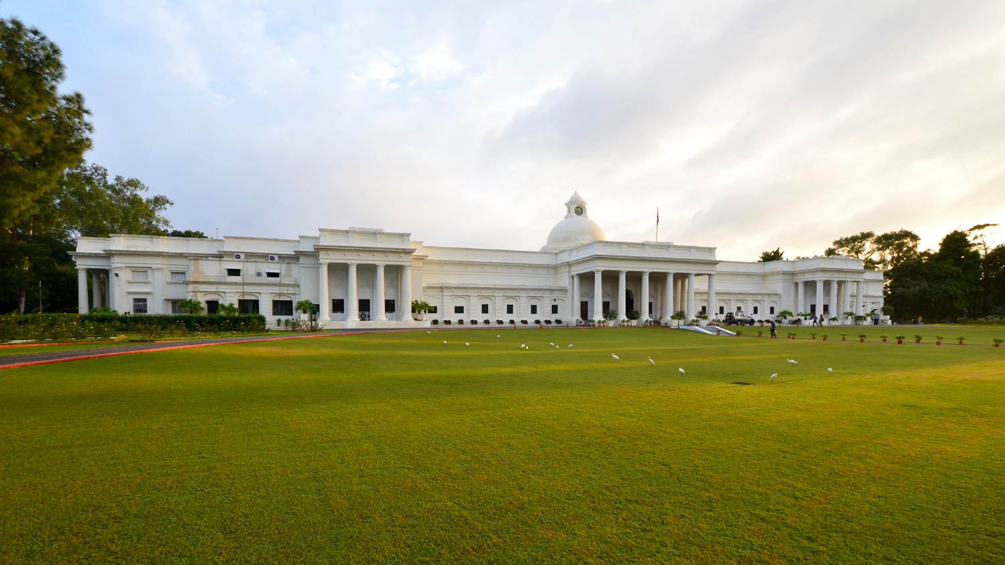
Uttarakhand – Intervention through
Design Thinking

Slide 2
Basic Tenets for Uttarakhand
Environment
Religion
Water
Sustainable Living

Slide 3
Themes for Intervention
Disaster Planning and Management
Water Conservation and Management
Heritage Mapping and Conservation
Tourism Management
Transportation Management
Energy Management
Built Environment Management
Health Mangement

Slide 4
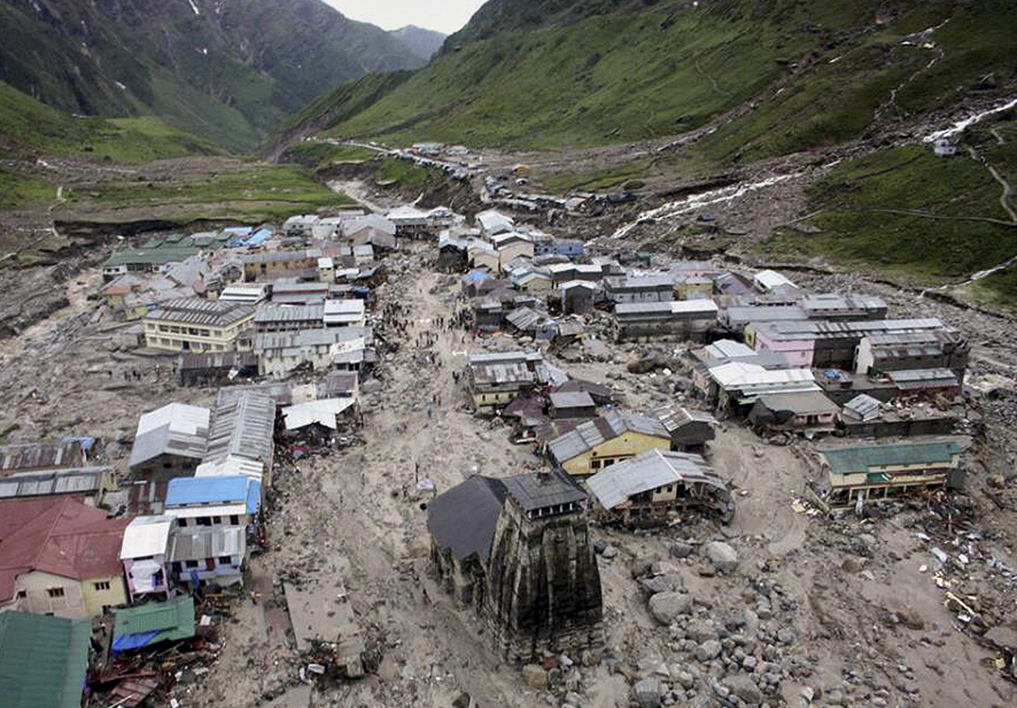
IIT Roorkee Vision
UTTARAKHAND
Hill Development
REGIONAL
IIT ROORKEE
INTERNATIONAL
Collaborate
& Develop
NATIONAL
Collaborate
& Develop

