Slide 1
UK CAMEROON BUSINESS NETWORKING EVENT
“THE CHANGING CUSTOMS ENVIRONMENT”
Reforming Cameroon Customs
DOUALA 29TH JANUARY 2014
FONGOD Edwin NUVAGA
Senior Customs Inspector / IT Director

Slide 2
INTRODUCTION
Cameroon customs joined the rest of the world to celebrate an annual event: The International customs day on January 26th 2014
This year’s theme as prescribed by the WCO is
COMMUNICATION with the slogan “Sharing information for better cooperation”.
This seminar comes in timely, for this is a year of communication.

Slide 3
CHALLENGES
Reduction of time release (dwell time) of goods within customs custody
(mid-term objective of 13. 5 days and targeted long term objective of 7days}
Improve upon the business climate in Cameroon, doing business score, TI index, improving the competitiveness of the Douala seaport, ensuring that Cameroon becomes an emergent nation by 2035, etc..
Improve upon governance and ethics

Slide 4
USEFUL TOOLS TO ENHANCE TRADE FACILITATION
I- Time release
II- Tax System
III- Customs Business Partnership
IV- Ethics and Governance

Slide 5
USEFUL TOOLS TO ENHANCE TRADE FACILITATION
I- Time release and revenue generation
a) Work hours at customs: 7H30 to 18H
(official working hours 7H30 to 15H30)
Some services work round the clock

Slide 6
t
USEFUL TOOLS TO ENHANCE TRADE FACILITATION
I- Time release and revenue generation
b) Monthly control of service execution through data-mining and analysis
This is a useful tool to identify problems and bottlenecks and improve upon efficiency and effectiveness

Slide 7
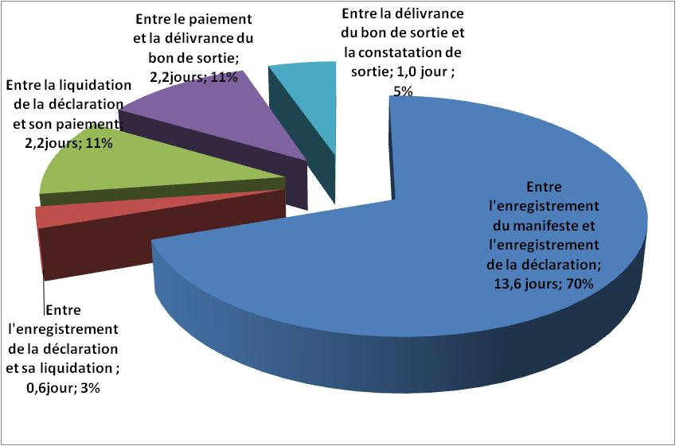
USEFUL TOOLS TO ENHANCE TRADE FACILITATION
t

Slide 8
USEFUL TOOLS TO ENHANCE TRADE FACILITATION
I- Time release and revenue generation
c) From a ONE-STOP-SHOP to a SINGLE WINDOW e-GUCE

Slide 9
USEFUL TOOLS TO ENHANCE TRADE FACILITATION
I- Time release and revenue generation
d) An experimental one stop shop for vehicle clearance is ongoing with a warehouse operator TMFD initial results show that cars can be cleared from this facility in a day

Slide 10
USEFUL TOOLS TO ENHANCE TRADE FACILITATION
I- Time release and revenue generation
e) Interfaces have been established between the customs operational software ASYCUDA and some stakeholders(OSCAR with The Douala international terminal DIT, NEXUS+, e-GUCE, SOCOMAR)

Slide 11
USEFUL TOOLS TO ENHANCE TRADE FACILITATION
I- Time release and revenue generation
f) Geo tracking of goods on transit using the GPS technology. Dwell time has reduced along our main corridors from months to 7 days to CHAD and 4 days to the CAR

Slide 12
USEFUL TOOLS TO ENHANCE TRADE FACILITATION
II- AN ATTRACTIVE TAX SYSTEM
g) The CEMAC common external tariff has four main tax categories
Essential consumer goods 5%
Equipment and raw materials 10%
Intermediary goods 20%
High consumable goods 30%
Special surtax of 25% on luxury goods, 12.5% on luxury cars

Slide 13
USEFUL TOOLS TO ENHANCE TRADE FACILITATION
II- AN ATTRACTIVE TAX SYSTEM
h) Special exonerations as found in
the mining, gas, petrol codes,
- the industrial free trade regime,
- the investment promotion code,
- companies that have signed special conventions with the state

Slide 14
USEFUL TOOLS TO ENHANCE TRADE FACILITATION
II- AN ATTRACTIVE TAX SYSTEM
i) Advantages range from total exoneration during research and exploration to a global 5% during the production phase

Slide 15
USEFUL TOOLS TO ENHANCE TRADE FACILITATION
II- AN ATTRACTIVE TAX SYSTEM
j) Franchise afforded for via instruments like:
- Article 276 of the CEMAC customs code,
- Act 2/92 UDEAC-556-CD-SE1,
- special statutory texts,
- presidential ordinances,
- finance laws,
- etc.

Slide 16
USEFUL TOOLS TO ENHANCE TRADE FACILITATION
III- CUSTOMS BUSINESS PARTNERSHIP
(COMBINING OUR TALENTS FOR BETTER PERFOMANCE)
Our countries rely on international trade for economic growth. As agencies at borders we constantly bear in mind how our work impacts upon those businesses that trade across borders and how we can become more effective and efficient to minimize our regulatory impact and encourage cross border trade

Slide 17
USEFUL TOOLS TO ENHANCE TRADE FACILITATION
III- CUSTOMS BUSINESS PARTNERSHIP
(COMBINING OUR TALENTS FOR BETTER PERFOMANCE)
Customs business collaboration at the frontline also produces direct benefits in the domain of trade security and compliance
Results of this collaboration:
Cameroon Customs business forum
Stakeholder’s nights during which meritorious enterprises are rewarded
Signing of performance contracts between 20 enterprises and the customs administration

Slide 18
USEFUL TOOLS TO ENHANCE TRADE FACILITATION
III- CUSTOMS BUSINESS PARTNERSHIP
(COMBINING OUR TALENTS FOR BETTER PERFOMANCE)
Some of the advantages guaranteed to enterprises that validate their contracts include:-
Examples:
Privilege of the blue channel (30%-90%)
Initiating enterprises towards the status of “Authorized Economic Operators”
Special service delivery advantages
These enterprises have proven to be secure business partners to whom tangible benefits have been given based on their performance

Slide 19
USEFUL TOOLS TO ENHANCE TRADE FACILITATION
IV- ETHICS AND GOVERNANCE/FIGHT AGAINGST DEVIANT BEHAVIOUR
a) In 2009 the DGC created a committee for the enhancement of ethics and governance at customs made up members from both the civil society and customs (CPEG)
Its role to advise the DGC on issues of governance
A governance operational unit (COG) receives complaints, queries, etc from service users, treats them and reports to the committee (CPEG), Proposes sanctions and redress
To ease contact, a toll free number 8044 runs 24/24. An email address gouvernancedouane@yahoo.fr

Slide 20
USEFUL TOOLS TO ENHANCE TRADE FACILITATION
IV- ETHICS AND GOVERNANCE/FIGHT AGAINGST DEVIANT BEHAVIOUR
b) Appeal committee
An appeal committee has been created at the level of the customs head office to handle appeals from users. Its neutrality is assured because half of its members come from out of customs and decisions are arrived at by simple majority

Slide 21
CONCLUSION
This period of profound reform should prompt all stakeholders to work more closely together, double their efforts to cooperate, establish a new dynamic, and take bold initiatives aimed at simplification, speed, transparency, predictability, effectiveness, efficiency and fairness of procedures.

Slide 22
THANK’S FOR YOUR KIND ATTENTION
“Their success are never sung but their failure are heralded”
JFK Kennedy’s historic declaration on Customs

